Slide 1
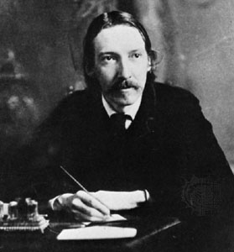
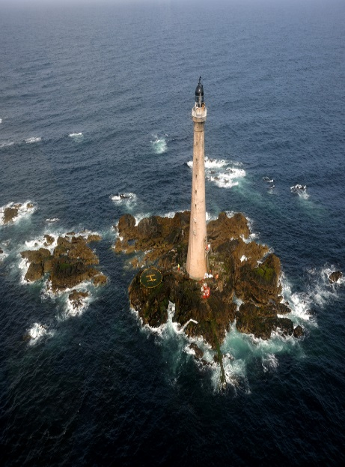
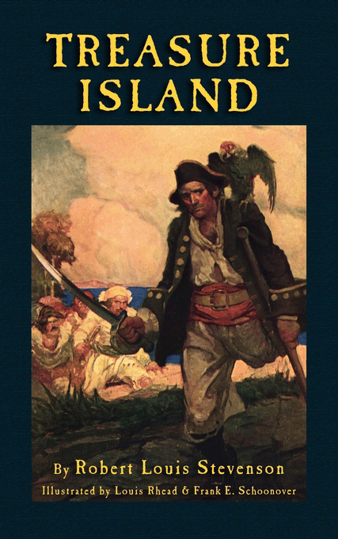
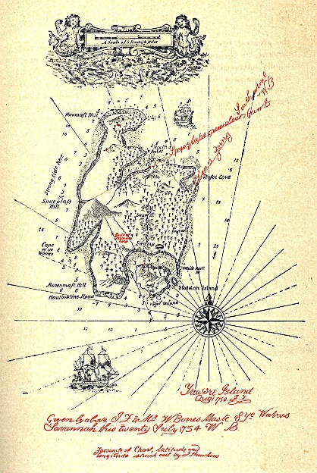
Victorian Fiction: Robert Louis Stevenson‘s Treasure Island (1883)
VL: Introduction to Literary Studies (WiSe 16/17)

Slide 2
Outline
Outline
1. Context
Author
Oeuvre
Movement
2. Basic Coordinates: Central Topics and Concerns
Story Outline
Bildungsroman or Adventure Story?

Slide 3
Outline
Outline
3. Aesthetics: Narrative and Literary Strategies
The legend of Captain Flint
Jim Hawkins as the main protagonist
Assertions of truth, verisimilitude, and fixation
4. Reception and Theoretical Perspectives
Literature and maps, maps and literature
A benchmark text for pirate stories

Slide 4
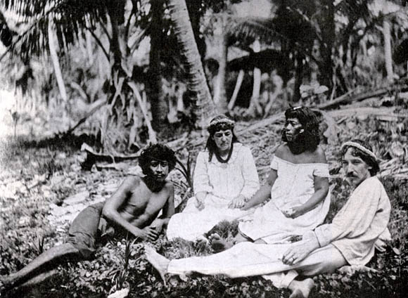
1. Context: Author
1. Context: Author
Robert Louis Stevenson (Edinburgh, 1850 – Samoa, 1894)

Slide 5
1. Context: Oeuvre – Novels
1. Context: Oeuvre
The Hair Trunk or the Ideal Commonwealth (1877, unf./unpubl.)
Treasure Island (1883)
Prince Otto (1885)
Strange Case of Dr Jekyll and Mr Hyde (1886)
Kidnapped (1886)
The Black Arrow: A Tale of the Two Roses (1888)
The Master of Ballantrae (1889)
The Wrong Box (1889, co-written with Lloyd Osborne)
The Wrecker (1892, co-written with Lloyd Osborne)
Catriona/David Balfour (1893, sequel to Kidnapped)
The Ebb-Tide (1894)
Weir of Hermiston (1896, unfinished)
St Ives: Being the Adventures of a French Prisoner in England (1897, finished posthumously by Arthur Quiller-Couch)

Slide 6
1. Context: Oeuvre – Poetry and Short Story Collections
1. Context: Oeuvre
A Child‘s Garden of Verses (1885)
Underwoods (1887)
Ballads (1891)
Songs of Travel and Other Verses (1896)
Poems Hitherto Unpublished (3 vol.: 1916, 1916, 1921)
New Arabian Nights (1882)
More New Arabian Nights: The Dynamiter (1885)
The Merry Men and Other Tales and Fables (1887)
Island Nights‘ Entertainments (1893)
Fables (1896)
Tales and Fantasies (1905)

Slide 7
1. Context: Oeuvre – Travel Writing
1. Context: Oeuvre
An Inland Voyage (1878)
Travels with a Donkey in the Cévennes (1879)
The Silverado Squatters (1883)
Across the Plains (1879-80, publ. 1892)
The Amateur Emigrant (1879-80, publ. 1895)
The Old and New Pacific Capitals (1882)
Essays of Travel (1905)

Slide 8
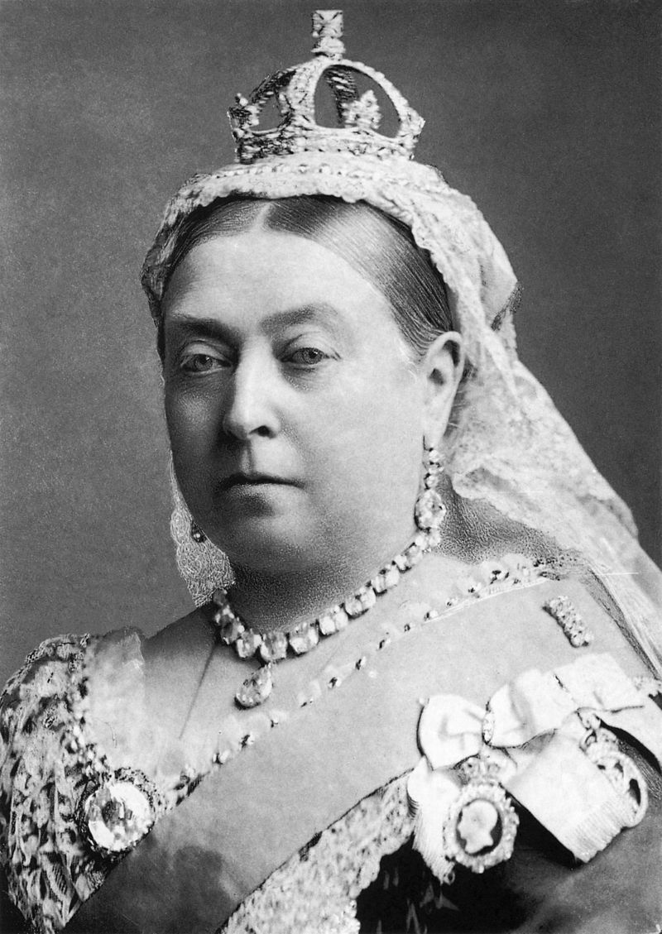
1. Context: Movement
1. Context: Movement
The Victorian Age
Queen Victoria‘s rule (1837-1901)
Early-Victorian (1830-1848)
Mid-Victorian (1848-1870)
Late-Victorian (1870-1901)
A period of massive change on all levels (social, political, economical, technological, cultural…)
Britain‘s economical and military predominance

Slide 9
1. Context: “To the Hesitating Purchaser”
1. Context: Movement
If sailor tales to sailor tunes,
Storm and adventure, heat and cold,
If schooners, islands, and maroons
And Buccaneers and buried Gold,
And all the old romance, retold
Exactly in the ancient way,
Can please, as me they pleased of old
The wiser youngsters of to-day:
So be it, and fall on! If not,
If studious youth no longer crave,
His ancient appetites forgot,
Kingston, or Ballantyne the brave,
Or Cooper of the wood and wave:
So be it, also? And may I
And all my pirates share the grave
Where these and their creations lie!

Slide 10
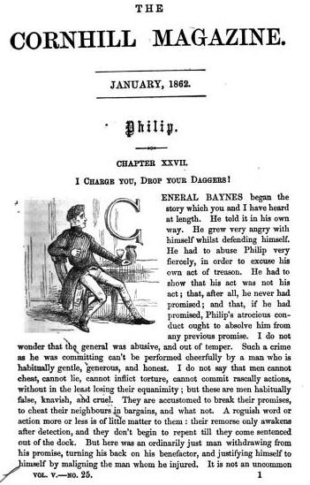
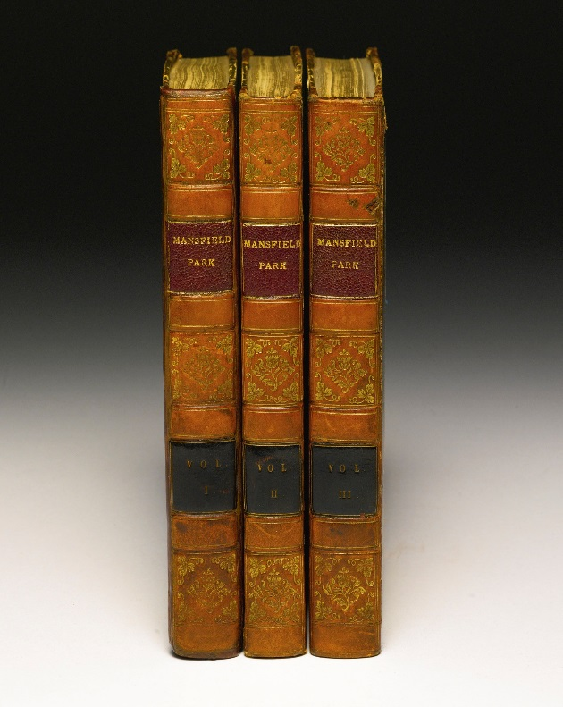
1. Context: Movement – Means of Publication
1. Context: Movement
Increasing literary market
1848: first railway station bookshop (W.H. Smith)
Circulating libraries
Magazines and journals
Triumph of the novel
→ Split in the readership

Slide 11
1. Context: Movement – Realism and Romance
1. Context: Movement
Realism (see Middeke 2012)
Verisimilitude: the likeliness of representation, and probability of an action (description should be as if it could have happened in this way); focus on social realities
Multitude of details that readers can recognise creates the illusion of ‘things as they are’
Elements in the text need to be recognisable and identifiable by readers → consensus and epistemological reassurance
Linear chronology, continuity, causal chain of events
Usually heterodiegetic narration with flexible focalisation in past tense
Generalisation/common horizon
Modern individuals’ craving for meaning in times of epistemological multiplicities and social problems

Slide 12
1. Context: Movement – Realism and Romance
1. Context: Movement
Romance (see Middeke 2012)
Origin: medieval heroic narratives (poetry and prose), e.g. Arthurian romance
Adventures, quests, love…
Supernatural elements
“A fictitious narrative in prose or verse; the interest of which turns upon marvellous and uncommon incidents“ (Sir Walter Scott)
E.g. Gothic romance, historical romance, scientific romance…
→ Two different, but complementary ways of looking at the world/writing literature
→ Co-existence with Realism fostered many hybrid forms

Slide 13
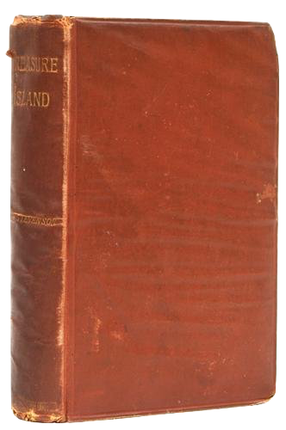
2. Basic Coordinates: Central Topic and Concerns
2. Basic Coordinates
Serialised publication 1881-1882 in Young Folks Magazine
First edition as a full volume in 1883

Slide 14
2. Basic Coordinates: Central Topic and Concerns
2. Basic Coordinates
The Six Parts
Part I: “The Old Buccaneer”
Part II: “The Sea Cook”
Part III: “My Shore Adventure”
Part IV: “The Stockade”
Part V: “My Sea Adventure”
Part VI: “Captain Silver”

Slide 15
2. Basic Coordinates: Central Topic and Concerns
2. Basic Coordinates
Flint’s treasure | Marooning of Ben Gun | Admiral Benbow Inn | Bristol | Sea Journey
[backstory] 1750 | [backstory] | Part I (ch. I-VI) | Part II (ch. VII-IX) | Part II (ch. X-XII)
Treasure Island | Return to Bristol | Jim’s Report
Parts III-VI (ch. XIII-XXXIII) | Part VI (ch. XXXIV) | 17--

Slide 16
2. Basic Coordinates: Central Topic and Concerns
2. Basic Coordinates
Bildungsroman and/or Adventure Story?
Bildungsroman (Novel of Education/Development)
Protagonist’s way from childhood/adolescence into adulthood on a quest for identity
From ignorance to understanding (often by moral/spiritual awakening)
Finding one’s soulmate, financial success, work ethic, fulfilment, meaningful/respectful relation to roots/family/community

Slide 17
2. Basic Coordinates: Central Topic and Concerns
2. Basic Coordinates
Bildungsroman and/or Adventure Story?
Adventure Story
“To the Hesitating Purchaser”
Pirates, battles, (remaining!) treasure, sea adventure…
(Apparent) supernatural elements (the curse of the island, the black spot, superstition, the legend of Captain Flint…)
Jim’s positioning among the other characters
Lack of female characters
Where IS Treasure Island?
Nightmarish ending

Slide 18
3. Aesthetics: Narrative and Literary Strategies
3. Aesthetics
The Legend of Captain Flint
Accumulation of vast fortune (£700,000) → mysterious burying of the treasure (1750) → six murders, no eyewitnesses → Flint’s rum poisoning in Savannah → map handed over to Billy Bones in 1754 (→ legend of Flint’s ghost guarding the treasure)
“‘Heard of him!’ cried the squire. ‘Heard of him, you say! He was the bloodthirstiest buccaneer that sailed. Blackbeard was a child to Flint. The Spaniards were so prodigiously afraid of him that, I tell you, sir, I was sometimes proud he was an Englishman. I've seen his top-sails with these eyes, off Trinidad, and the cowardly son of a rum-puncheon that I sailed with put back—put back, sir, into Port of Spain.’” (Stevenson 1999 [1883]: 31)

Slide 19
3. Aesthetics: Narrative and Literary Strategies
3. Aesthetics
Jim Hawkins as the Main Protagonist
“Squire Trelawney, Dr. Livesey, and the rest of these gentlemen having asked me to write down the whole particulars about Treasure Island, from the beginning to the end, keeping nothing back but the bearings of the island, and that only because there is still treasure not yet lifted, I take up my pen in the year of grace 17--, and go back to the time when my father kept the “Admiral Benbow” inn, and the brown old seaman, with the sabre cut, first took up lodging under our roof.” (Stevenson 1999 [1883]: 3)

Slide 20
3. Aesthetics: Narrative and Literary Strategies
3. Aesthetics
Assertions of Truth, Verisimilitude, and Fixation
Inspired by A General History of the Pyrates (Captain Charles Johnson, 1724)
The map as concrete evidence, signed by Captain Flint → tangible link between Flint’s backstory and Jim’s journey
Evidentiary support 1: “Just at the door, the captain aimed at the fugitive one last tremendous cut, which would certainly have split him to the chine had it not been intercepted by our big signboard of Admiral Benbow. You may see the notch on the lower side of the frame to this day.” (Stevenson 1999 [1883]: 12)

Slide 21
3. Aesthetics: Narrative and Literary Strategies
3. Aesthetics
Assertions of Truth, Verisimilitude, and Fixation
Evidentiary support 2: “‘Here, Jim—here's a cur'osity for you,’ said Silver, and he tossed me the paper. It was around about the size of a crown piece. One side was blank, for it had been the last leaf; the other contained a verse or two of Revelation—these words among the rest, which struck sharply home upon my mind: ‘Without are dogs and murderers.’ The printed side had been blackened with wood ash, which already began to come off and soil my fingers; on the blank side had been written with the same material the one word ‘Depposed.’ I have that curiosity beside me at this moment […].” (Stevenson 1999 [1883]: 162)

Slide 22
4. Reception and Theoretical Perspectives
4. Theoretical Perspectives
Literature and Maps, Maps and Literature
The Intratextual Map
The Paratextual Map
“[…] I made the map of an island; it was elaborately and (I thought) beautifully coloured; the shape of it took my fancy beyond expression; it contained harbours that pleased me like sonnets; and with the unconsciousness of the predestined, I ticketed my performance ‘Treasure Island.’” (Stevenson 1999 [1894]: 193)

Slide 23
4. Reception and Theoretical Perspectives
4. Theoretical Perspectives
“I am told there are people who do not care for maps, and find it hard to believe. The names, the shapes of the woodlands […]; there is an inexhaustible fund of interest for any man with eyes to see, or twopence worth of imagination to understand with. No child but must remember laying his head in the grass, staring into the infinitesimal forest, and seeing it grow populous with fairy armies.” (Stevenson 1999 [1894]: 193)
“[A]s I pored upon my map of ‘Treasure Island’, the future characters of the book began to appear there visibly among imaginary woods […], as they passed to and fro, fighting, and hunting treasure, on these few square inches of a flat projection. The next thing I knew, I had some paper before me and was writing out a list of chapters.” (Stevenson 1999 [1894]: 193)

Slide 24
4. Reception and Theoretical Perspectives
4. Theoretical Perspectives
“I had written it up to the map. The map was the chief part of my plot. […] [I]t was because I had made two harbours that the Hispaniola was sent on her wanderings with Israel Hands. […] I have said it was the most of the plot. I might almost say it was the whole.” (Stevenson 1999 [1894]: 197)
“It is perhaps not often that a map figures so largely in a tale; yet it is always important. The author must know his countryside, whether real or imaginary, like his hand […]. With an almanac, and the map of the country and the plan of every house, either actually plotted on paper or clearly and immediately apprehended in the mind, a man may hope to avoid some of the greatest possible blunders.” (Stevenson 1999 [1894]: 197f.)

Slide 25
4. Reception and Theoretical Perspectives
4. Theoretical Perspectives
“[H]e who is faithful to his map, and consults it, and draws from it his inspiration, daily and hourly, gains positive support […]. The tale has a root there; it grows in that soil; it has a spine of its own behind the words. […] [E]ven with imaginary places, he will do well in the beginning to provide a map. As he studies it, relations will appear that he had not thought upon. He will discover obvious though unsuspected short cuts and footpaths and […] it will be found to be a mine of suggestion.” (Stevenson 1999 [1894]: 198)
The paratextual map as…
An aesthetic object (“beautifully coloured”; “harbours that pleased me like sonnets”)
A trigger for imagination
A tool for writing literature (inspiration, plotting device, characters’ movements)
A tool for reading literature (tracking characters’ movements)
Literary realism and authentification

Slide 26
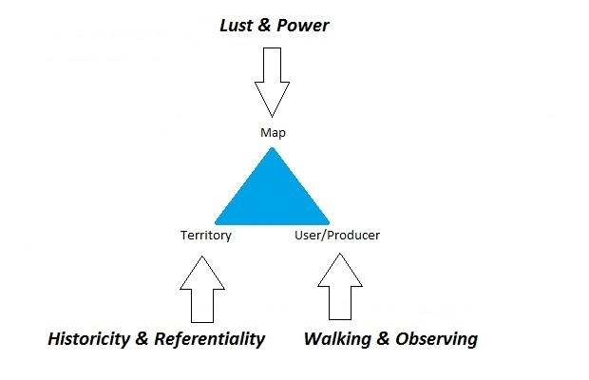
4. Reception and Theoretical Perspectives
4. Theoretical Perspectives
Literature and Maps, Maps and Literature

Slide 27
4. Reception and Theoretical Perspectives
4. Theoretical Perspectives
Lust and Power (based on Stockhammer 2007)
Maps as aesthetic objects
Maps as triggers for imagination
Maps as tools of power, verification, and control
Historicity and Referentiality
The joint history of maps and literature
How ‘real’ are fictional maps? How fictional are maps of ‘real’ places?
Walking and Observing (based on De Certeau 1984)
Immediacy and panoptic vision
Treasure hunts and “The map is not the territory” (Alfred Korzybski)

Slide 28
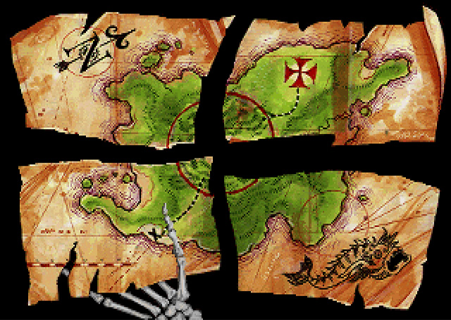
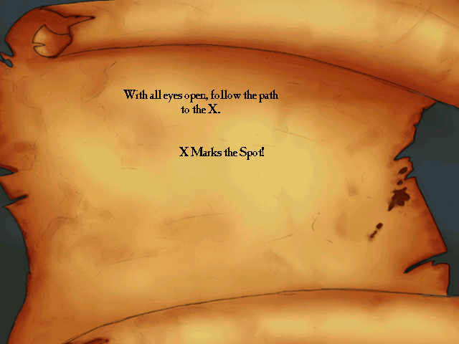
4. Reception and Theoretical Perspectives
4. Reception
Treasure Maps in the Monkey Island Video Game Series

Slide 29
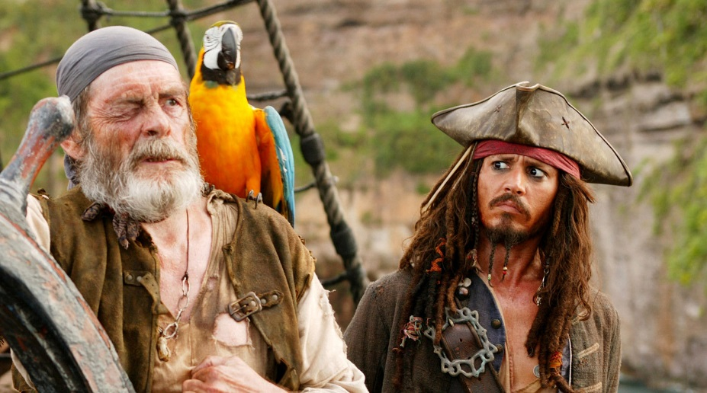
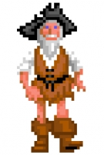
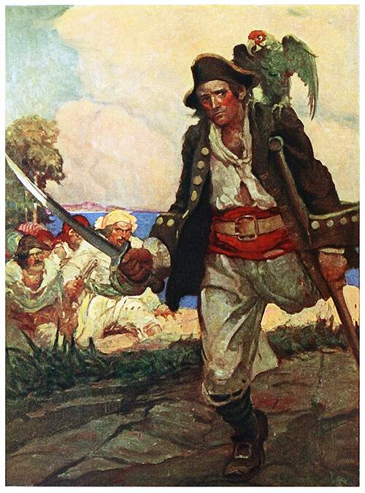
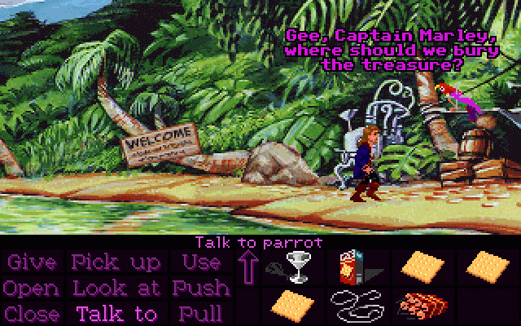
4. Reception and Theoretical Perspectives
4. Reception
Iconic Pirates and Parrots

Slide 30
Bibliography
Bibliography
Buckton, Oliver S. (2007). Cruising with Robert Louis Stevenson: Travel, Narrative, and the Colonial Body. Athens, OH: Ohio University Press.
Certeau, Michel De (1984 [1980]). The Practice of Everyday Life. University of California Press.
Kelley, Greg. (2011). “Navigating the Legends of Treasure Island: Narrative, Maps, and the Material.” Ray Cashman, Tom Mould, and Pravina Shukla, eds.: The Individual and Tradition: Folkloristic Perspectives. Bloomington: Indiana UP, 235-249.
Maxwell, Richard and Katie Trumpener (2011). “The Romance of the Outlands: The Fin-de-sciécle Adventure Story between History and Geography.” The Yearbook of English Studies, 41(2), 106-124.
Middeke, Martin (2012). “The Victorian Age”. Martin Middeke, Timo Müller, Christina Wald, and Hubert Zapf, eds.: English and American Studies. Theory and Practice. Stuttgart: Metzler, 56-77.
Stevenson, Robert Louis (1999 [1883]). Treasure Island. Ed. and Intr. John Seelye. London: Penguin.
Stockhammer, Robert (2007). Kartierung der Erde. Macht und Lust in Karten und Literatur. München: Fink.

Slide 31
Thank you!
Contact:
Raphael Zähringer, M.A.
English Department
Wilhelmstraße 50
72074 Tübingen · Germany
Phone: +49 7071 29-78470
Raphael.zaehringer@uni-tuebingen.de

