Slide 1
National Model United Nations (NMUN)
Practicing international diplomacy

Slide 2
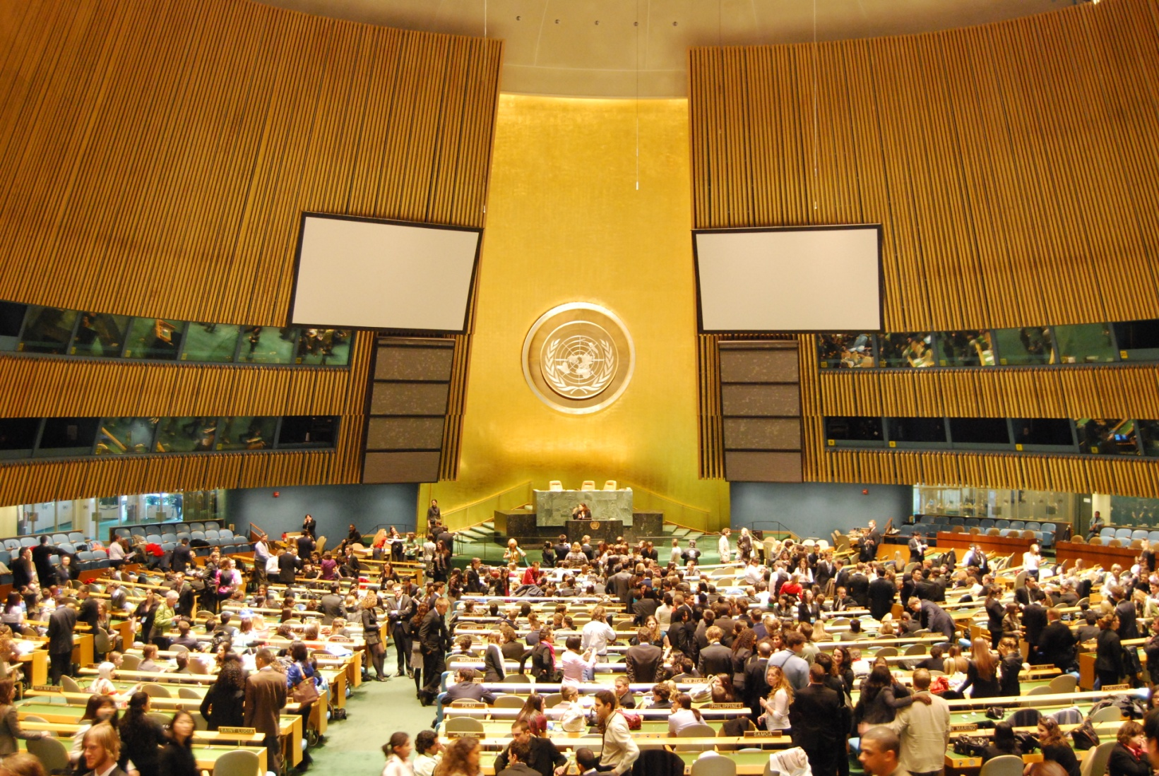
What is NMUN?
The world‘s largest simulation of UN committees and specialised agencies on university level (2010: 5,000 students from all over the world, 20 committees and agencies such as the General Assembly and ECOSOC)
Held annually in New York at conference hotels, opening and closing ceremonies in the Great Hall, UN Headquarters

Slide 3
Tübingen at NMUN
Student delegations have taken part at NMUN New York since 1997, represented diverse countries such as Japan, India, Mexico and the Sudan
Preparation for NMUN in two parts: seminar on the United Nations system (held by Prof. Hasenclever in summer term) and workshop on specific NMUN skills (held by Ingvild Bode and two former delegates, the so-called head delegates, in winter term)

Slide 4
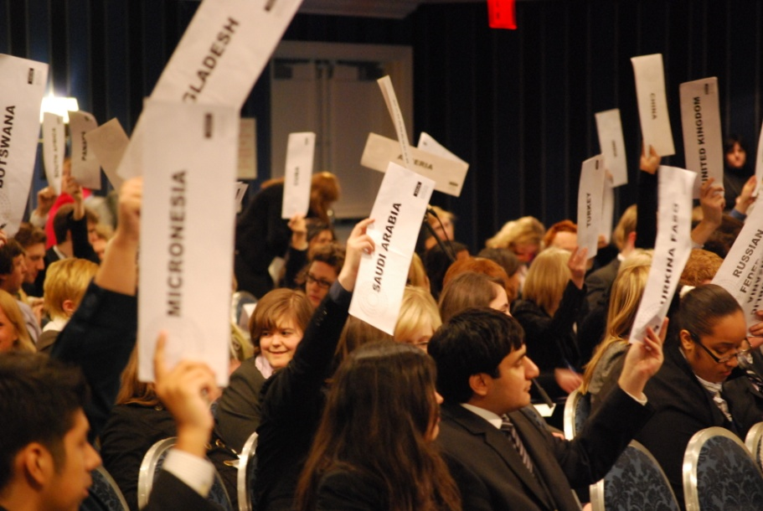
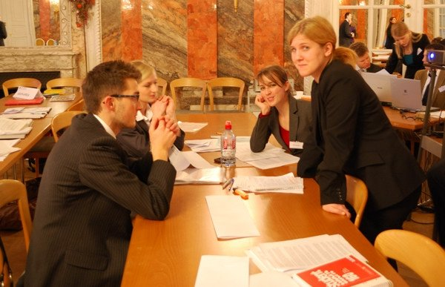
NMUN Workshop
NMUN delegate skills
Rules of Procedure
how to write the main documents needed for UN simulations (position papers, resolutions , reports)
speech and rhetorical training
Country-specific preparation
Several test simulations (Hohenheim MUN, Tübingen MUN)
Self-administered project

Slide 5
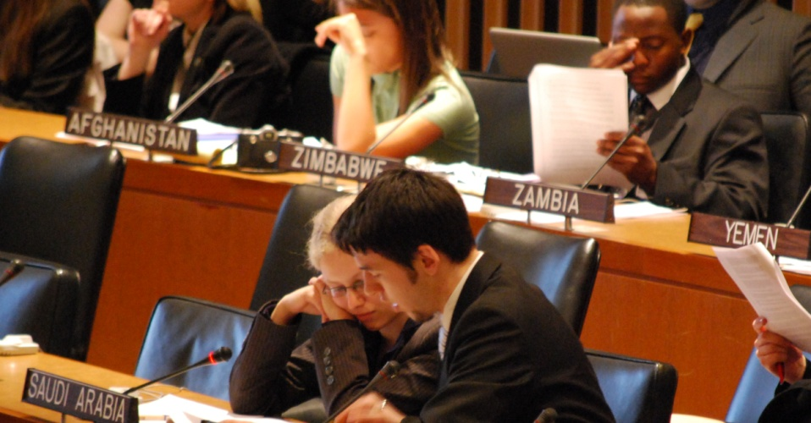
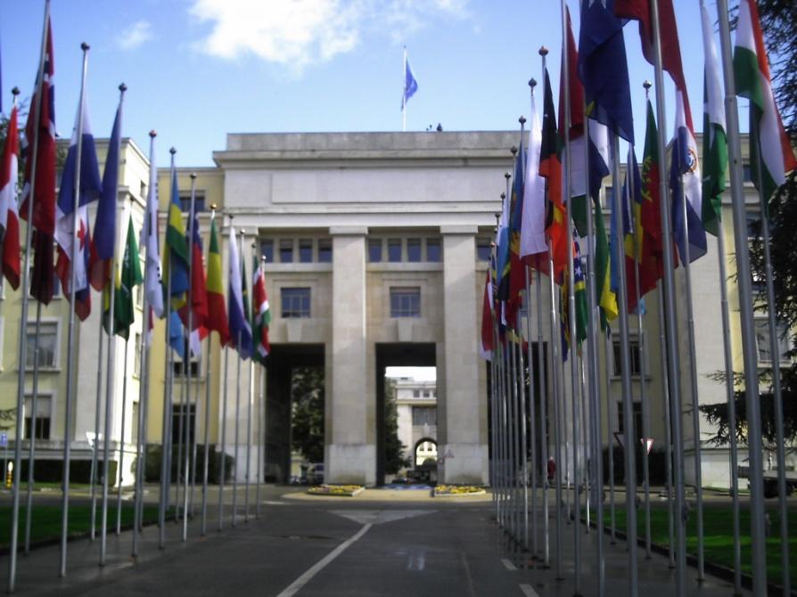
Why participate?
Insight into internationl diplomacy and foreign policy measures
Practicing communication skills and negotiation strategies
In-depth understanding of UN procedures
Excursion to Geneva (visits to UN organisations and diplomatic missions)
Trip to NYC in March/April (usually includes visit to the Permanent Mission of the country Tübingen is representing)

Slide 6
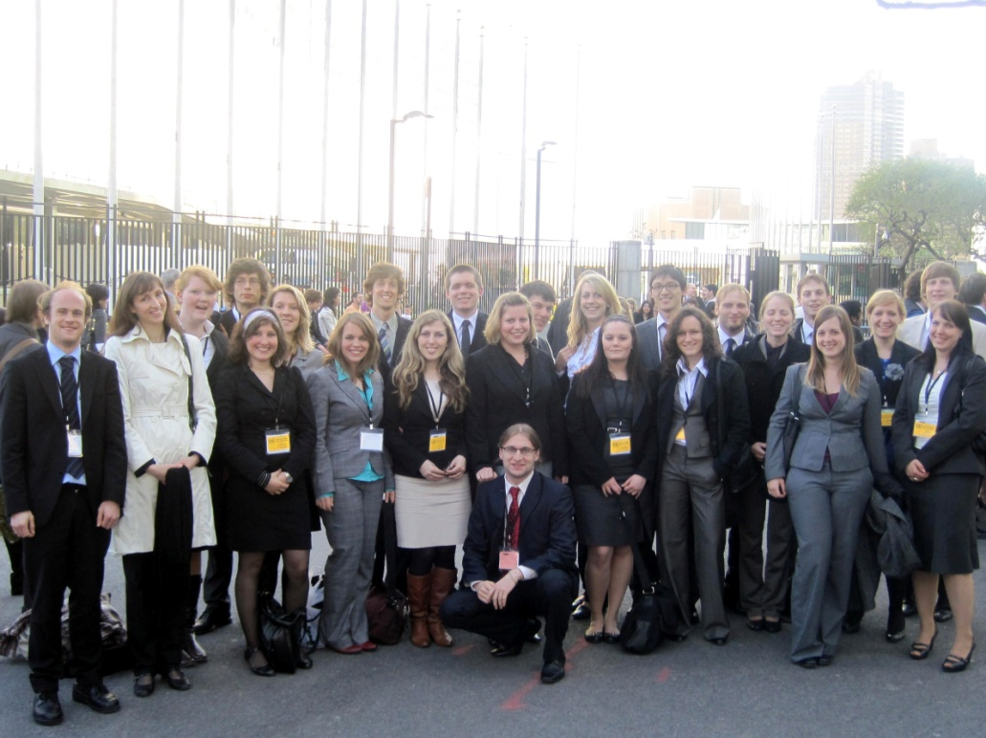
Interested?
Send an email to
ingvild.bode@uni-tuebingen.de
First preparation session at the end of the summer term

