Slide 1
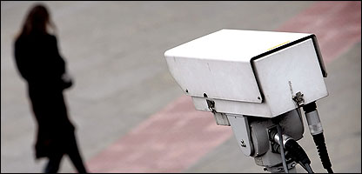
Surveillance and social identity: Privacy perceptions and the potential for division
Aisling T. O’Donnell¹
Michelle K. Ryan² & Jolanda Jetten^{2,3}
¹
²
³

Slide 2
Social identity, surveillance & division
“The same technology that threatens the
autonomy of the individual seems destined
to frustrate attempts to reestablish
community and shared responsibility
because it destroys the essential
components of trust and accountability.”
Oscar H. Gandy, The Panoptic Sort: A Political Economy of Personal Information (1993, p. 3)

Slide 3
Questions arising…
Does surveillance threaten the autonomy of the individual?
Does surveillance frustrate attempts to create a sense of community?
Does surveillance destroy our sense of shared responsibility?

Slide 4
Surveillance in context: The UK
In the UK, we are captured on CCTV 300 times per day
(BBC, 2002)
There are an estimated 4 million CCTV cameras in the UK
(BBC, 2009)
The UK has one of the worst records for visual surveillance in the world
(Privacy International, 2007)
Notes:
So why study CCTV? Well, as I said, as a social psychologist I’m interested in real social issues that impact on our everyday lives. And CCTV is a big issue these days, especially in Britain. Ask them how often they think they are captured on CCTV in an average day, or how many cameras there are in the UK.
We are actually captured on CCTV *at least* 300 times a day on average. Note that this figure is from 2002 so is now likely to be out of date. A more recent figure is that there are at least 4 million cameras in use in the UK. Privacy International, an organization interested in civil liberties and surveillance, produced a report about the use of surveillance in many countries around the world. They classified the UK as one of the worst, in terms of how much surveillance we have and also how much it is misused.

Slide 5
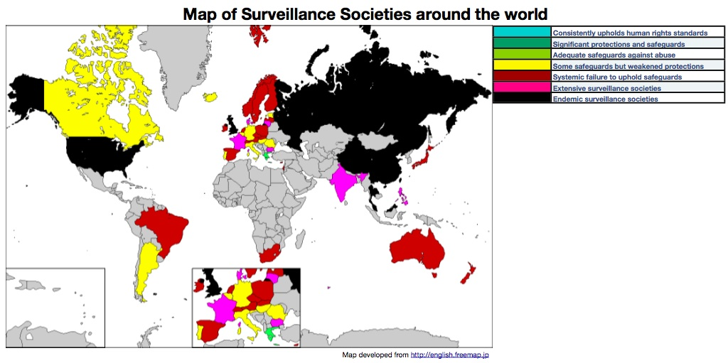
Surveillance in context
Privacy International (2007)
Notes:
This is a map of the world produced by privacy international, where they rate many countries in terms of the prevalence of surveillance. there are seven possible categories, and you can see that the UK ranks as the most severe, “endemic surveillance society”. By endemic, what they mean is that a high level of surveillance is peculiar to this particular location; it is ingrained in the way society works.

Slide 6
How do people react to CCTV?
“It invades my privacy!”
“I don’t expect any privacy when I walk down the street.”
“If you’ve done nothing wrong, there’s nothing to fear.”
“If I’m innocent, why should I be watched?”

Slide 7
A social identity account of surveillance
Can take into account the identities of those imposing surveillance and those affected
Should offer a more nuanced account of how people feel about surveillance

Slide 8
What is the social identity approach?
Social identity = that part of a person’s self concept that is related to their relationship with others
Social identity theory (Tajfel & Turner, 1979, 1982)
1. Categorisation
Categorising the self as a group member
2. Identification
Defining the self in terms of a group identity
3. Comparison
Positive distinctiveness of ingroup compared to other groups (outgroups)

Slide 9
What is the social identity approach?
How do we categorise as group members?
Self-categorisation theory (Turner et al., 1987)
Depersonalisation (‘switching on’)
Behavioural continuum
Interpersonal behaviour
Intergroup behaviour
Self-concept
Personal identity
Social identity

Slide 10
Examples from social identity research
Behaviour coming from in-group members is interpreted differently to that of out-group members
e.g., Criticism is seen as acceptable coming from within the in-group
Hornsey, Oppes & Svensson (2002)
Surveillance can also be seen as either beneficial or detrimental to the group

Slide 11
Shared identity affects surveillance perceptions
Purpose as safety
Identification / shared identity
Privacy infringement
O’Donnell, Jetten & Ryan (2010a). Who is watching over you? The role of shared identity in perceptions of surveillance. European Journal of Social Psychology.

Slide 12
Implications
Currently salient/relevant social identity with source of surveillance renders surveillance less of an invasion of privacy
This is explained by the assumption, where identity is shared, that surveillance is for the benefit of the in-group

Slide 13
Can social identity always compensate?
Social identity leads to acceptance of things proposed by in-group members
e.g. Abrams et al. (1990), Platow et al. (2005)
However, group members also need to act in line with the group’s interests to be influential
Reicher & Hopkins (2003)
Notes:
First: these findings backed up previous social identity research showing that we are more accepting of things proposed by in-group members.
Second: however, we also know that people can’t just get away with anything because others identify as belonging to the same group as them – their actions need to be seen to fit with what is best for the group.
Third: we know that surveillance is used to ensure certain behaviours in people. In a work setting, it is used to ensure people do their jobs properly. However, we were interested in how surveillance would affect both people’s view of those in power and also discretionary behaviours, which are valuable to an organisation, but not in anyone’s job description. We could expect to see these where people identify with the power holders in their organisation; however, will this still be the case when surveillance is used where it is not needed?

Slide 14
Workplace scenario studies
2 (identity: shared or not shared) X 2 (surveillance: low or high) between-participants design

Slide 15
Surveillance affects shared identity perceptions

Slide 16
Underlying effects
β = -.28*
Leader perceptions
Privacy infringement
β = .54*
(β = -.24*)
β = .20*
β = -.18
Identity X
Surveillance
Willingness to work for the group
(β = -.18*)
β = -.06
(Z = 2.43, p = .02)
O’Donnell, Jetten & Ryan (2010b). Watching over your own: How surveillance moderates the effect of shared identity on perceptions of leaders and follower behaviour. European Journal of Social Psychology.
(Z = 1.74, p = .08)
Notes:
We also replicated the mediation found in the previous study. Surveillance moderated the effect of identity on OCB, and this was partly explained by perceptions that the leadership were part of the team. However, this time we also found that although surveillance moderated the effect of identity on leader endorsement, THIS effect was mediated by perceptions of privacy infringement.
Here you can see that as predicted, the intervening process explaining why leader endorsement is greater where there is shared identity AND low surveillance is that in this condition, leaders do not contravene the expectations of the group, invading their privacy.

Slide 17
Behavioural laboratory study
2 (identity: shared or non-shared) x 2 (surveillance: low or high) between-participants design

Slide 18
Dependent measures
Productivity
Number of paper aeroplanes made
Quality of work
Quality of paper aeroplanes, rated from 1-5 by three raters (ICC = .70)
Helping behaviour
Number of participant suggestions

Slide 19
Productivity
O’Donnell, Ryan & Jetten (2012). The hidden costs of surveillance for performance and helping behaviour. Group Processes and Intergroup Relations.

Slide 20
Quality
No significant effects of identity and surveillance on quality
However…
Higher
productivity
Lower
quality
β = -.23*
O’Donnell, Ryan & Jetten (2012). The hidden costs of surveillance for performance and helping behaviour. Group Processes and Intergroup Relations.

Slide 21
Helping behaviour
O’Donnell, Ryan & Jetten (2012). The hidden costs of surveillance for performance and helping behaviour. Group Processes and Intergroup Relations.

Slide 22
Implications
Surveillance has real practical implications
More work
… but more work = worse work
Less willingness to help, even when identity is shared
Identity increases helping, but not when surveillance is high

Slide 23
Conclusions
Shared identity makes surveillance seem less invasive
Surveillance not benefiting the group impacts negatively on perceptions of identity
This translates into observable effects on real behaviour
Important implications for citizenship and social responsibility

Slide 24
Implications for division
Overt or heavy-handed surveillance can undermine assumptions of care
Can also damage intragroup relations
Power holder(s); others
Within peer groups
Anything that reinforces group boundaries may lead to division

Slide 25
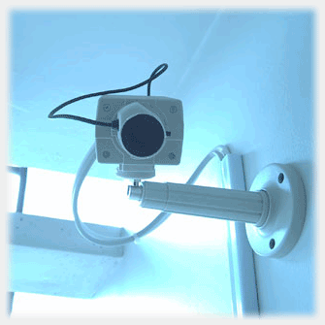
Thank you for listening
Aisling.ODonnell@ul.ie
http://limerick.academia.edu/AislingODonnell

