Slide 1
Exclusive security.
On the discriminatory potential of security

Slide 3
Security Technologies and Exclusion
Security technologies for example the body scanner exclude people belonging to salient groups. But they are not only excluded, but stigmatized, labeled as not-normal and - in this context - as dangerous.

Slide 4
Security technologies and structural discrimination
Structural discrimination must be assumed, “when the rules of a society's major institutions consistently produce disproportionately disadvantageous outcomes for the members of certain salient social groups and the production of such outcomes is unjust […] apart from any direct discrimination in which the collective or individual agents of the society might engage.” (Altman 2011)
=> key factor is not the intention but the effect

Slide 5
Human Security
“Human security refers to the quality of life of the people of a society or polity. Anything which degrades their quality of life […] is a security threat.”
(Ramesh Thakur, Vice Rector, Peace and Security, United Nations University)
“A second element is that people should enjoy without discrimination all rights and obligations - including human, political, social, economic and cultural rights - that belonging to a State implies. A third element is social inclusion - or having equal access to the political, social and economic policy making processes, as well as to draw equal benefits from them. “
(Sadako Ogata, (former) United Nations High Commissioner for Refugees)

Slide 6
Exclusive Security
Threats to security are diverse. They can be political and military,
but also social.
Exclusion and discrimination by security technologies increases
a person`s uncertainty and will have consequences on his or her
quality of life.
For salient groups the implementation of security technologies
like the body scanner is not necessarily enhancing security, in
the contrary, its producing more social insecurity.
=> “Exclusive security”

Slide 7
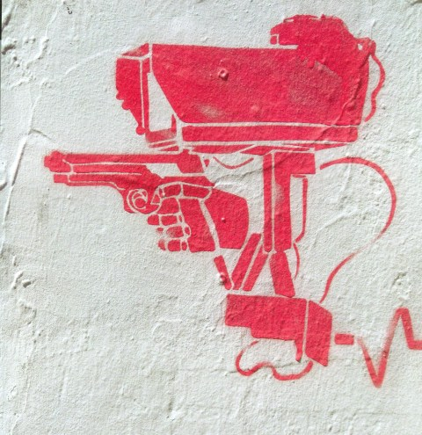

Slide 8
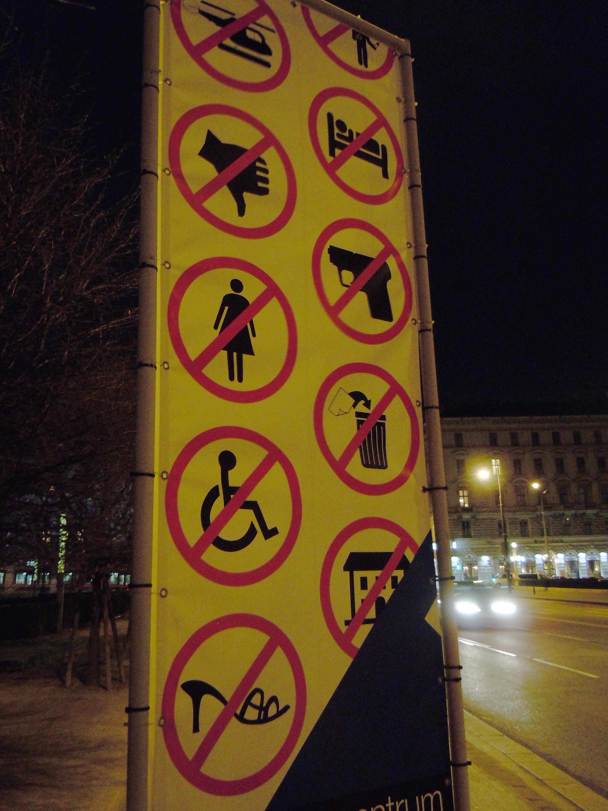
Thank you !
Security, Ethics, and Justice 23.6.2012 - Heidi Schäfer © 2012 Universität Tübingen
Notes:
8

Slide 9
Altman, Andrew: "Discrimination", The Stanford Encyclopedia of Philosophy (Spring 2011 Edition), Edward N. Zalta (ed.), URL = http://plato.stanford.edu/archives/spr2011/entries/discrimination/.
Ammicht Quinn, Regina/ Rampp, Benjamin: "It'll Turn Your Heart Black You Can Trust": Angst, Sicherheit und Ethik, Vierteljahrshefte zur Wirtschaftsforschung 4 / 2009, S. 136-149.
Kimmel, Michael S./Ferber Abby L.(Eds.): Privilege. A Reader. Westview Press 2003.
Ogata, Sadako: "Inclusion or Exclusion: Social Development Challenges For Asia and Europe." Statement of Mrs. Sadako Ogata, United Nations High Commissioner for Refugees at the Asian Development Bank Seminar, 27 April 1998. <http://www.unhcr.ch/refworld/unhcr/hcspeech/27ap1998.htm> 08/22/01
Pincus, Fred L./Ehrlich, Howard (Eds.): Race and Ethnic Conflict: Contending Views on Prejudice, Discrimination and Ethnoviolence, 2nd Edition, Westview Press 1998.
Thakur, Ramesh: “From National to Human Security.” Asia-Pacific Security: The Economics-Politics Nexus. Eds. Stuart Harris, and Andrew Mack. Sydney: Allen & Unwin, 1997, p. 53-54.

