Slide 1
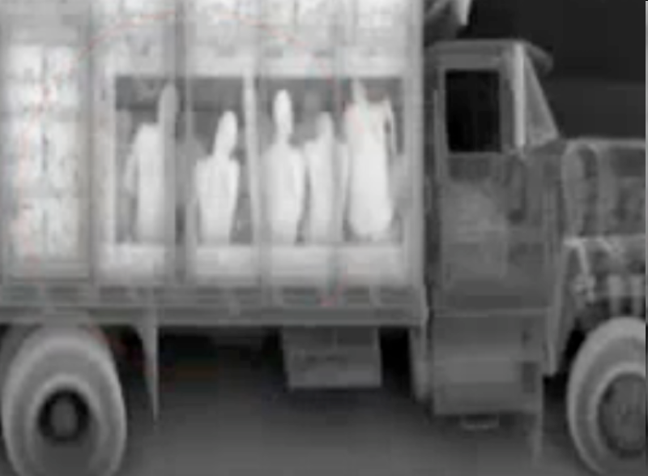
The Enemy Among Us. On Categories, Standards, and Security Technologies as Infrastructures Security, Ethics and Justice. IZEW, June 2012
Jutta Weber
Institute for Media Studies
University of Paderborn
jutta.weber@upb.de

Slide 2
Gliederung
The concept of TECHNO-Security
Understanding Technology as Culture: Norms, Standards, Infrastructures
Militarization of Everyday Life
The concept of Techno-SECURITY
Notes:
Technologien der Behinderung: (Theoretische Grundlagen: Cultural Studies of Technoscience, Disability Studies und Intersektionalität)

Slide 3
“Uniforms strut with dogs
Find a fingernail clipper
Command, Spread your legs,
hands up, unbuckle
that belt, let it drop.
Now my shoes provoke
Security designed to make me
bow down, tolerate any invasions.”
Renato Rosaldo

