Slide 1
Body scanner – a technical review
Overview
X-ray: the (historically) first solution
Microwave technology as an alternative
Forthcoming technologies
envisioned already in 1901
(O. Multhaupt, Die moderne Elektrizität)

Slide 2
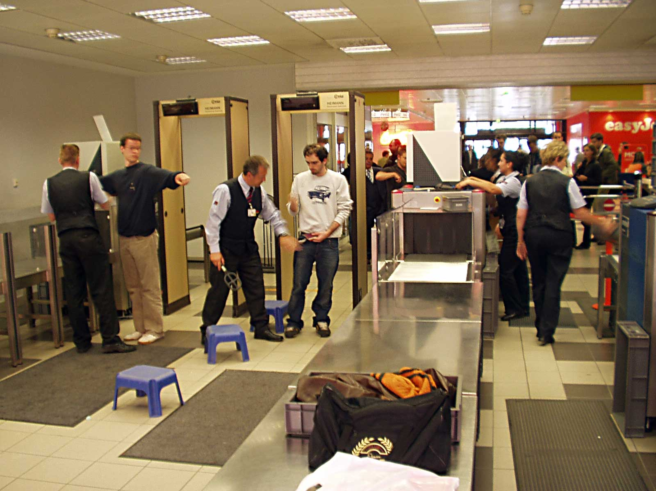
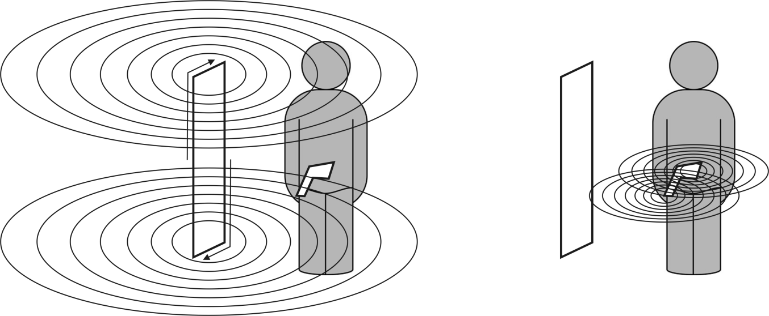
Looking back: walk-through metal detectors
Still the standard procedure at airports (and probably will stay)
„Pulsed induction“
magnetic pulses (about 1/10 of the strength of earth field)
detection of eddy current response (only electrical conductors detectable)
Quota alarm to trigger manual re-checks
exciting magnetic pulse
transmitter and receiver coil
eddy current response (transmitter off)

Slide 3
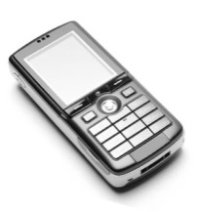
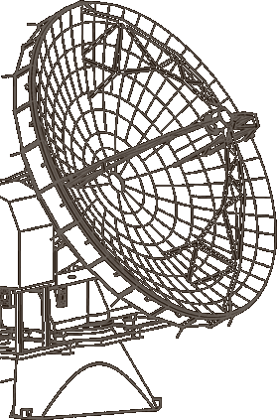
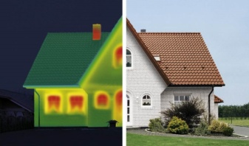
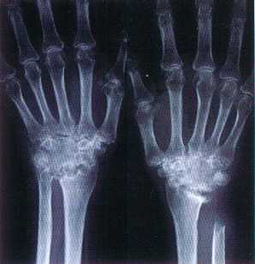
Concept of a ‚body scanner‘
Create an image of the person to be checked, using electromagnetic waves (‚light‘ in a broader sense: X-ray, visible, infrared, terahertz, microwave)
Use light which shines through the clothing of the person (rules out visible and infrared light)
Exploit properties of a hidden object, which might differ from those of the human body (absorptivity, reflectivity)
1 m 10 cm 1 cm 1 mm 100 µm 10 µm 1 µm 300 nm 30 nm wavelength
300 MHz 3 GHz 30 GHz 300 GHz 3 THz 30 THz 300 THz 1 PHz 10 PHz frequency
0.01 0.1 1 10 100 1,000 10,000 100,000 1,000,000 wave number (cm⁻¹)
radio microwave terahertz infrared visible ultraviolet X-ray

Slide 4
Overview of feasible concepts
body scanner
ionizing waves (X-ray)
Low energy waves (µwave, THz)
transmission
backscatter
active
passive
2D
3D
amplified (outdoor)
passive (indoor)

Slide 5
Overview of feasible concepts
body scanner
ionizing waves (X-ray)
transmission
backscatter

Slide 6
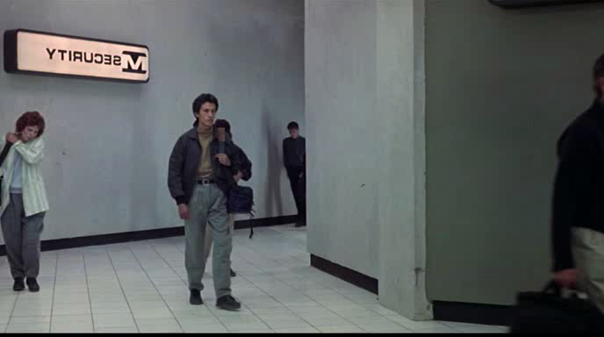
X-ray technology: as Hollywood envisions it…

Slide 7


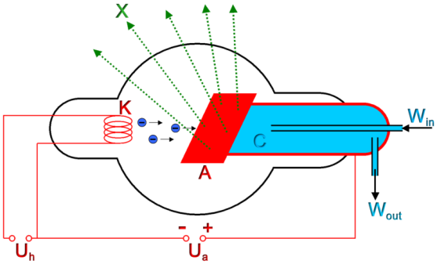
…and in reality: backscatter technique
scattered signal
Interaction of X-ray with matter
scattering: dominant for ‚soft‘ tissue
absorption, e.g. for metals
large volume
scintillator detector
lat. scintillare: flicker
excellent detection capability for metals and ceramics, but difficulties for organic compounds (too close to human issue)
mechanical aperture
X-ray tube

Slide 8
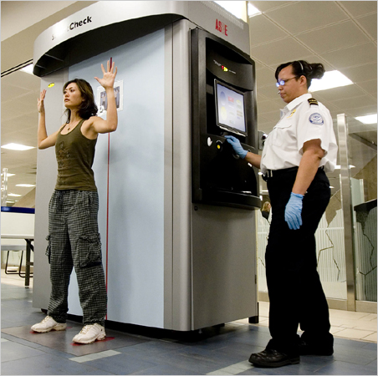
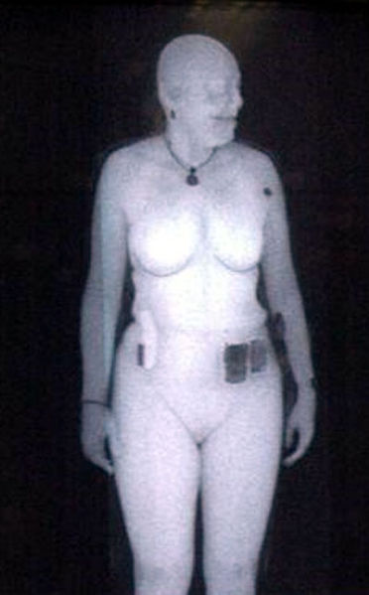
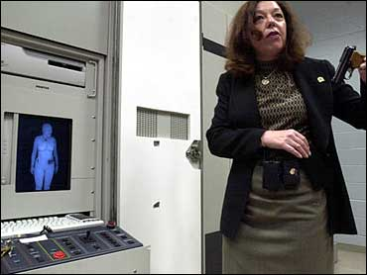
State of the art in X-ray tools
Susan Hallowell, director of security lab of Homeland security Transportation Security Administration
American Science and Engineering „Smart-Check“
double- or single scan (master/slave setup)
6 seconds per scan
dose <0,1µS (for comparison: dental X-ray about 5µS)

Slide 9
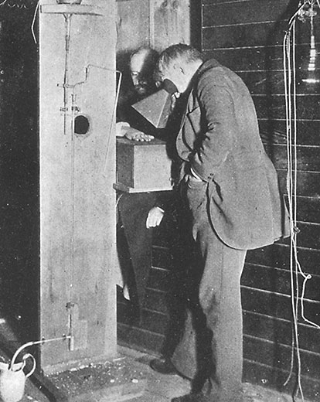
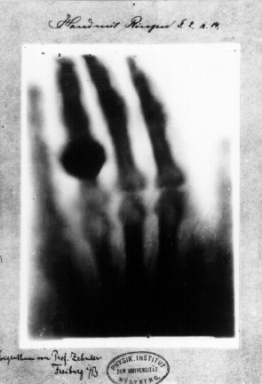
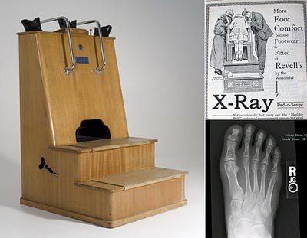
What about health issues?
First published X-ray image: Konrad Wilhelm Röntgens wife‘s hand with wedding ring
In the past, X-ray was treated as a party gag and practical daily tool.

Slide 10
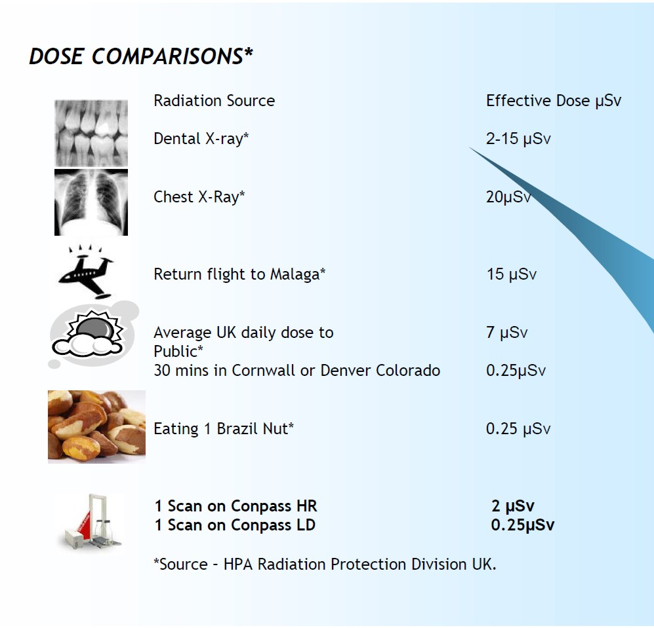
Only panic?
No!
"Forget Japan's Radiation Cloud – Could a TSA Scanner at LAX Give You Cancer?"
“Scientists question safety of airport full body scanners”
"After Stroke Scans, Patients Face Serious Health Risks”
“Airport body scanners deliver radiation dose 20 times higher than first thought”
Feig S, Hendrick R (1997). "Radiation risk from screening mammography of women aged 40–49 years". J Natl Cancer Inst Monogr (22): 119–24

Slide 11
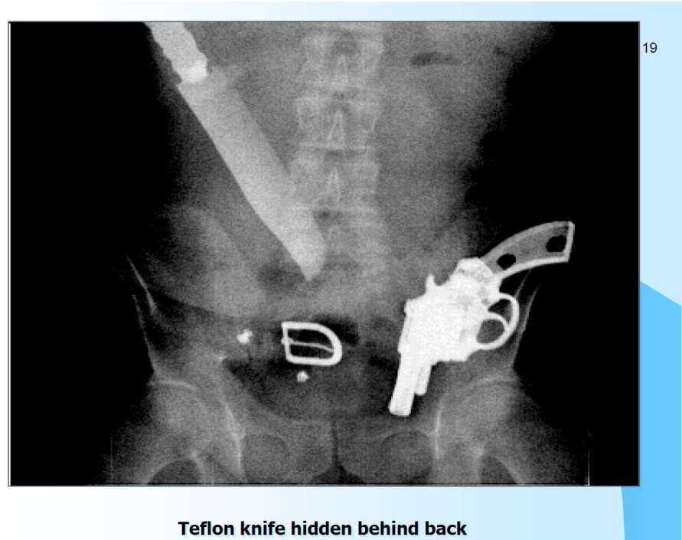
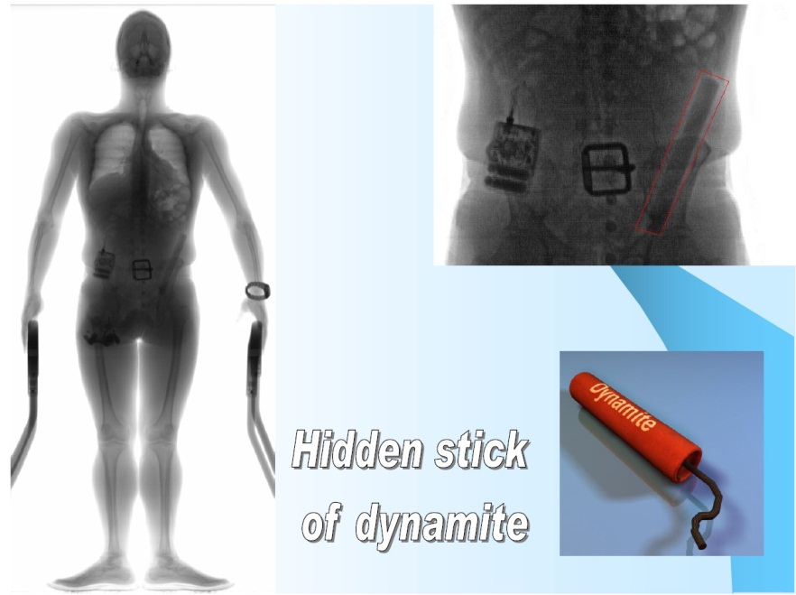
Consequence
Although X-ray is the only technology which potentially could reveal objects INSIDE a human body, it is excluded from body scanning in Europe
(at least for the present, and except of extreme circumstances)

Slide 12
Overview of feasible concepts
body scanner
ionizing waves (X-ray)
Low energy waves (µwave, THz)
transmission
backscatter
active
passive
2D
3D
amplified (outdoor)
passive (indoor)

Slide 13
Overview of feasible concepts
body scanner
Low energy waves (µwave, THz)
active
3D

Slide 14
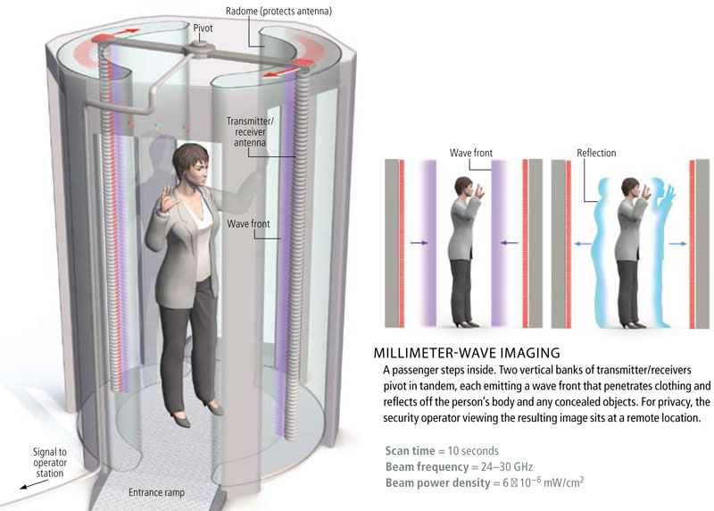
Active millimetre wave imaging
Millimetre waves:
wavelength between 1 and 10 mm (for comparison: ‚cell phone wave’ approx. 10 cm)
approved technologies from RADAR, e.g. car distance control
waves are mostly reflected by human skin – no health issues

Slide 15
Basic principle of 3-dimensional image reconstruction
transmitter channel
transmitted pulse
t
transit time to object
return time of reflected signal
receiver channel
amplitude: measure of material properties
trigger
t
reflected pulses from different layers of the object
Result: a ‚voxel‘: pixel with three coordinates and an amplitude information

Slide 16
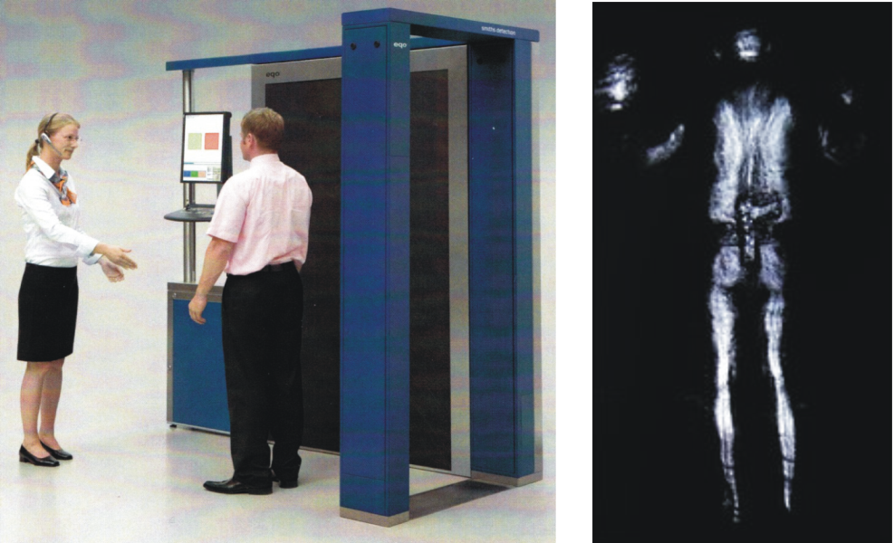
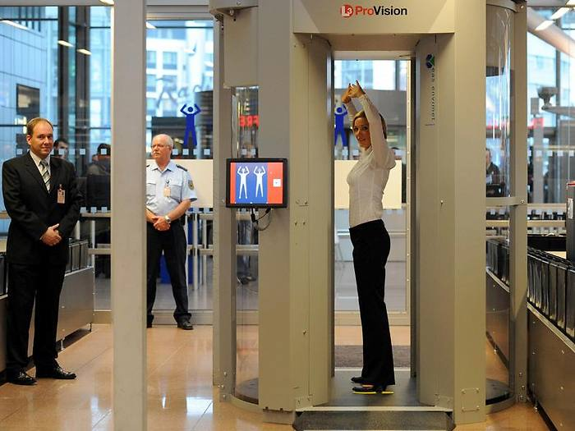
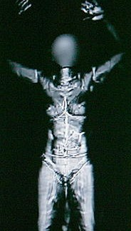
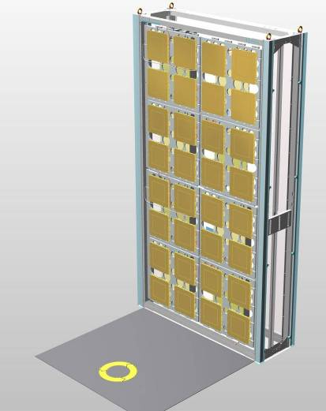
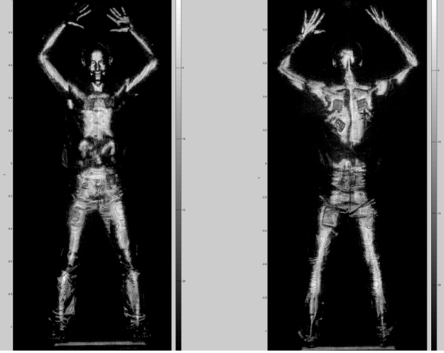
Most famous implementations
L3 Communication: Provision ATD (tested in HH)
Smith detection eqoTM : under review in Tübingen
Very similar techniques, but different levels of maturity and sophistication
Rohde & Schwarz QPASS, German project

Slide 17
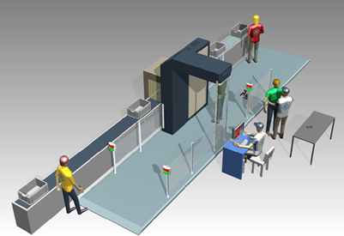
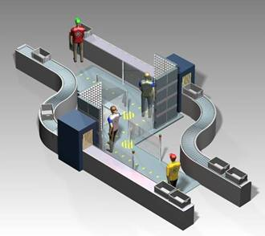
Deployment concepts
Deployment in airports has to meet extreme demands on throughput and false alarm rates
Short processing time
Robust detection algorithm, potentially by the help of additional sensing concepts (explosive spectroscopy, stress analysis etc.)
Realizing the „Wandelgang“: check en passant
→ becomes very ambitious with current technologies
by courtesy of Rohde & Schwartz

Slide 18
Overview of feasible concepts
body scanner
ionizing waves (X-ray)
Low energy waves (µwave, THz)
transmission
backscatter
active
passive
2D
3D
amplified (outdoor)
passive (indoor)

Slide 19
Overview of feasible concepts
body scanner
Low energy waves (µwave, THz)
passive
amplified (outdoor)
passive (indoor)

Slide 20
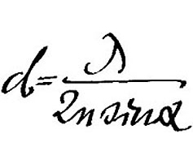
Why physics has an aversion to body scanning
wavelengths limits the achievable spatial resolution
short wavelengths are useless for body scanning
person(T_{S} ,ε, r)
distance
cloth(ε, r, t)
Aperture D
solid angle Ω of received signal
object (T_{O}, ε, r, t)
resolution d
background(T_{b}, ε, r)
active illumination
with shorter wavelengths:
resolution becomes better
transmission through cloth vanishes
reflection from human body vanishes

Slide 21
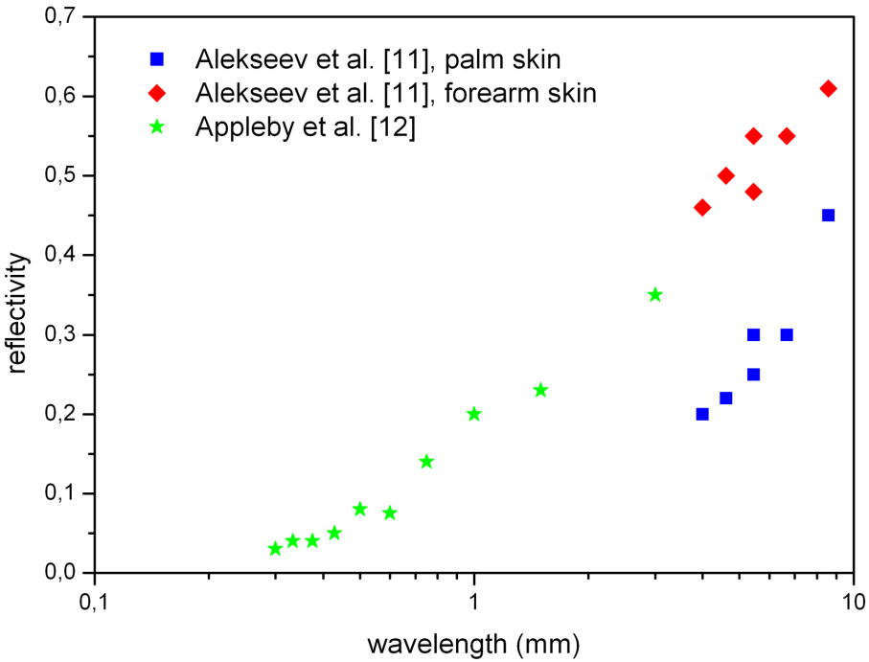
Thinking beyond: passive imaging is not only an evasion but a logical solution
“We do these things, not because they are easy, but because they are hard.“
JFK announcing the moon landing project
No! They are actually easier than active imaging!
reflection from human body

Slide 22
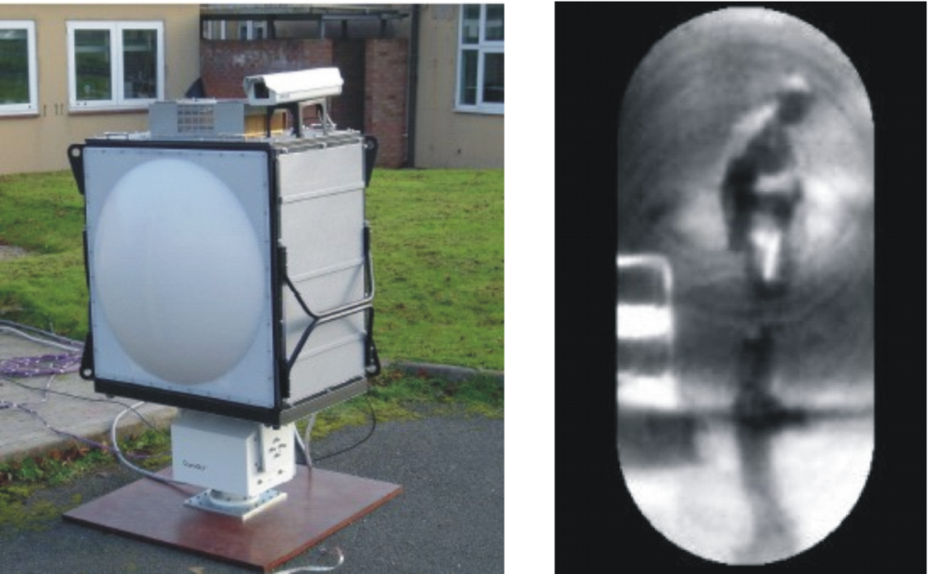

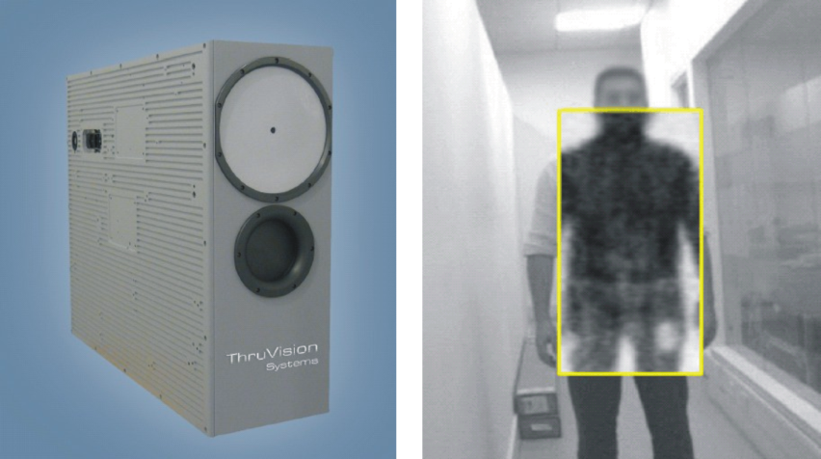
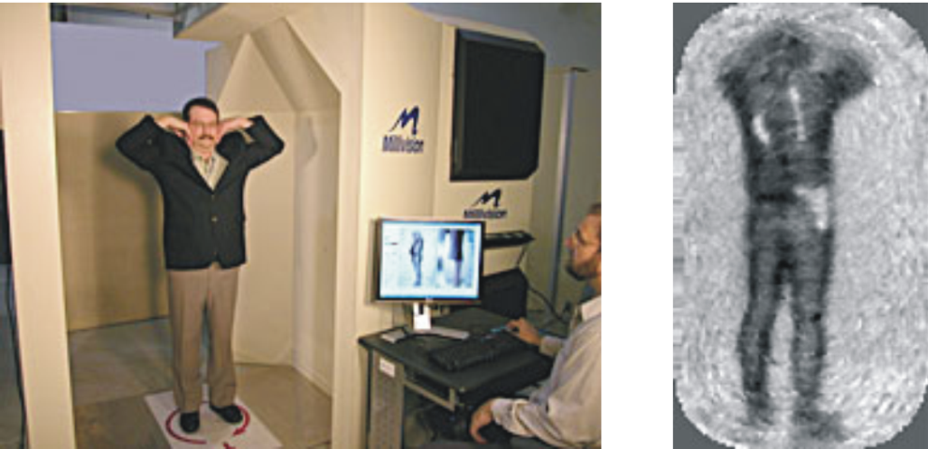
...of course it‘s not that easy
Passive imaging outdoor (Qinetiq)
Limited indoor resolution (Thruvision)
Simulating outdoor condition by a cooled wall (Millivision)

Slide 23
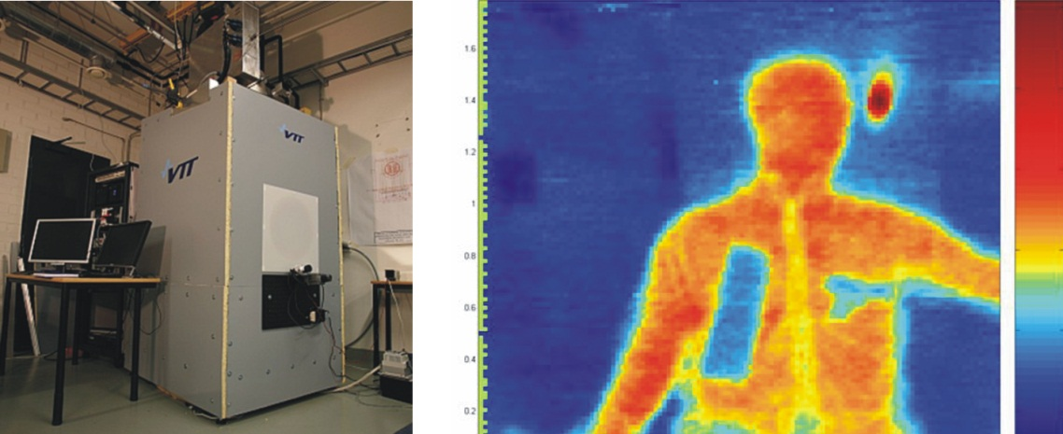
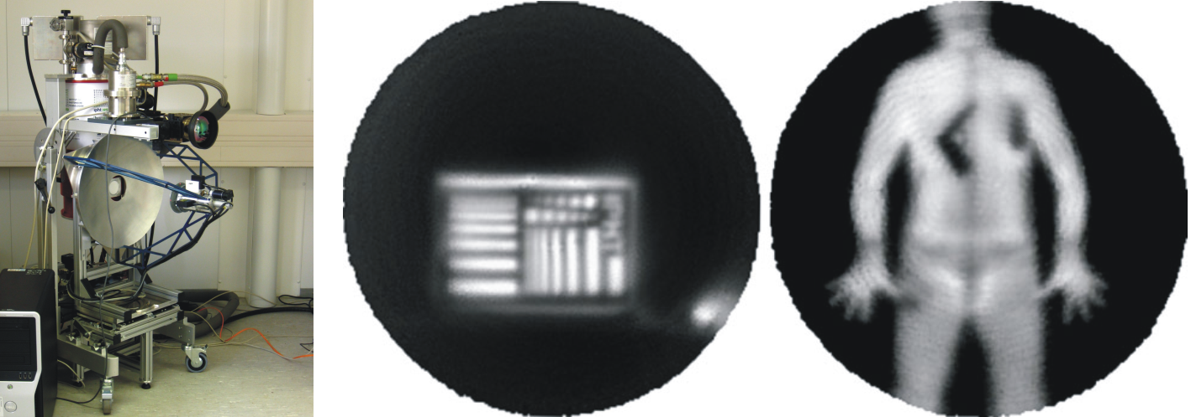
Current research: terahertz technology
Saab + NIST (USA) + VTT (Finnland)
Rohde & Schwarz + IPHT Jena

Slide 24
Conclusions
X-ray body scanning is a dream (of security officials) and a nightmare (for public) at the same time. In Europe it is excluded for the present.
Active millimetre wave imaging is an effective alternative. Various mature devices are close to market, and EU has cleared the legal pathway for them.
Current limitations are the missing flexibility and real-time capability, together with an imperfect automated object detection.
In future, flexible and portable cameras can be an add-on and allow for re-thinking traditional measures.
Material identification is a dream of the future. Body scanners will be restricted to object detection rather than identification for a long time.

Slide 25
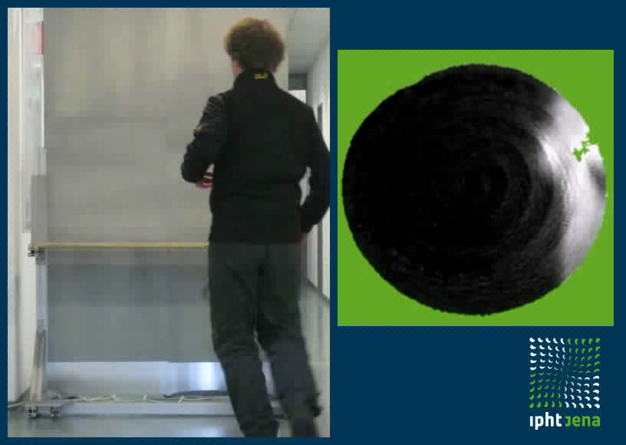
…and finally a little advertisement
Thank you for your attention!

