Slide 1
Main results from The Second International Study on Confirmation Work (2012-2015)
The following slides present selected figures and tables from the book publications.
It is strongly recommended to read the explaining paragraphs in the books.
Overview on the books: https://www.randomhouse.de/Webtags/Konfirmandenarbeit-erforschen-und-gestalten/24731.rhd
More information is available on the project website: www.confirmation-research.eu
Contact to the researching team: Dr. Wolfgang Ilg, wolfgang.ilg@gmx.net

Slide 2
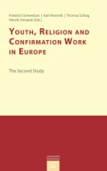
Sample sizes
Schweitzer, Friedrich / Niemelä, Kati / Schlag, Thomas / Simojoki, Henrik (eds.) (2015):
Youth, Religion and Confirmation Work in Europe. The Second Study. Gütersloh/Germany.
(volume 7 of the series, p. 25)

Slide 3
The Design of the Study
Schweitzer, Friedrich / Niemelä, Kati / Schlag, Thomas / Simojoki, Henrik (eds.) (2015):
Youth, Religion and Confirmation Work in Europe. The Second Study. Gütersloh/Germany.
(volume 7 of the series, p. 26)

Slide 4
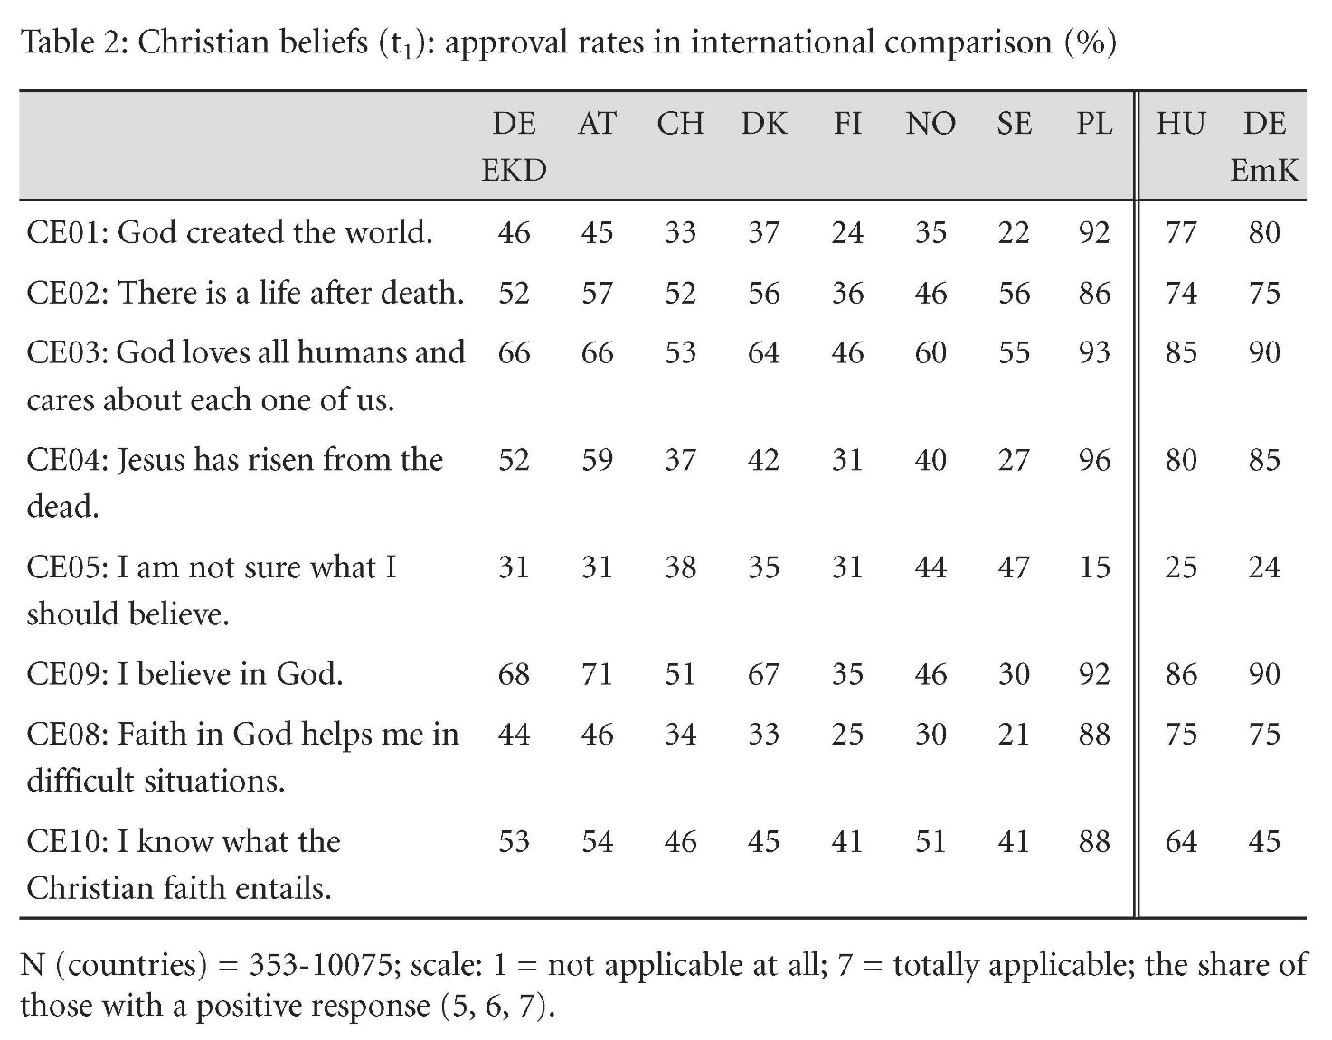
Christian beliefs
Schweitzer, Friedrich / Niemelä, Kati / Schlag, Thomas / Simojoki, Henrik (eds.) (2015):
Youth, Religion and Confirmation Work in Europe. The Second Study. Gütersloh/Germany.
(volume 7 of the series, p. 34)

Slide 5
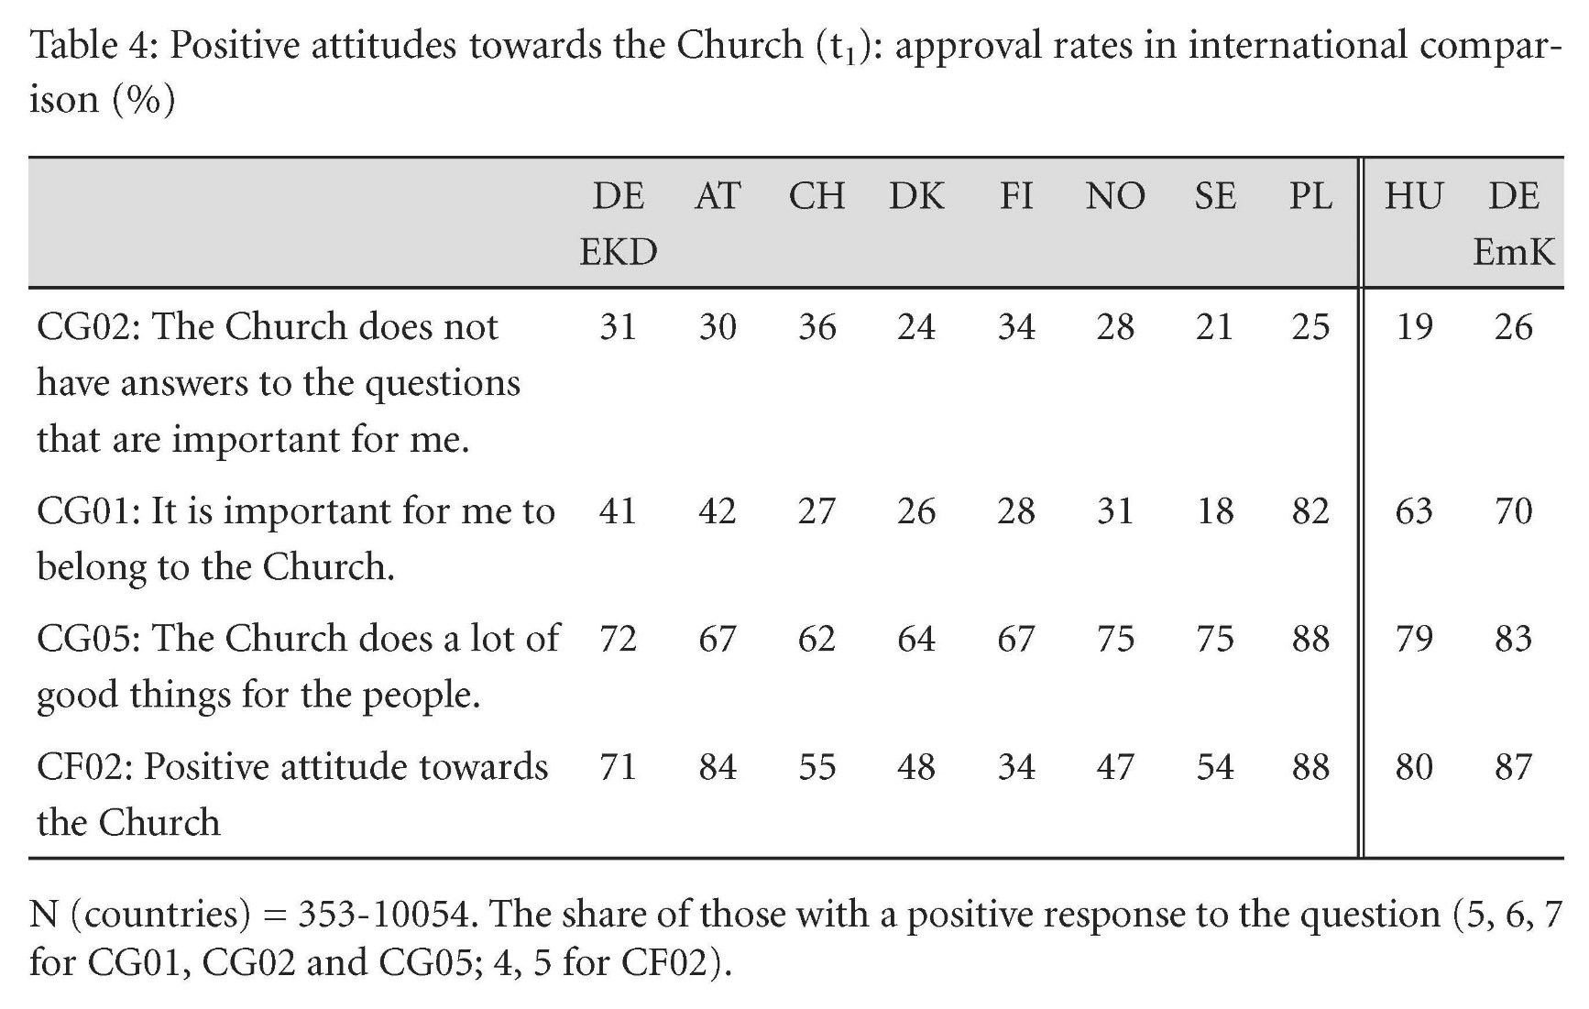
Positive attitudes towards the Church
Schweitzer, Friedrich / Niemelä, Kati / Schlag, Thomas / Simojoki, Henrik (eds.) (2015):
Youth, Religion and Confirmation Work in Europe. The Second Study. Gütersloh/Germany.
(volume 7 of the series, p. 36)

Slide 6
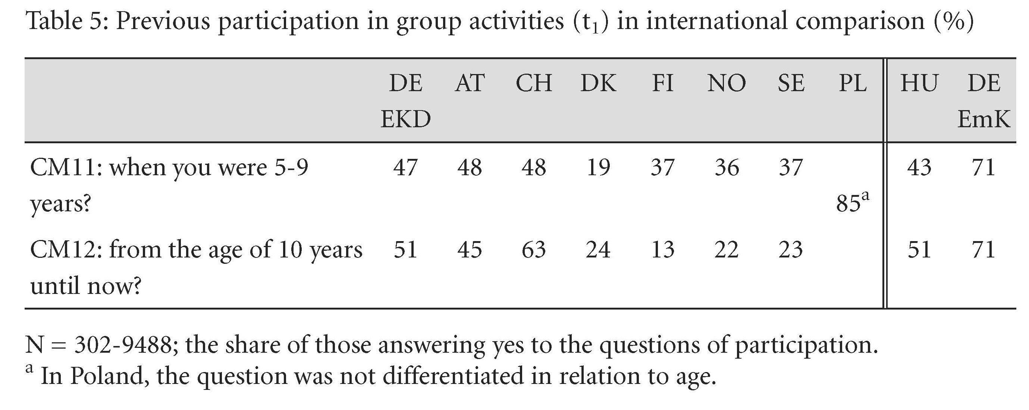
Previous participation in group activities
Schweitzer, Friedrich / Niemelä, Kati / Schlag, Thomas / Simojoki, Henrik (eds.) (2015):
Youth, Religion and Confirmation Work in Europe. The Second Study. Gütersloh/Germany.
(volume 7 of the series, p. 38)

Slide 7
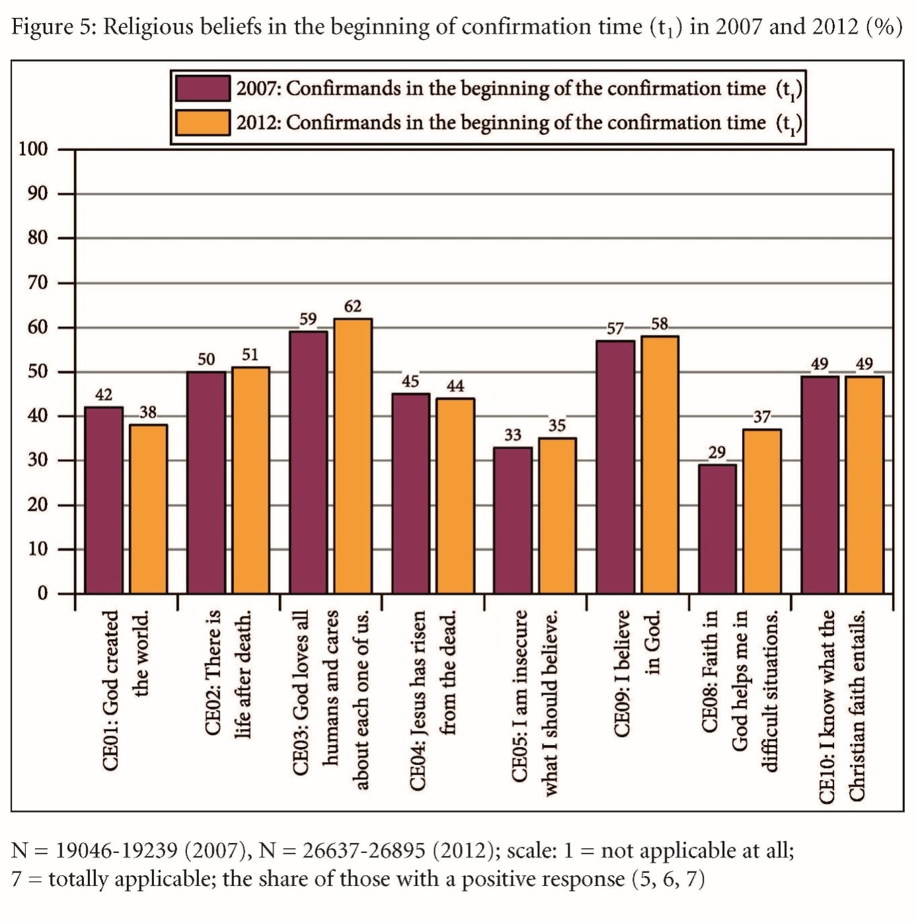
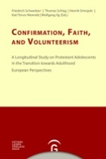
Beliefs in the beginning of confirmation
Schweitzer, Friedrich / Niemelä, Kati / Schlag, Thomas / Simojoki, Henrik (eds.) (2015):
Youth, Religion and Confirmation Work in Europe. The Second Study. Gütersloh/Germany.
(volume 7 of the series, p. 42)

Slide 8
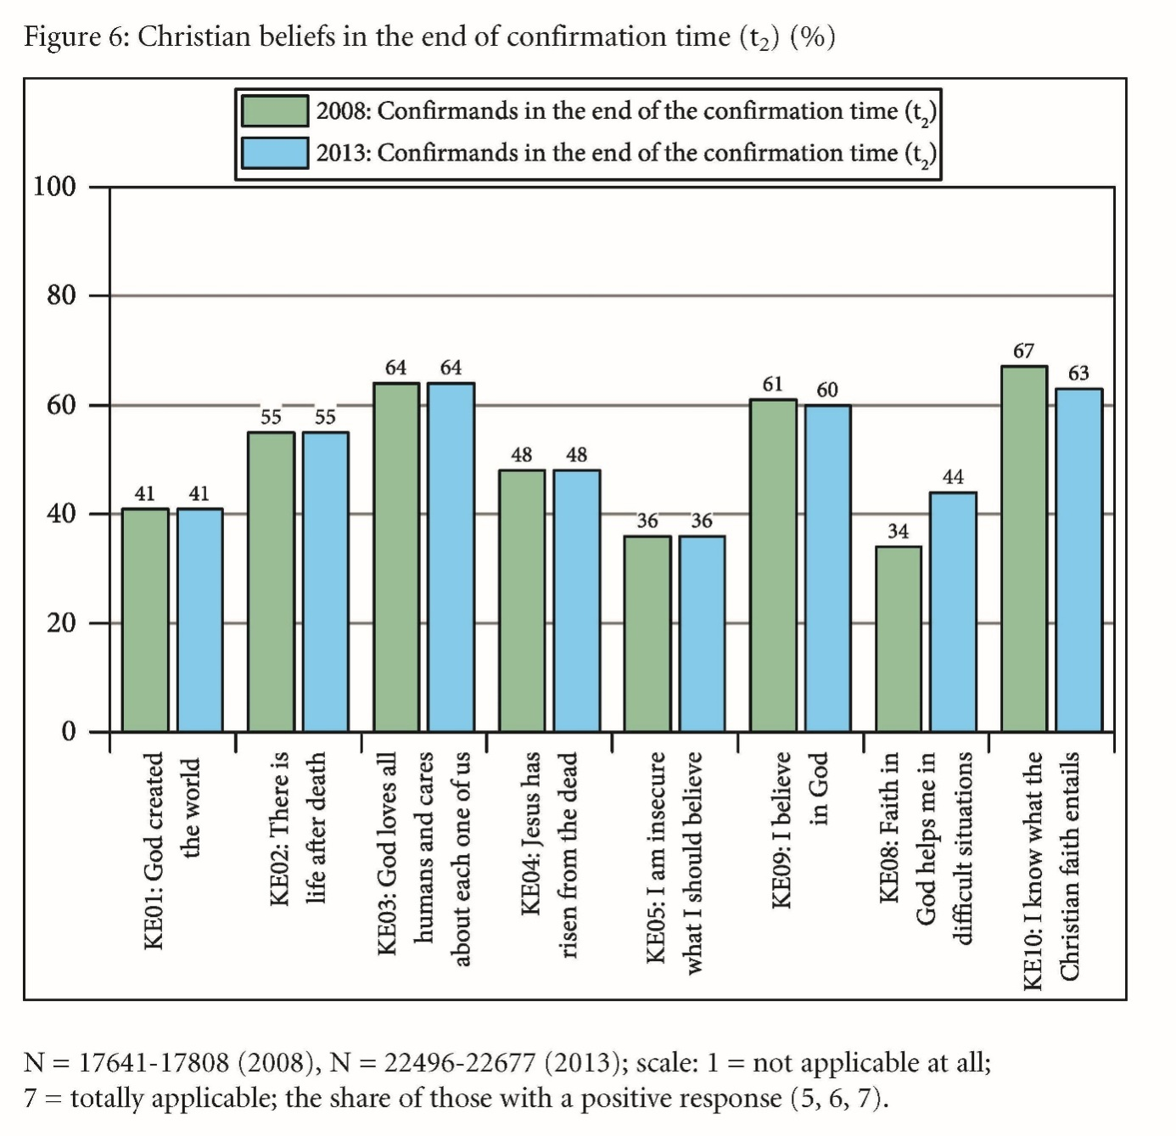
Beliefs in the end of confirmation
Schweitzer, Friedrich / Niemelä, Kati / Schlag, Thomas / Simojoki, Henrik (eds.) (2015):
Youth, Religion and Confirmation Work in Europe. The Second Study. Gütersloh/Germany.
(volume 7 of the series, p. 43)

Slide 9
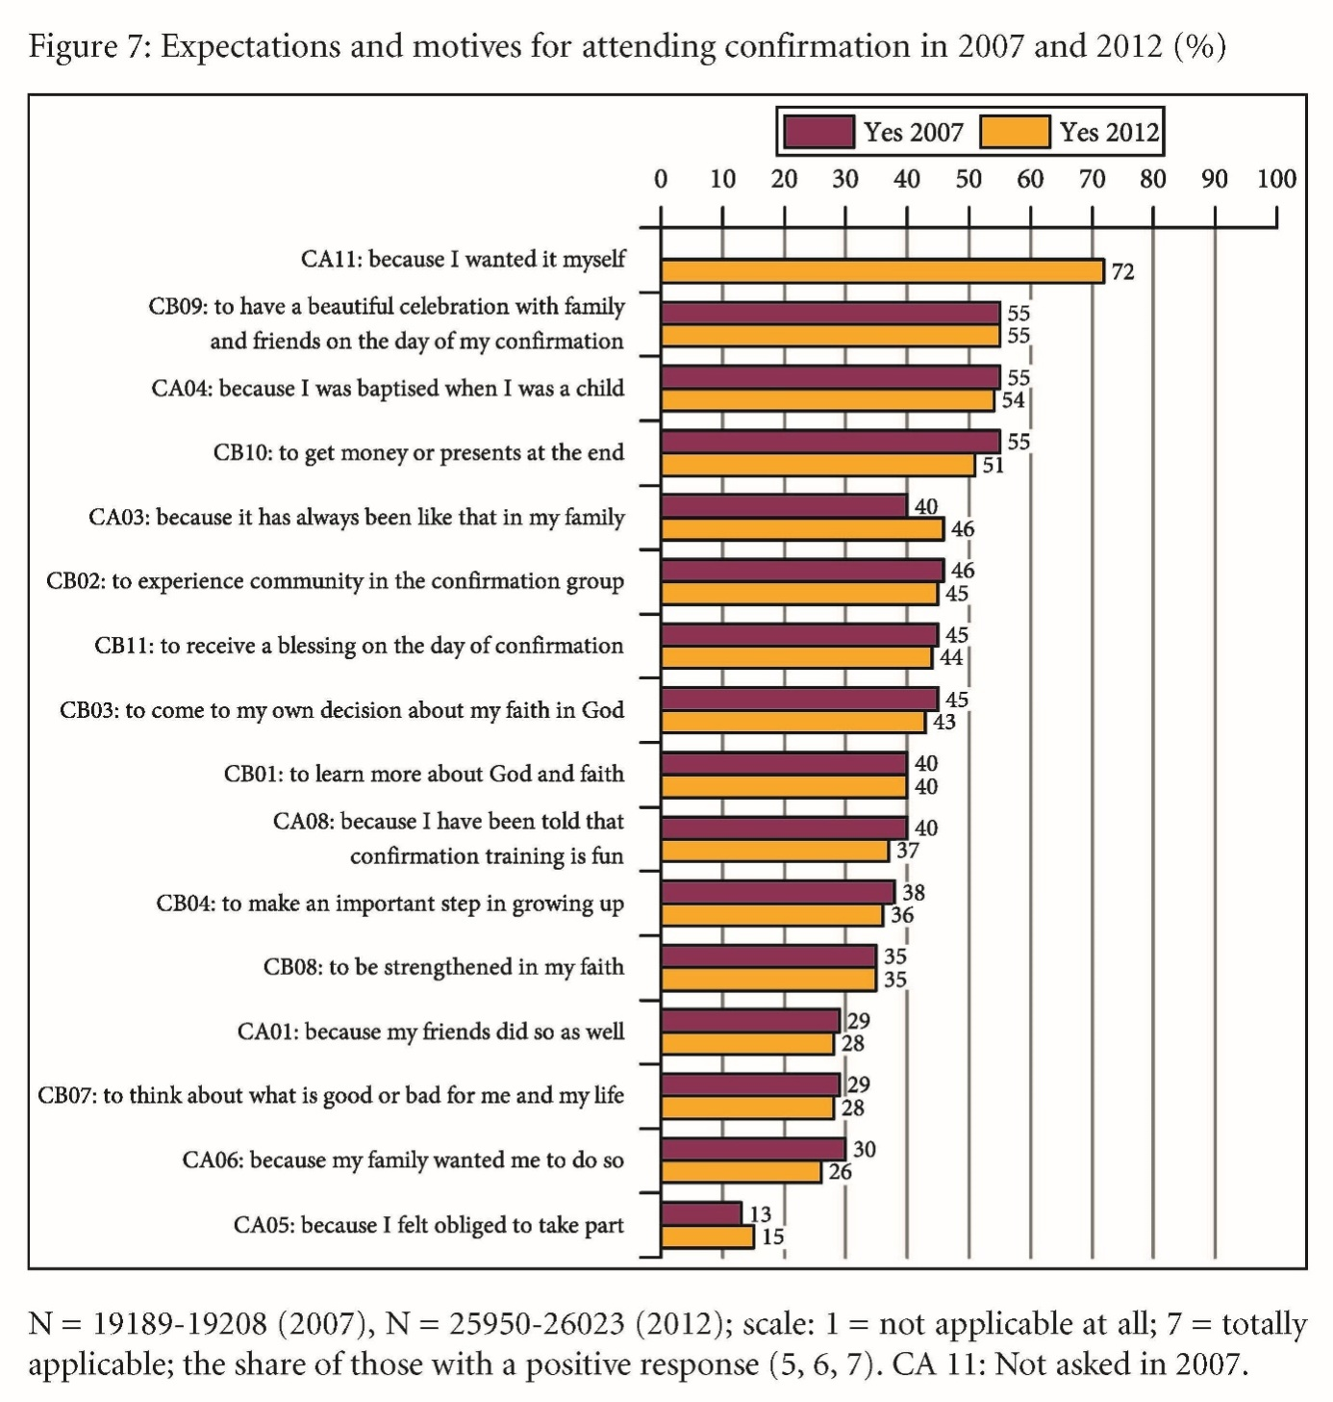
Expectations and motives
Schweitzer, Friedrich / Niemelä, Kati / Schlag, Thomas / Simojoki, Henrik (eds.) (2015):
Youth, Religion and Confirmation Work in Europe. The Second Study. Gütersloh/Germany.
(volume 7 of the series, p. 60)

Slide 10
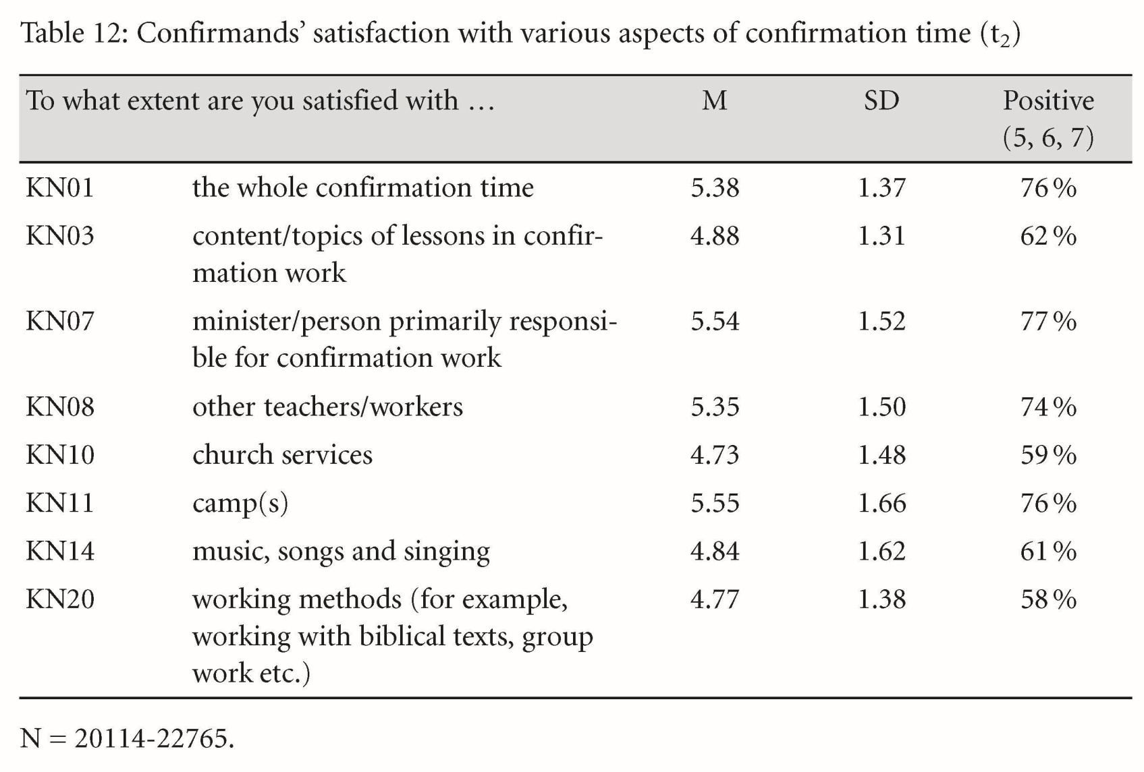
Confirmands‘ satisfaction
Schweitzer, Friedrich / Niemelä, Kati / Schlag, Thomas / Simojoki, Henrik (eds.) (2015):
Youth, Religion and Confirmation Work in Europe. The Second Study. Gütersloh/Germany.
(volume 7 of the series, p. 69)

Slide 11
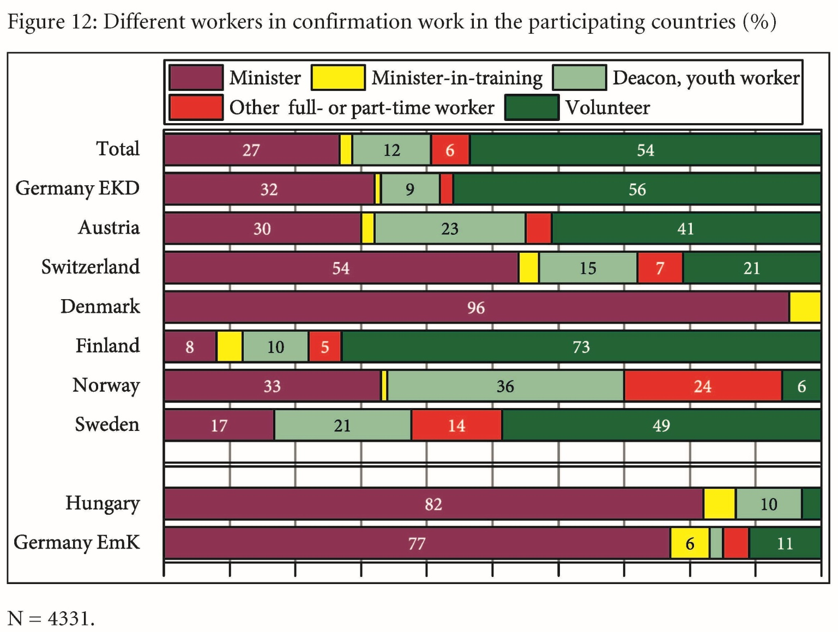
Different workers
Schweitzer, Friedrich / Niemelä, Kati / Schlag, Thomas / Simojoki, Henrik (eds.) (2015):
Youth, Religion and Confirmation Work in Europe. The Second Study. Gütersloh/Germany.
(volume 7 of the series, p. 72)

Slide 12
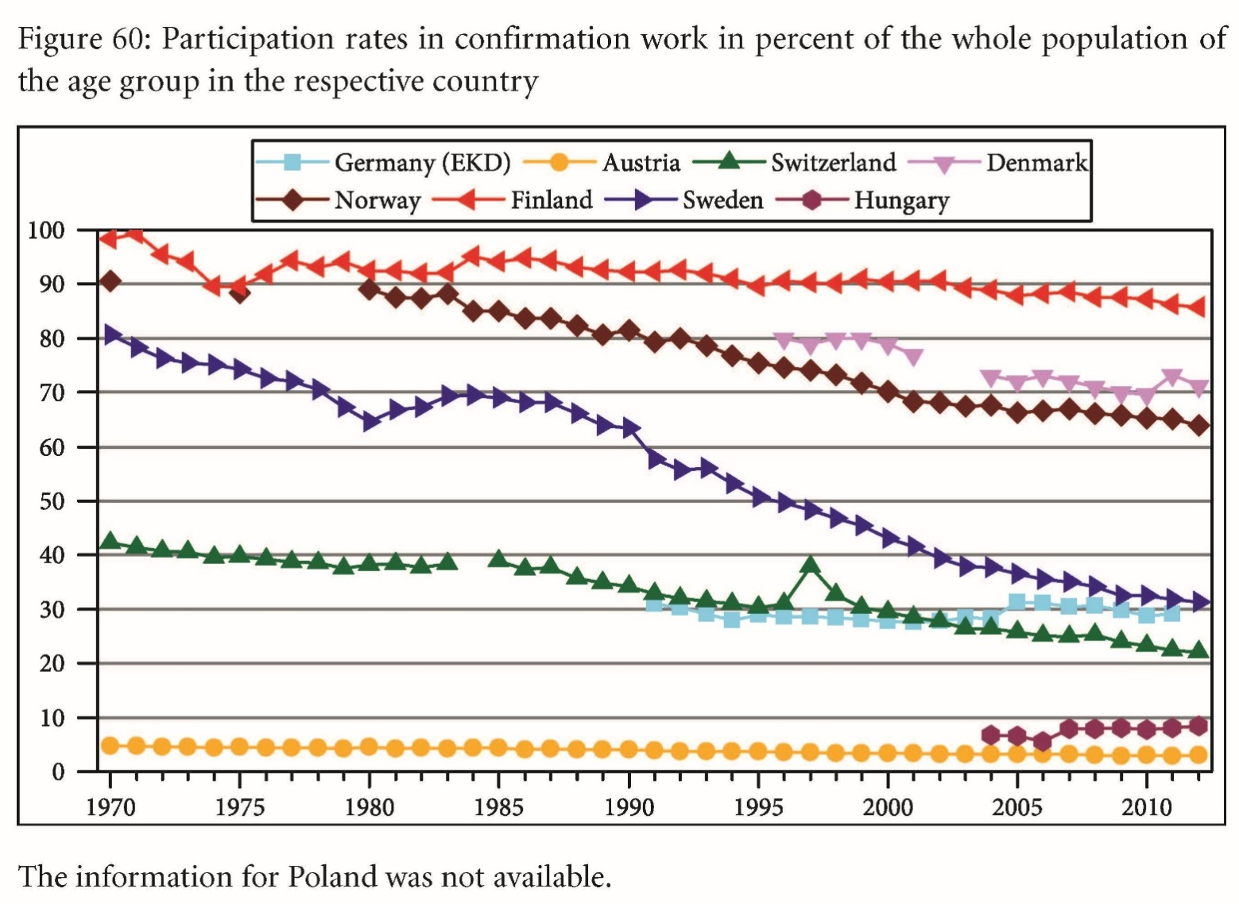
Participation in confirmation work
Schweitzer, Friedrich / Niemelä, Kati / Schlag, Thomas / Simojoki, Henrik (eds.) (2015):
Youth, Religion and Confirmation Work in Europe. The Second Study. Gütersloh/Germany.
(volume 7 of the series, p. 307)

Slide 13
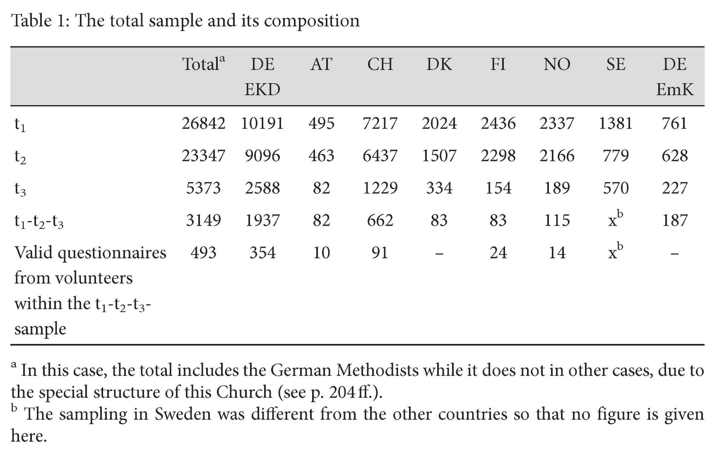
Total sample and its composition
Schweitzer, Friedrich / Schlag, Thomas / Simojoki, Henrik / Tervo-Niemelä, Kati / Ilg, Wolfgang (eds.) (2017):
Confirmation, Faith, and Volunteerism. A Longitudinal Study on Protestant Adolescents in the Transition towards Adulthood. European Perspectives. Gütersloh/Germany.
(volume 10 of the series, p. 25)

Slide 14
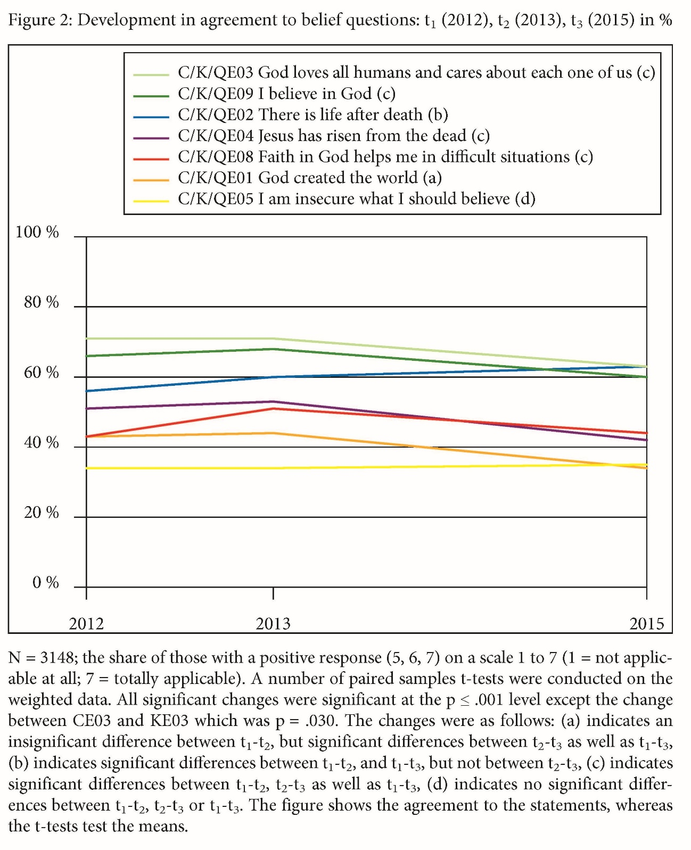
Agreement to belief question
Schweitzer, Friedrich / Schlag, Thomas / Simojoki, Henrik / Tervo-Niemelä, Kati / Ilg, Wolfgang (eds.) (2017):
Confirmation, Faith, and Volunteerism. A Longitudinal Study on Protestant Adolescents in the Transition towards Adulthood. European Perspectives. Gütersloh/Germany.
(volume 10 of the series, p. 49)

Slide 15
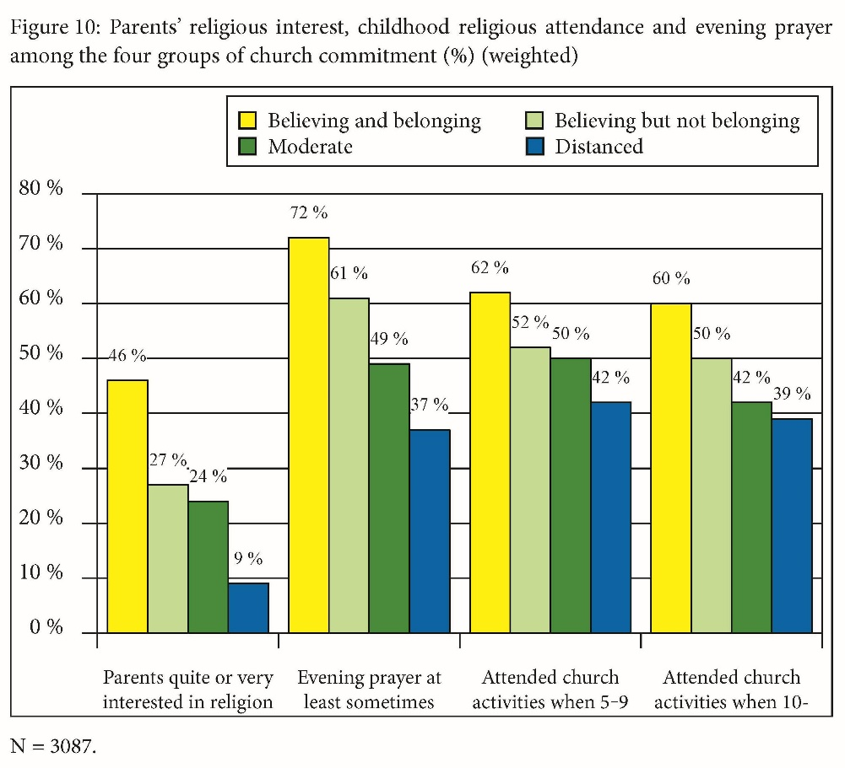
Differences in the four groups of church commitment
Schweitzer, Friedrich / Schlag, Thomas / Simojoki, Henrik / Tervo-Niemelä, Kati / Ilg, Wolfgang (eds.) (2017):
Confirmation, Faith, and Volunteerism. A Longitudinal Study on Protestant Adolescents in the Transition towards Adulthood. European Perspectives. Gütersloh/Germany.
(volume 10 of the series, p. 68)

Slide 16
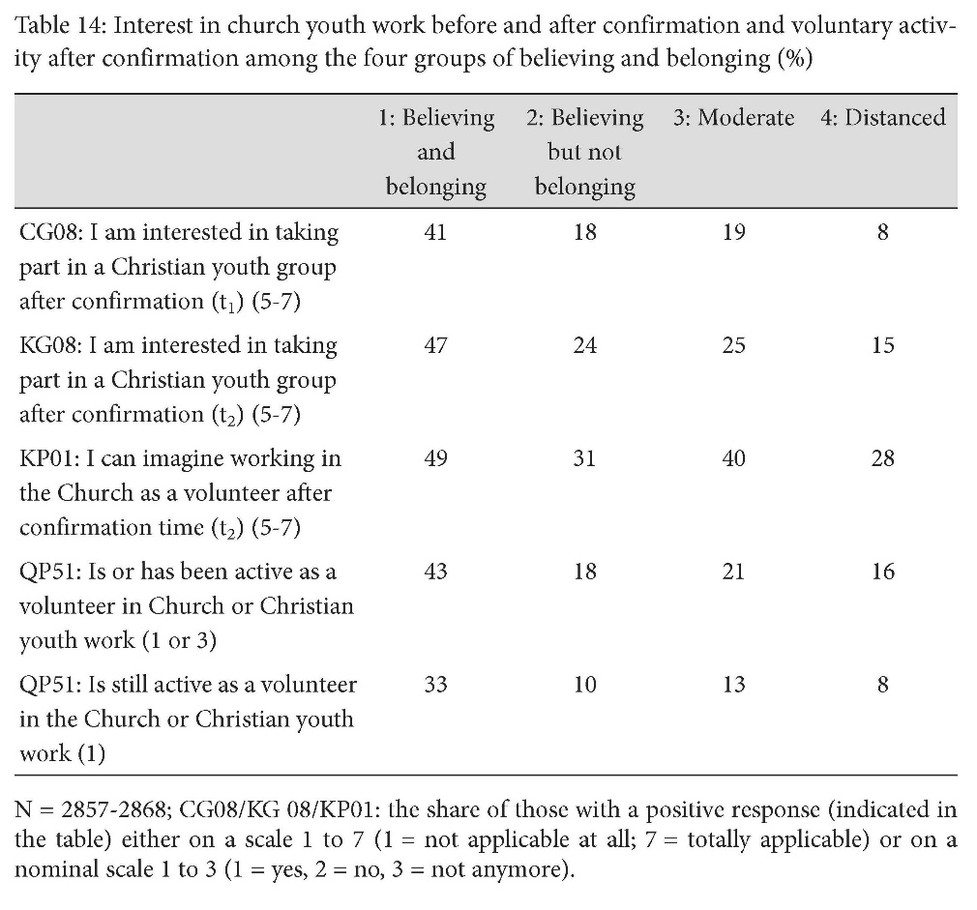
Interest in church youth work
Schweitzer, Friedrich / Schlag, Thomas / Simojoki, Henrik / Tervo-Niemelä, Kati / Ilg, Wolfgang (eds.) (2017):
Confirmation, Faith, and Volunteerism. A Longitudinal Study on Protestant Adolescents in the Transition towards Adulthood. European Perspectives. Gütersloh/Germany.
(volume 10 of the series, p. 72)

Slide 17
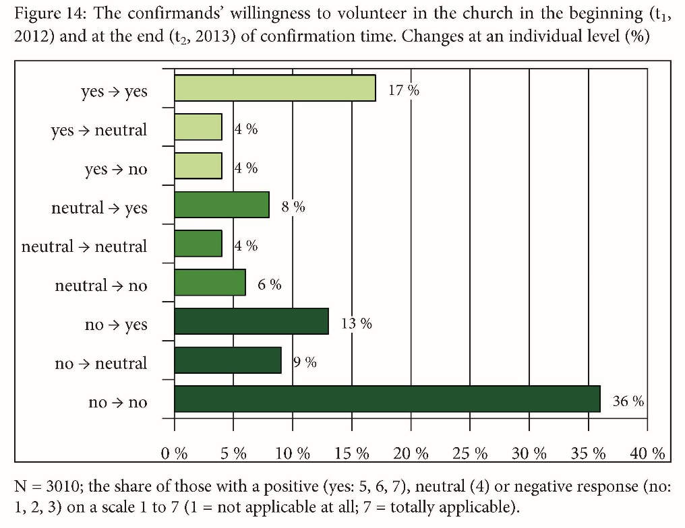
Willingness to volunteer
Schweitzer, Friedrich / Schlag, Thomas / Simojoki, Henrik / Tervo-Niemelä, Kati / Ilg, Wolfgang (eds.) (2017):
Confirmation, Faith, and Volunteerism. A Longitudinal Study on Protestant Adolescents in the Transition towards Adulthood. European Perspectives. Gütersloh/Germany.
(volume 10 of the series, p. 88)

Slide 18
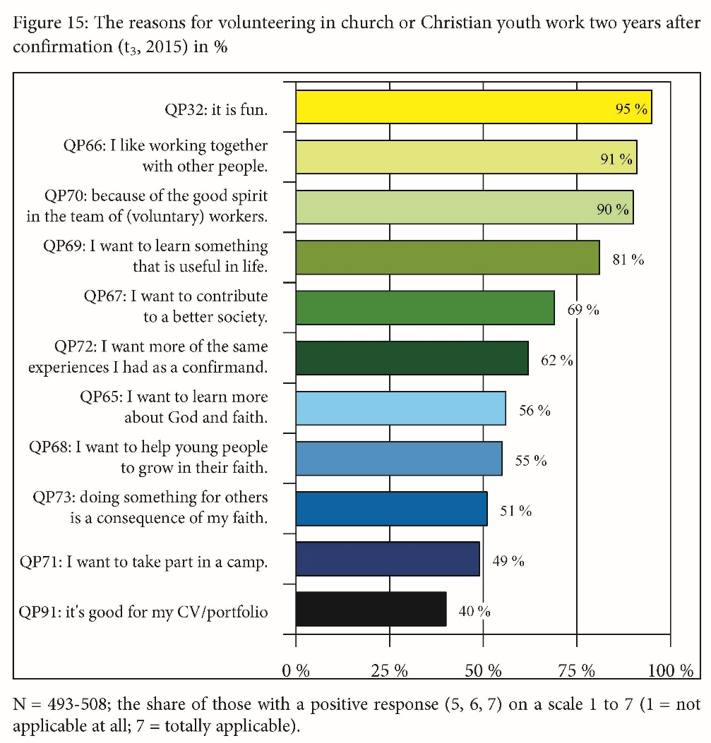
Reasons for volunteering
Schweitzer, Friedrich / Schlag, Thomas / Simojoki, Henrik / Tervo-Niemelä, Kati / Ilg, Wolfgang (eds.) (2017):
Confirmation, Faith, and Volunteerism. A Longitudinal Study on Protestant Adolescents in the Transition towards Adulthood. European Perspectives. Gütersloh/Germany.
(volume 10 of the series, p. 93)

Slide 19
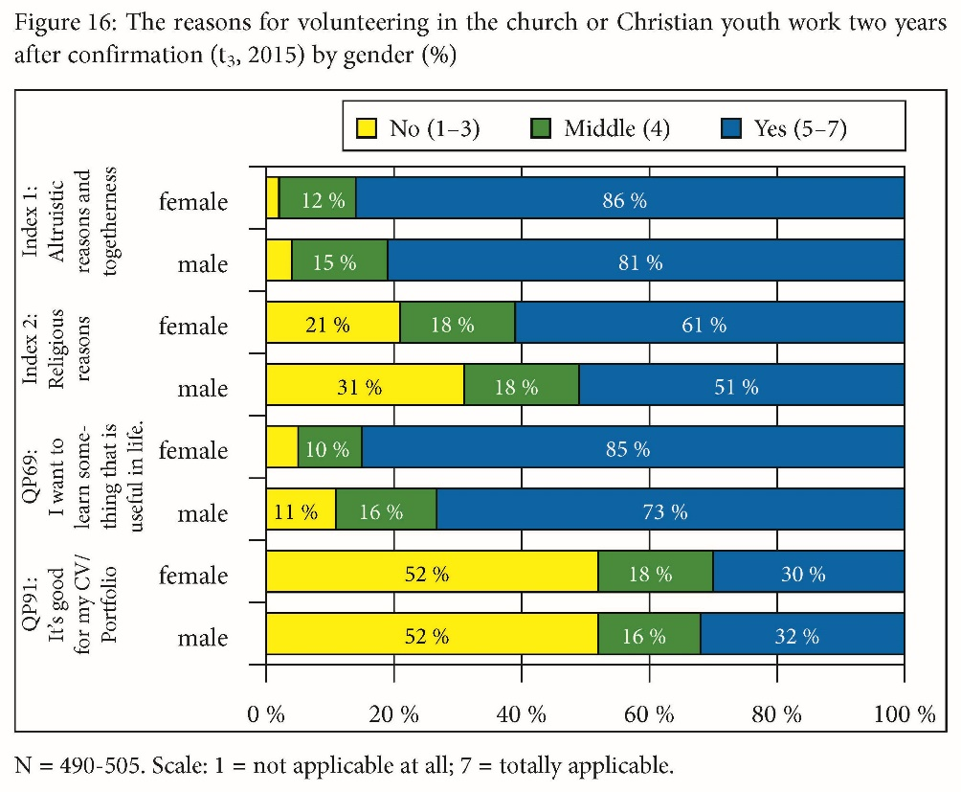
Reasons for volunteering
Schweitzer, Friedrich / Schlag, Thomas / Simojoki, Henrik / Tervo-Niemelä, Kati / Ilg, Wolfgang (eds.) (2017):
Confirmation, Faith, and Volunteerism. A Longitudinal Study on Protestant Adolescents in the Transition towards Adulthood. European Perspectives. Gütersloh/Germany.
(volume 10 of the series, p. 94)

Slide 20
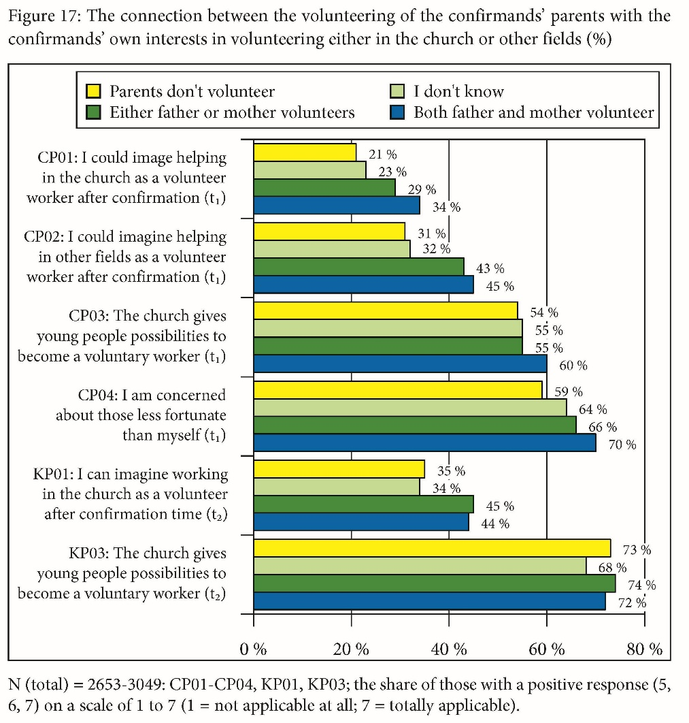
Connection between parents and confirmands
Schweitzer, Friedrich / Schlag, Thomas / Simojoki, Henrik / Tervo-Niemelä, Kati / Ilg, Wolfgang (eds.) (2017):
Confirmation, Faith, and Volunteerism. A Longitudinal Study on Protestant Adolescents in the Transition towards Adulthood. European Perspectives. Gütersloh/Germany.
(volume 10 of the series, p. 95)

Slide 21
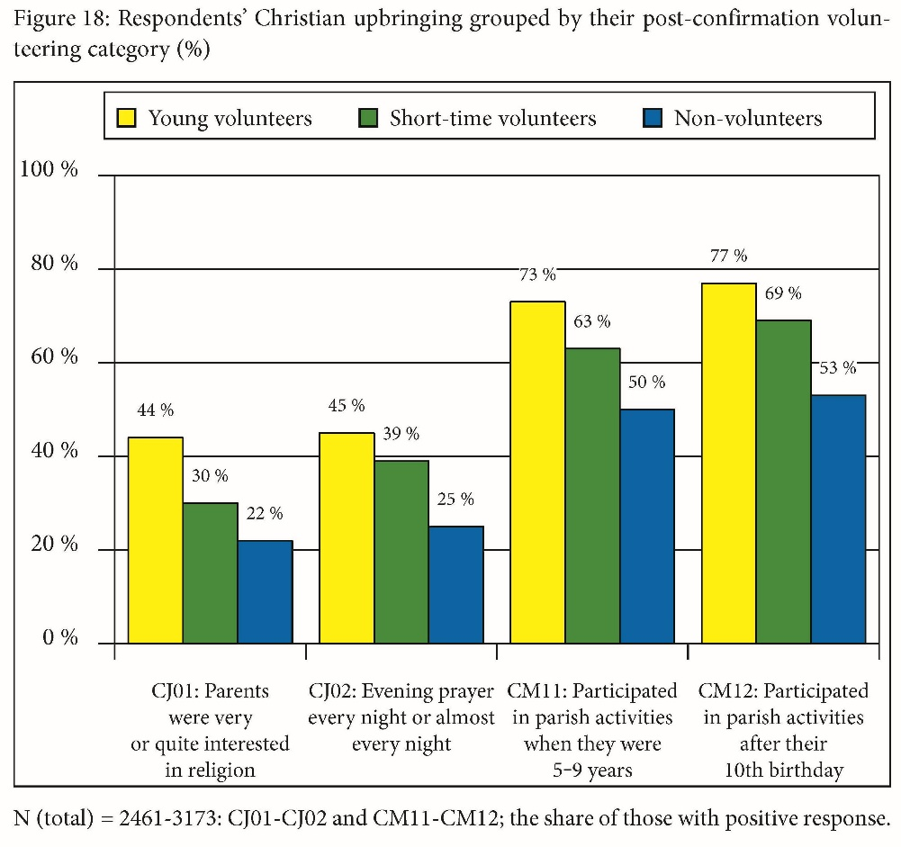
Christian upbringing
Schweitzer, Friedrich / Schlag, Thomas / Simojoki, Henrik / Tervo-Niemelä, Kati / Ilg, Wolfgang (eds.) (2017):
Confirmation, Faith, and Volunteerism. A Longitudinal Study on Protestant Adolescents in the Transition towards Adulthood. European Perspectives. Gütersloh/Germany.
(volume 10 of the series, p. 96)

Slide 22
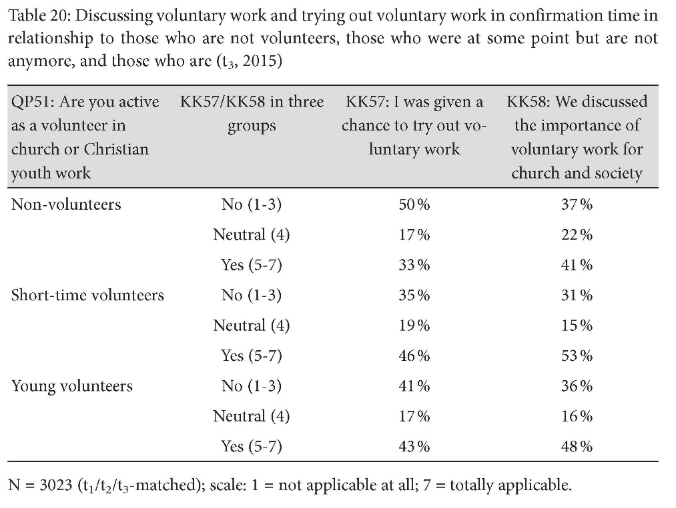
Discussing voluntary work
Schweitzer, Friedrich / Schlag, Thomas / Simojoki, Henrik / Tervo-Niemelä, Kati / Ilg, Wolfgang (eds.) (2017):
Confirmation, Faith, and Volunteerism. A Longitudinal Study on Protestant Adolescents in the Transition towards Adulthood. European Perspectives. Gütersloh/Germany.
(volume 10 of the series, p. 101)

Slide 23
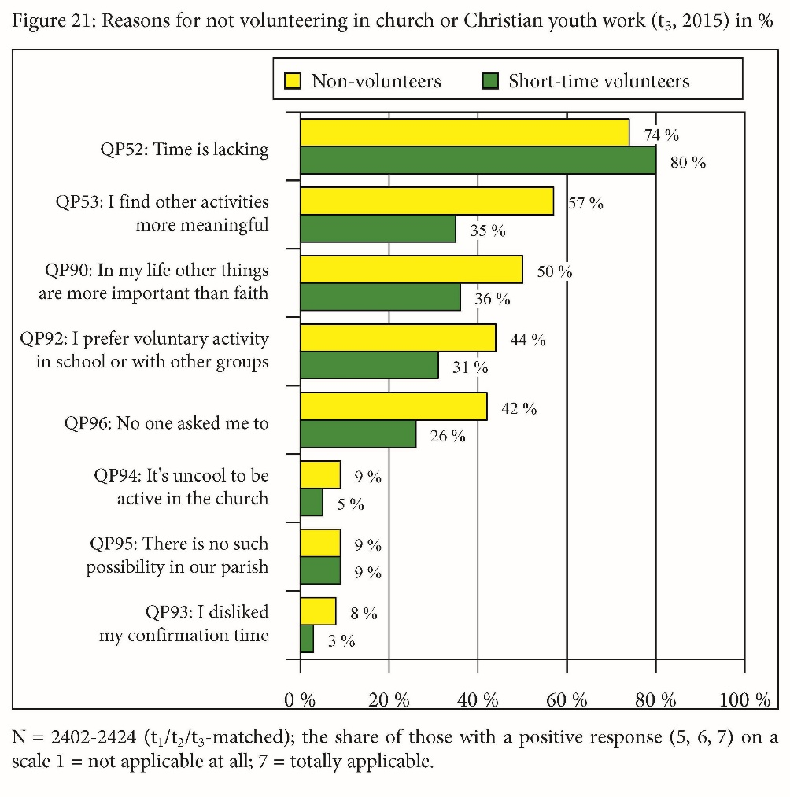
Reasons for not volunteering
Schweitzer, Friedrich / Schlag, Thomas / Simojoki, Henrik / Tervo-Niemelä, Kati / Ilg, Wolfgang (eds.) (2017):
Confirmation, Faith, and Volunteerism. A Longitudinal Study on Protestant Adolescents in the Transition towards Adulthood. European Perspectives. Gütersloh/Germany.
(volume 10 of the series, p. 104)

Slide 24
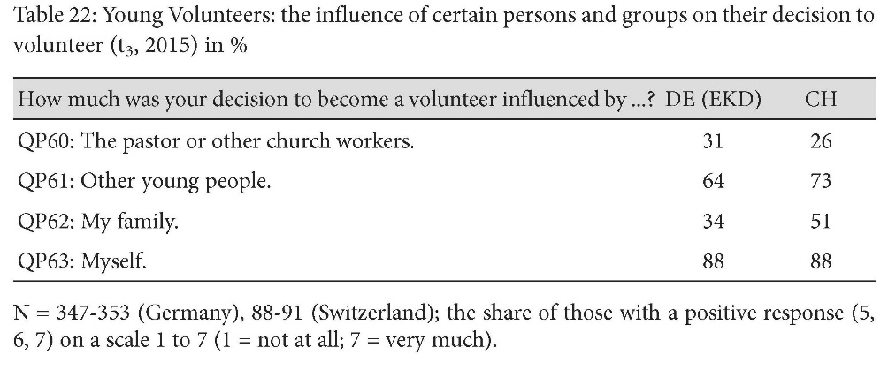
Influence on the decision to start volunteering
Schweitzer, Friedrich / Schlag, Thomas / Simojoki, Henrik / Tervo-Niemelä, Kati / Ilg, Wolfgang (eds.) (2017):
Confirmation, Faith, and Volunteerism. A Longitudinal Study on Protestant Adolescents in the Transition towards Adulthood. European Perspectives. Gütersloh/Germany.
(volume 10 of the series, p. 110)

Slide 25
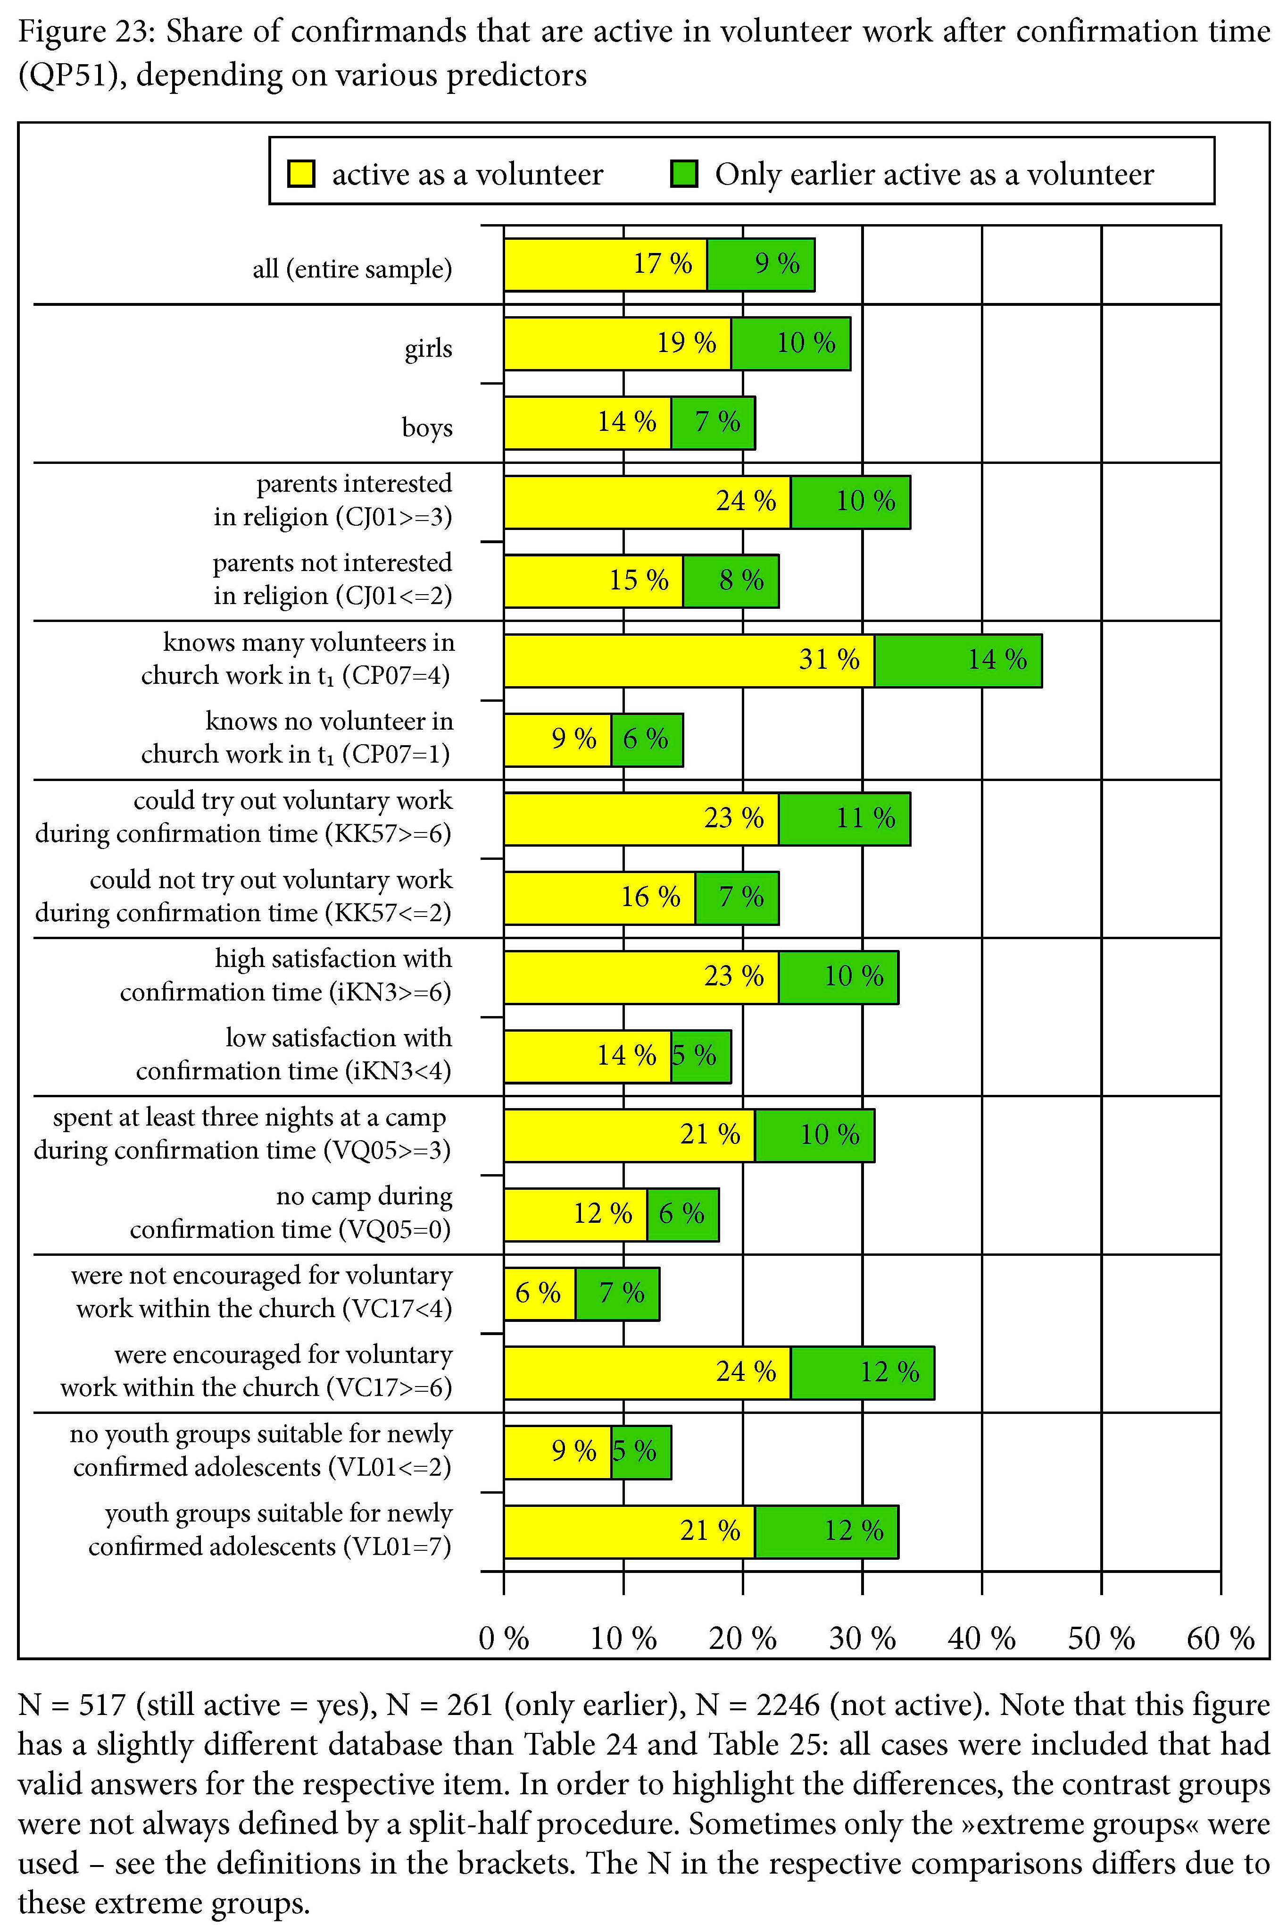
Share of volunteers, depending on predictors
Schweitzer, Friedrich / Schlag, Thomas / Simojoki, Henrik / Tervo-Niemelä, Kati / Ilg, Wolfgang (eds.) (2017):
Confirmation, Faith, and Volunteerism. A Longitudinal Study on Protestant Adolescents in the Transition towards Adulthood. European Perspectives. Gütersloh/Germany.
(volume 10 of the series, p. 125)

Slide 26
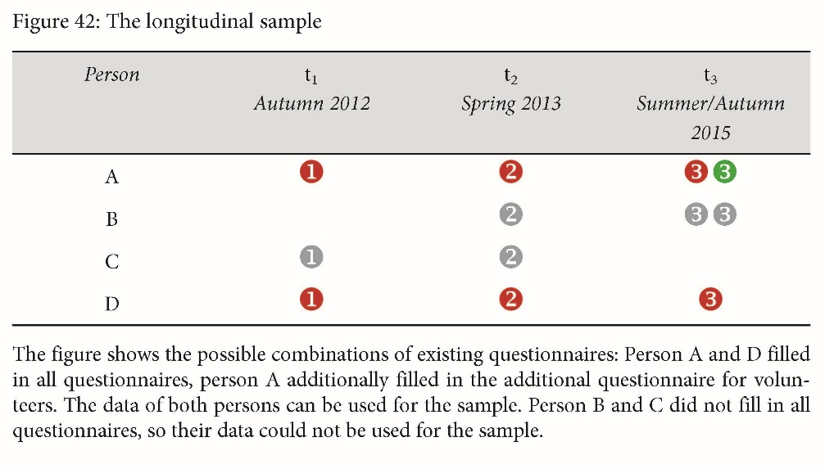
The longitudinal sample
Schweitzer, Friedrich / Schlag, Thomas / Simojoki, Henrik / Tervo-Niemelä, Kati / Ilg, Wolfgang (eds.) (2017):
Confirmation, Faith, and Volunteerism. A Longitudinal Study on Protestant Adolescents in the Transition towards Adulthood. European Perspectives. Gütersloh/Germany.
(volume 10 of the series, p. 247)

Slide 27
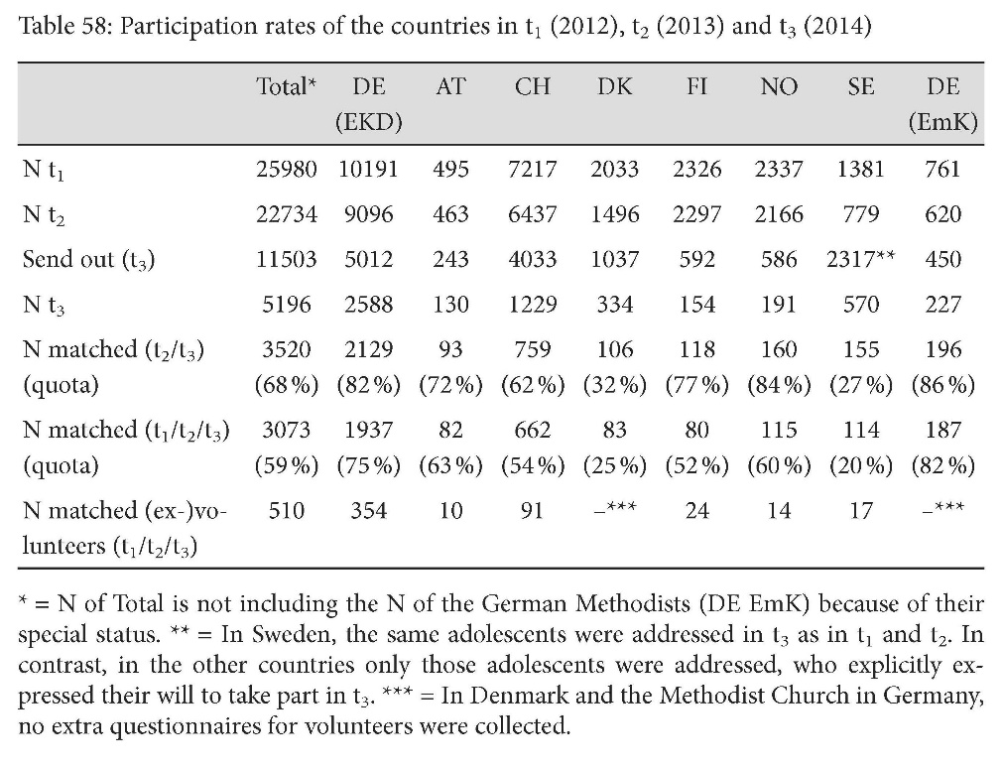
Participation rates
Schweitzer, Friedrich / Schlag, Thomas / Simojoki, Henrik / Tervo-Niemelä, Kati / Ilg, Wolfgang (eds.) (2017):
Confirmation, Faith, and Volunteerism. A Longitudinal Study on Protestant Adolescents in the Transition towards Adulthood. European Perspectives. Gütersloh/Germany.
(volume 10 of the series, p. 249)

