Slide 1
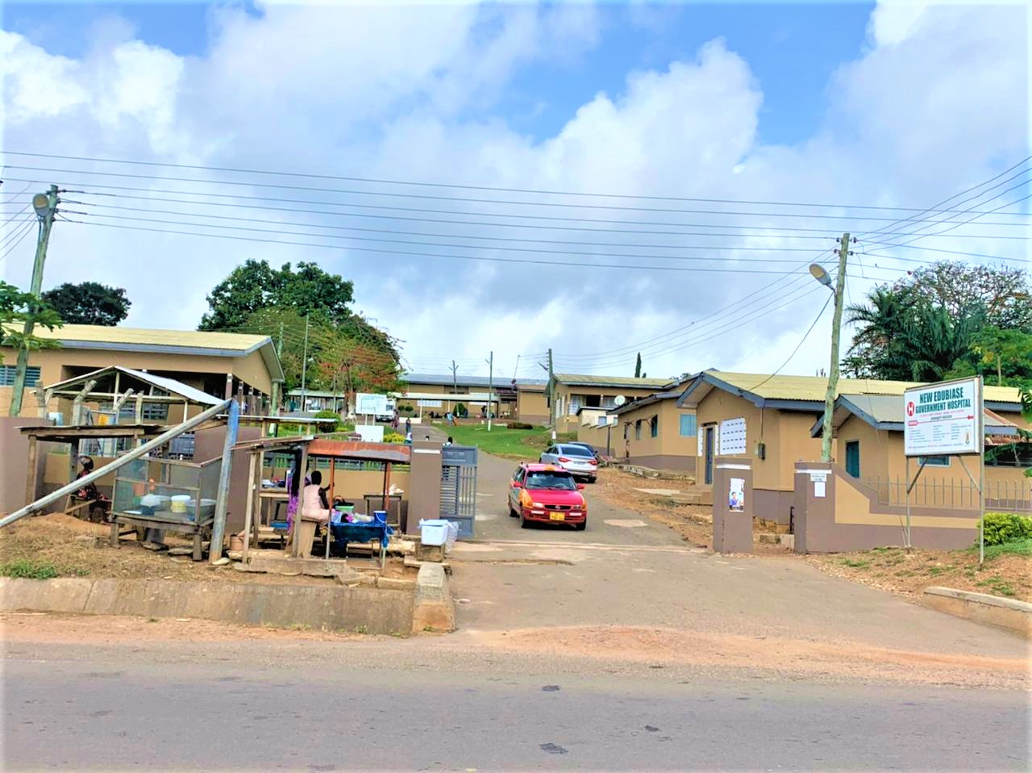
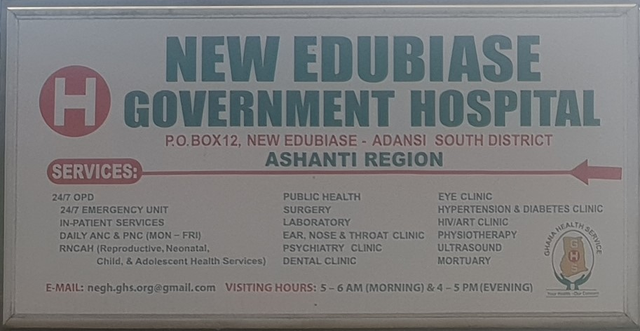
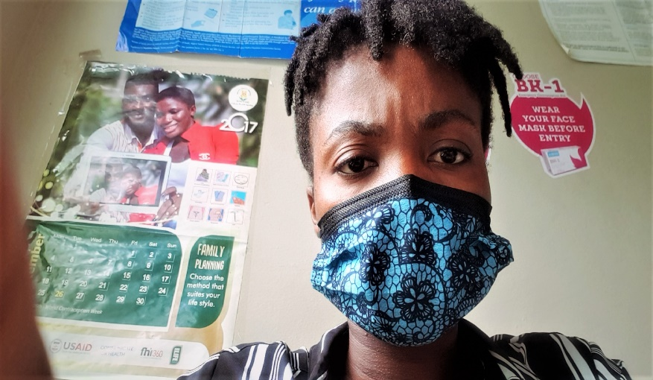
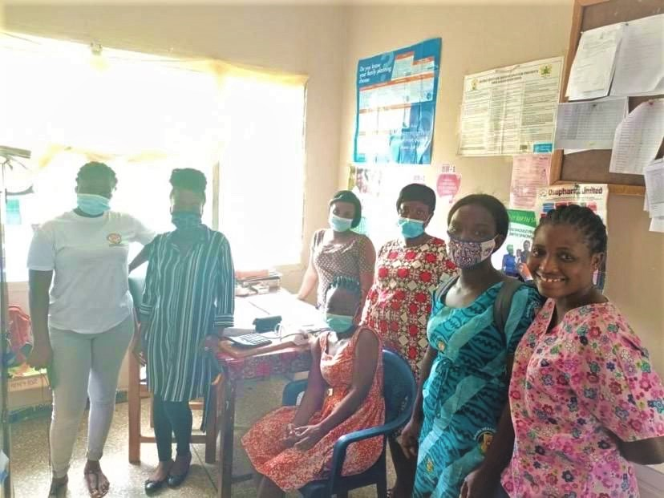
CONTRACEPTION: EXAMINING WOMENS’ PERSPECTIVES ON CONTRACEPTIVE USE AND FAMILY PLANNING AT NEW EDUBIASE, ADANSI SOUTH, ASHANTI REGION, GHANA
Internship and Study Project. Summer Term 2021/ 2022
Internship
Work
Research
Methods
Findings
The internship was conducted at the Reproductive Health Unit, a unit under the New Edubiase Government Hospital. The hospital serves a population of 115, 378 which comprises New Edubiase which is the District Capital, and other surrounding villages. The mission of the hospital is to be the best hospital in Ashanti Region and they have been able to achieve that by being the second best twice in 2020 and 2021. Now, at the Reproductive Health Unit where I was stationed, the main aim of the unit is to provide proper and reliable reproductive health services to the people. During my internship, I shared a single office with five (5) nurses including the senior nurse, and the other office space available is also serves as the insertion room. My workload was 30 hours per week and I worked from 8:00 am-2:00 pm. I would say the existence of COVID-19 never affected my work routine or schedule.
My work at the reproductive health Unit was a learning process and an observation process. Here, after a detailed orientation, the actual work was familiarizing myself with various methods of contraception/ family planning, practicing how to administer the three (3) months contraceptive injection called Depo Provera. In addition, I had the opportunity to observe the insertion and the removal of the Implanon (three years contraceptive implant) and Jadelle (five years contraceptive implant). Lastly, I was tasked to document the information of both old and new acceptors who visit the unit and the Head nurse of the unit supervised my entire work.
About my research, I was interested in knowing the why behind certain contraceptive choices and decisions through examining the opinions and actions of reproductive-age women between 15 to 45 years who visit the Reproductive Health Unit at the New Edubiase Government Hospital regarding contraceptive use/ family planning. Here, my interest was to find answers to questions, which include; what are the opinions and or thoughts behind the contraceptive choices and decisions by reproductive-age women at New Edubiase? What is the extent to which spousal help influences the contraceptive decision of reproductive-age women at New Edubiase? How do these women come about with their reproductive health choices?, and what are the perceived threats, hurdles.
Twenty women were interviewed at the Reproductive Health Unit under the New Edubiase Government Hospital using the Semi-Structured interview technique. Sixteen questions were asked during the semi-structured interview and informed consent was obtained from each participant. After permission was sought from participants, audio recordings were made and the recorded interview was later transcribed. The health workers at the reproductive health unit helped with the recruitment of women who visited the unit within that period. A semi-structured interview was used due to its flexibility and its open-ended questions format, which allows for the exploration of various perspectives of contraceptives without deviating from the main topics that help in comparisons
Family planning in context takes a form of social meanings that echoed readiness regarding women’s ability to choose, socio-economic standing, life as individuals and the cultural and religious perspectives.
The idea of choice was very important to the women. Interview response highlight a major decline in the impact religion and culture have on women’s contraceptive use and family planning methods and this varies amongst participants. Past experiences of women interviewed affected their understanding of their body and how it associates with the shame attached to sexual activities. Also, it has helped women space birth and avoid unwanted or unintended pregnancies.
.
Davida Agyapomaa Acheampong
Universität Tübingen – MA Social and Cultural Anthropology- davida.Acheampong@student.uni-tuebingen.de - Credit: All photos were taken by Davida Agyapomaa Acheampong.

