Slide 1
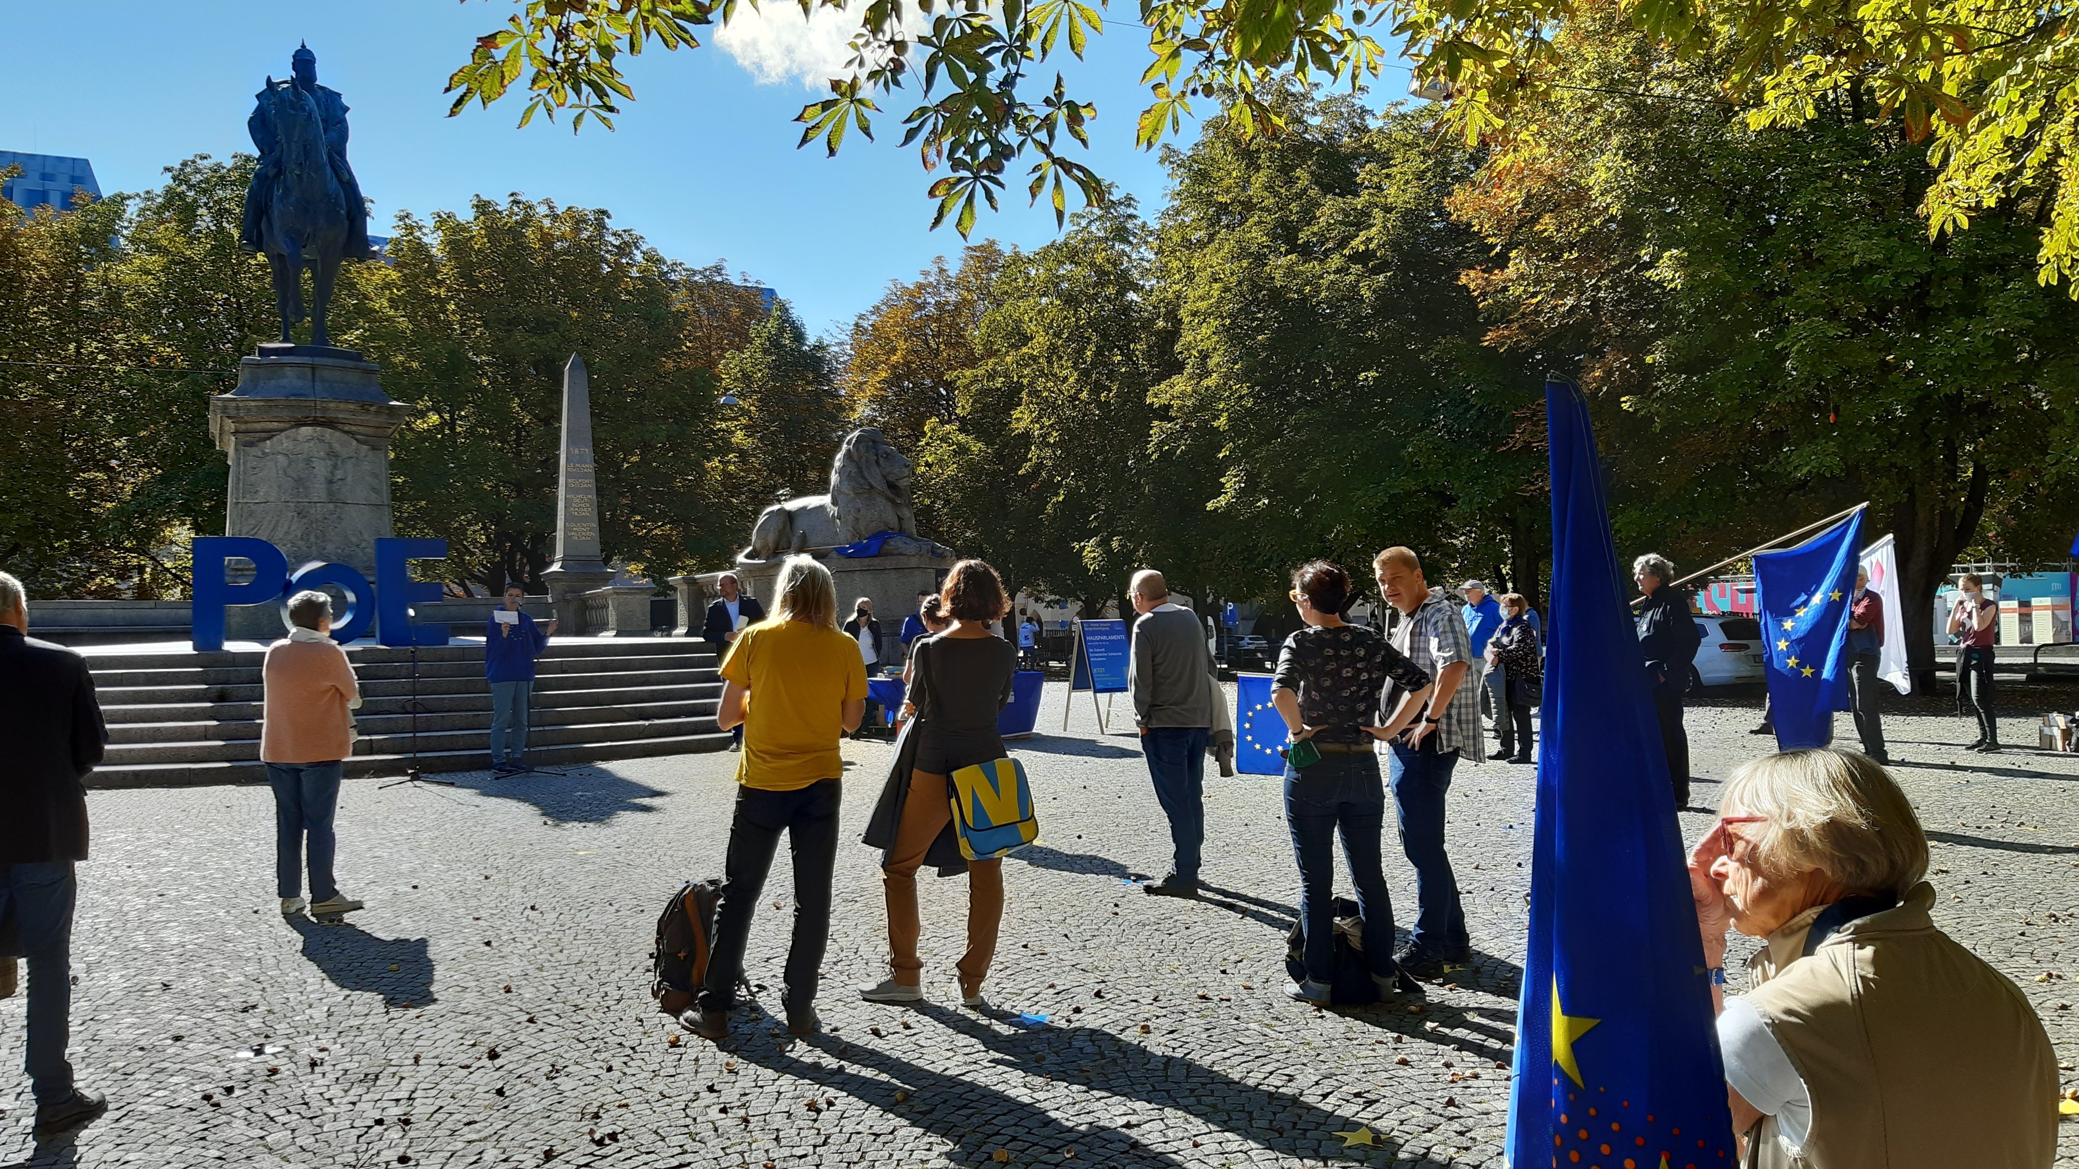
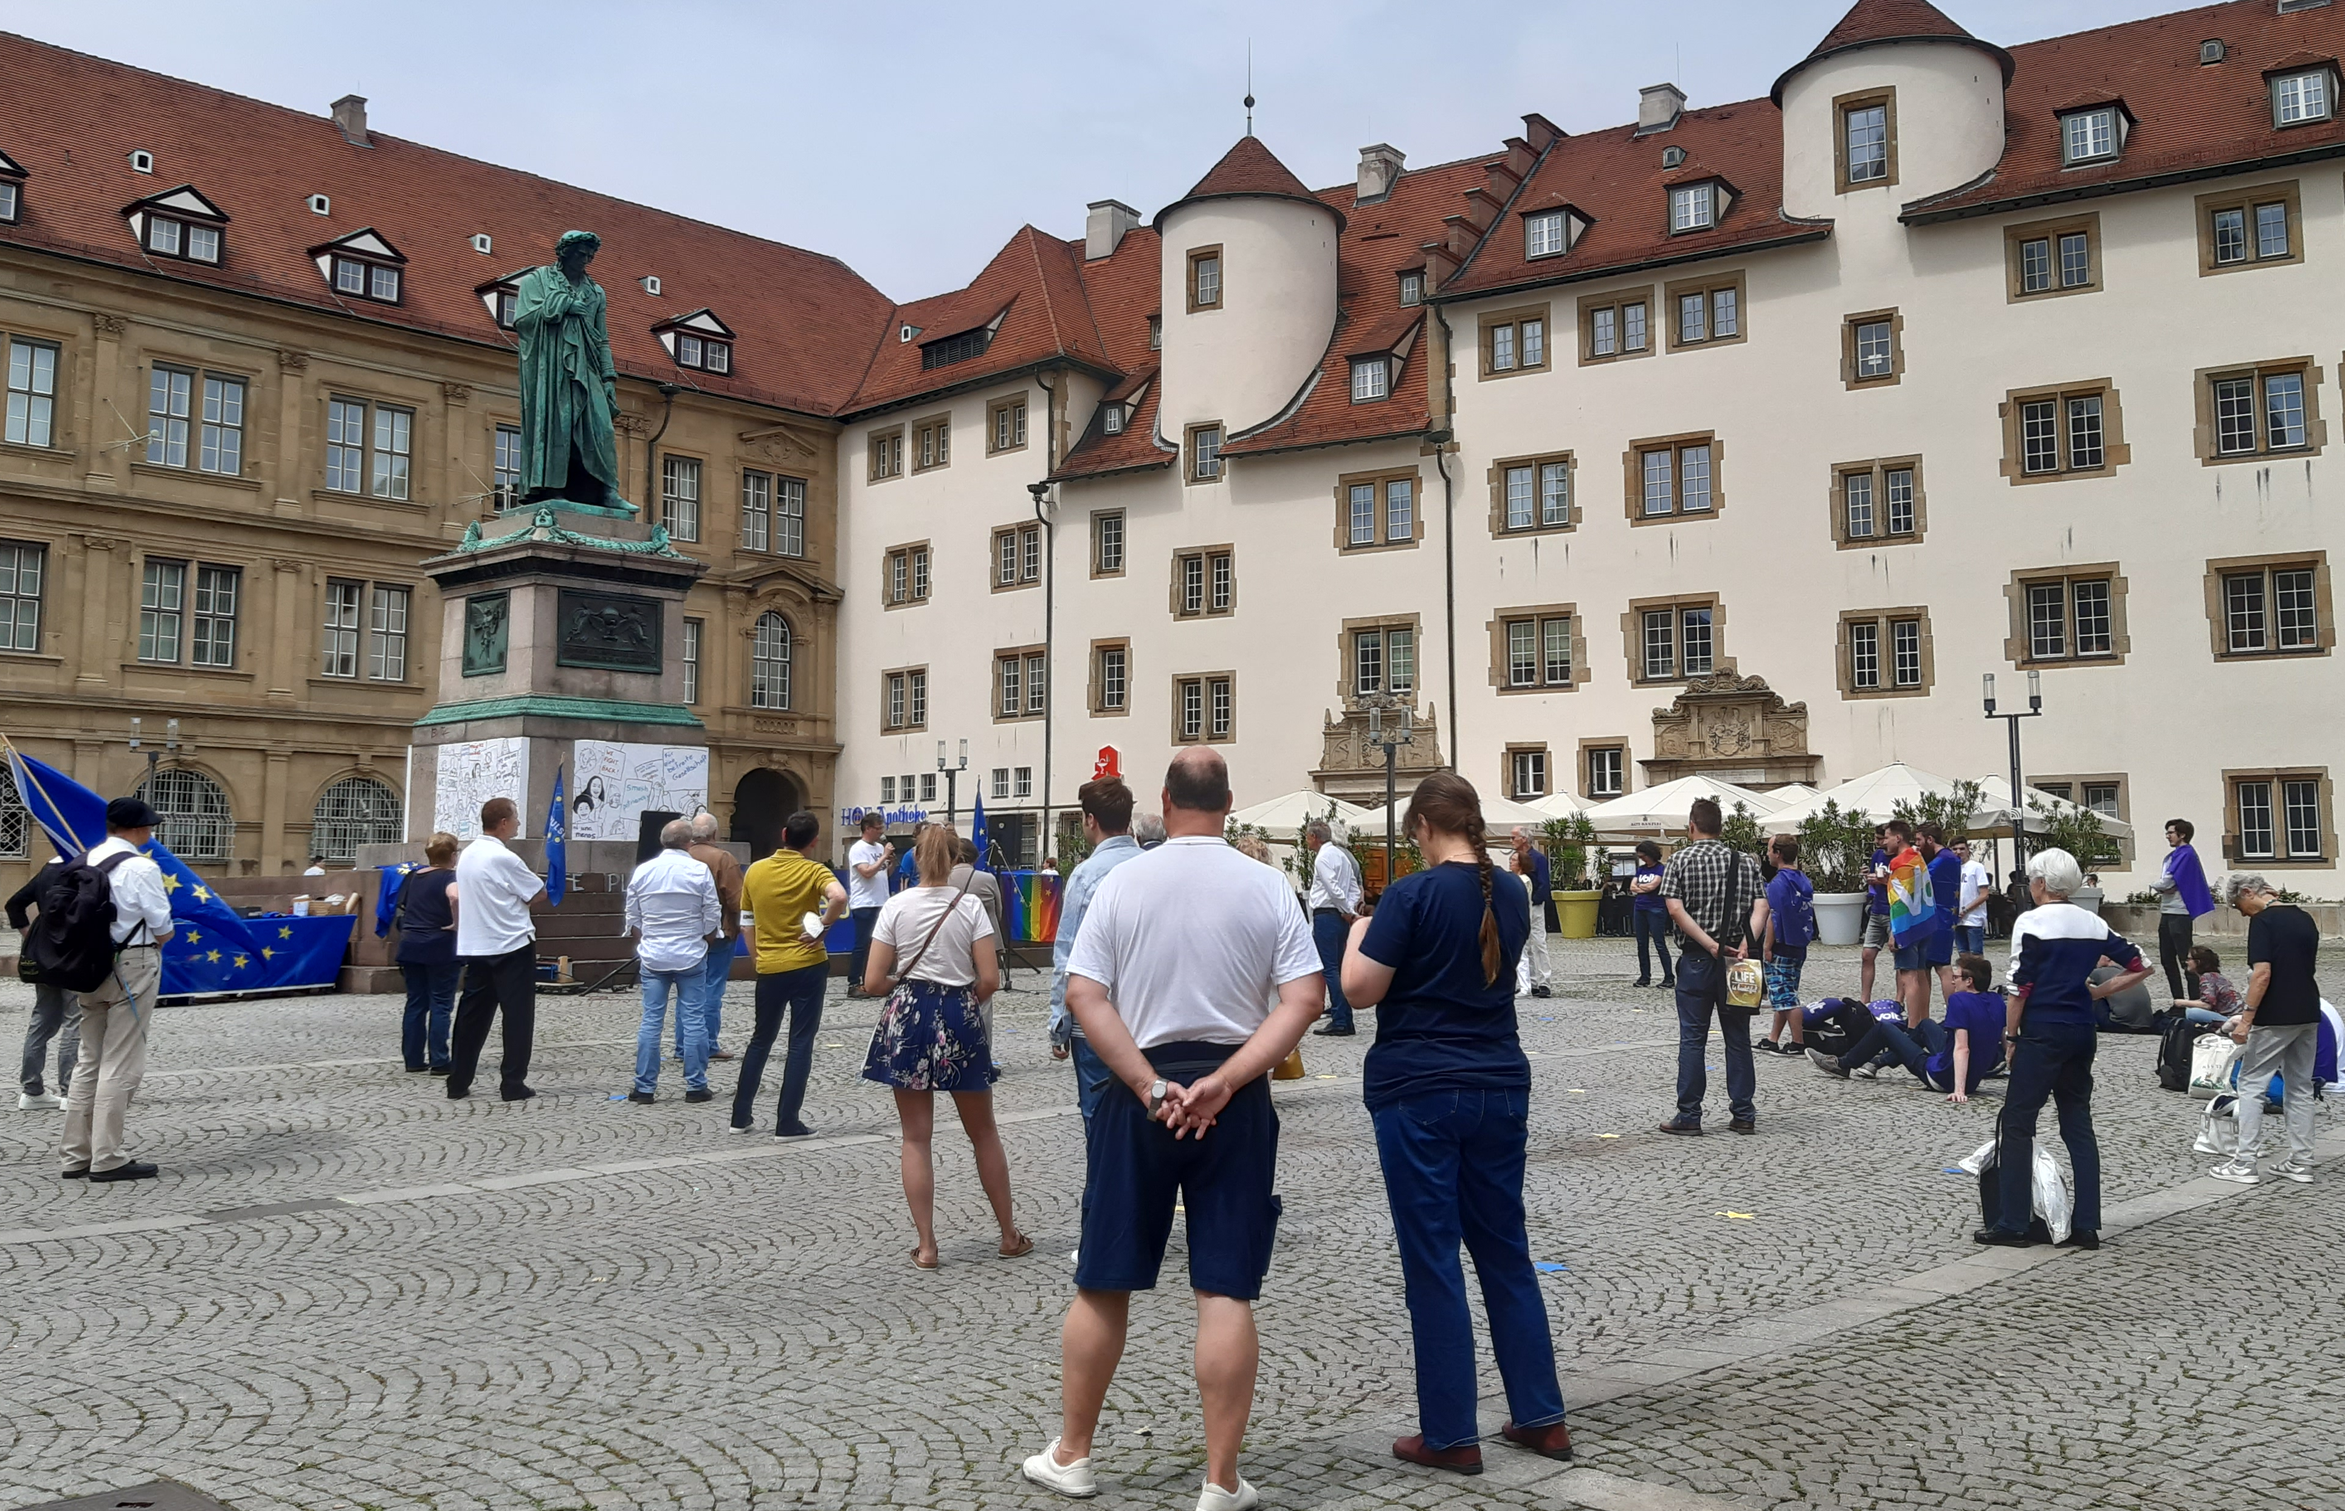
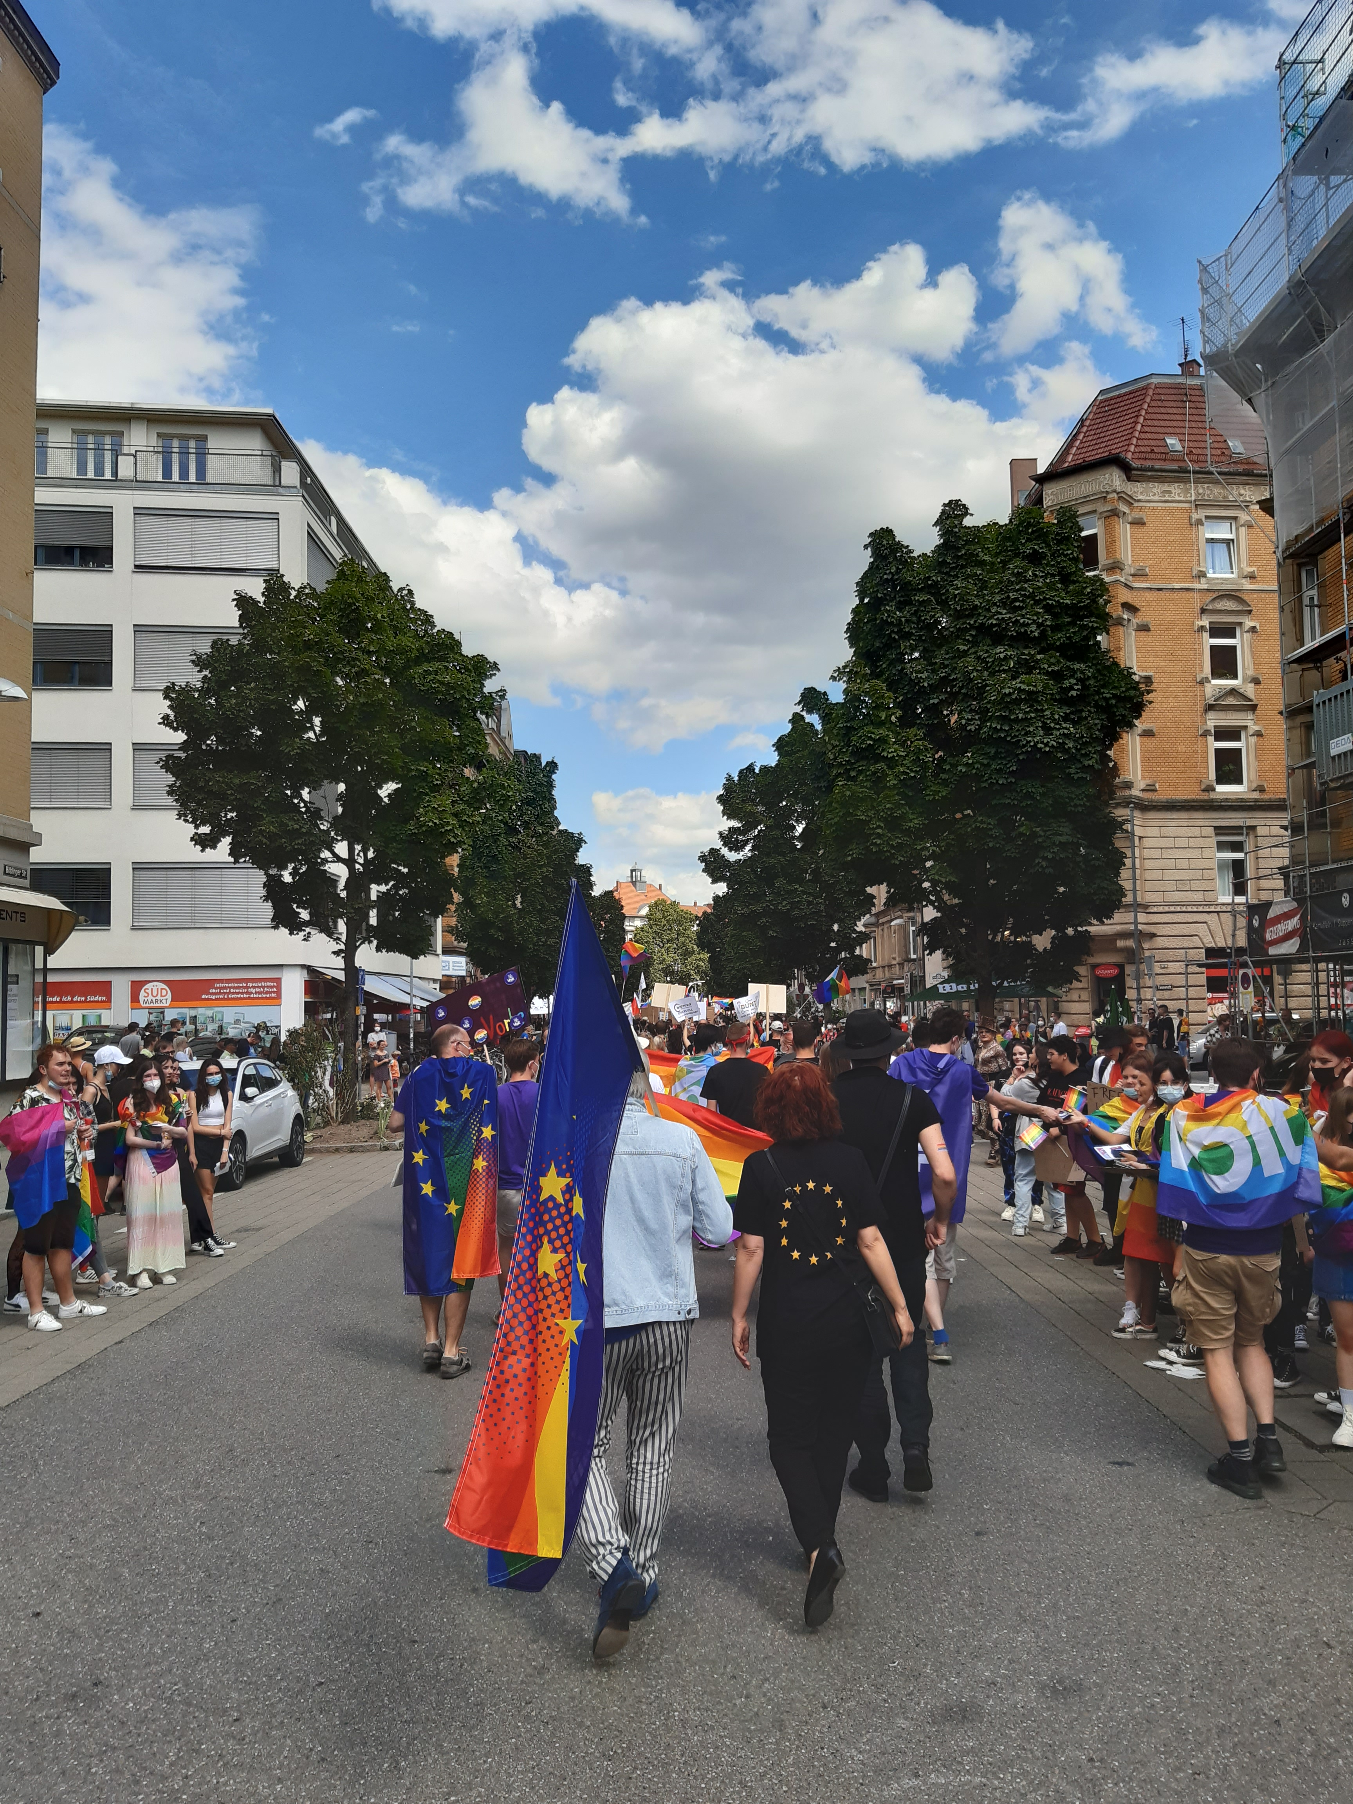
Standing for Europe: Case Study PoE-Stuttgart
J. Mariscal Vega - MA Social and Cultural Anthropology 2022 - mariscal.vg@gmail.com
PoE-Stuttgart
Master Thesis
Articulating Europe
  The local chapter of Pulse of Europe (PoE) is made up of a dozen members who, active since February 2017, carry out public rallies that take place every first Sunday of the month, in addition to other related activities, with the aim of promoting and giving visibility to the importance of stand for a united Europe.
  Understanding identity as an identification process that is never finished nor fixed, the research takes a discursive approach to explore How ‘Europe’ is articulated in the lives of PoE members? What discourses and practices sustain a meaningful idea of Europe in their lives? Giving relevance to 'Europe' as an object of anthropological inquiry capable of generating identification processes among the European population.
  An anthropological insight that pays attention to the link between the micro-level of everyday life and the macro-level of large political processes. Emphasizing that the shaping of Europe is also taking place from below and that, therefore, this is a perspective to consider in the debates on European identity and its socio-political consequences in the context of European integration led by the EU.
  Practices of Being in Public: Making Europe and its supporters more visible for the public. Europe as the result of our public and political (in)action.
  Practices Across Borders: Significant experiences in life take place beyond national borders. Europe as a space that allows transcending the constraints of national boundaries.
  Discourses of Rights & Values: Freedom, democracy, rule of law, peace, diversity. Europe as a political space where rights and values can be protected and granted.
  Discourses of the Other: The main threat to a united Europe is nationalism-populism. Europe's other is defined by a civic-political distinction that distances from essentialist definitions.
Debating Europe
  National Winners: The social positioning of citizens is based on the guarantees of the national State. It is a successful national belonging what favors the emergence of identification with Europe.
  (Non)Elite Driven: The political and economic elites do not lead nor seem to sufficiently defend a united Europe. Their visions about Europe are ahead of the elites.
  New Cleavage: Emerging political distinctions give relevance to a cultural cleavage along open and closed formations.
Fieldwork
  After the first immersion between Jul-Sep 2020, the fieldwork was interrupted by the coronavirus outbreak and was resumed for most of its execution during the second semester of the year 2021. Participant observation was carried out during six public rallies and one parade (CSD Stuttgart), and eleven interviews were conducted under non-structured and semi-structured formats.
©Photos by Mariscal 2021

