Slide 1





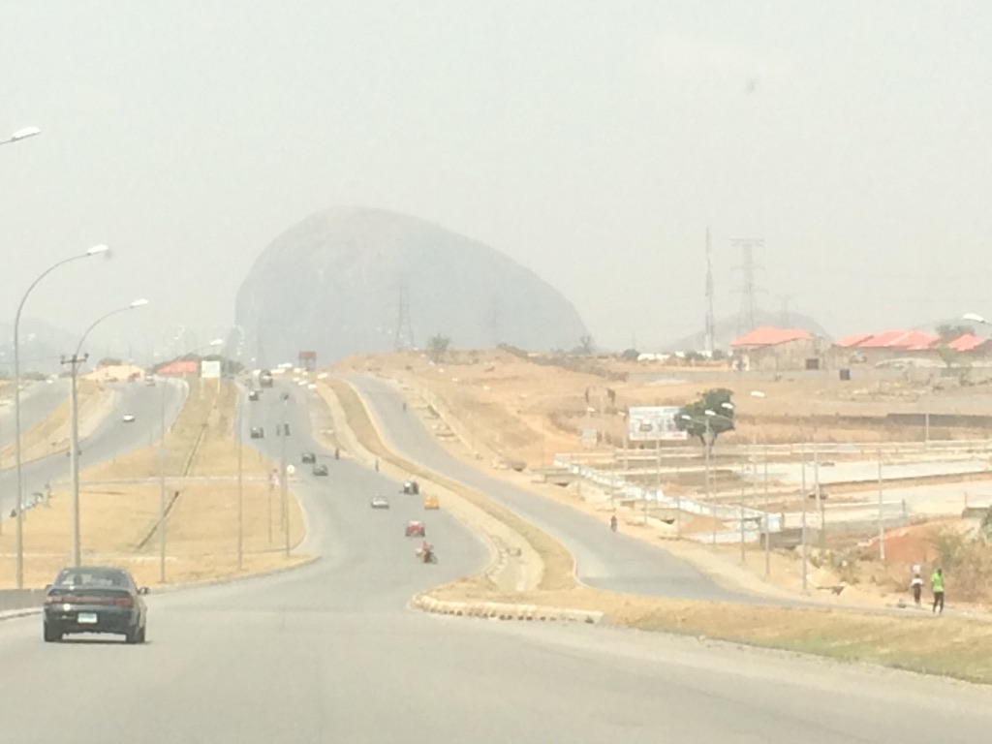
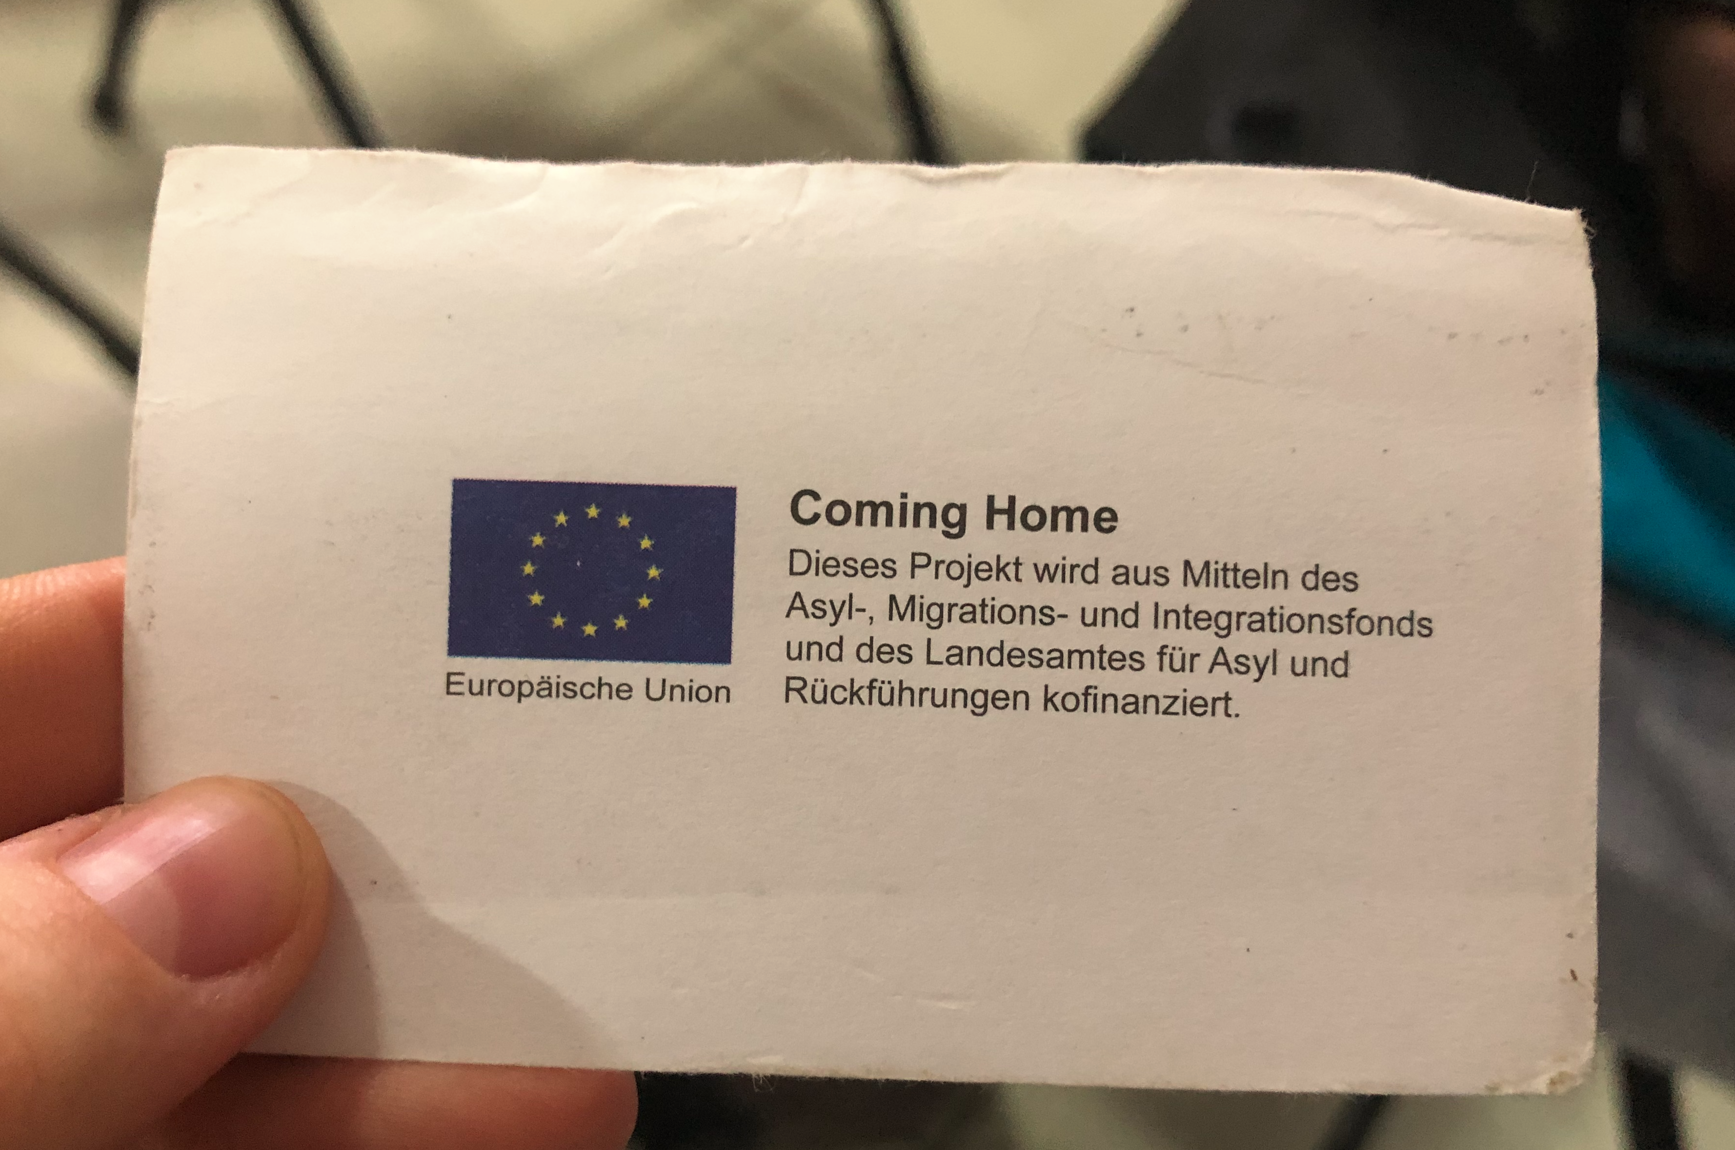





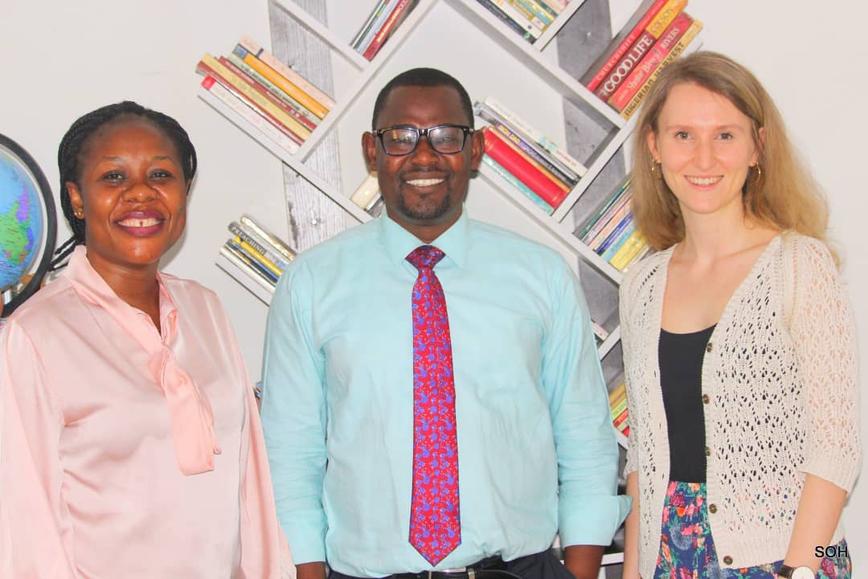



Returning Home? – A Case Study on Notions, Expectations and Sentiments of Returned Nigerian Migrants
Field Research in Nigeria from February – May 2022
Mobility Semester 2021/2022
Overview:
In migration research the question of where someone belongs to or where someone feels home has always been a topic of great relevance. It is very much linked to the question or idea of where migrants get their cultural identity from and how they become part of a new social environment. The hope for a better life is the motive for all people who want to migrate. This is usually due to a poor economic situation in the respective country of origin. In Nigeria, this attitude towards leaving one's country, with the belief of a better future outside of Nigeria has intensified over the years. The expectations of the migrant's social network play a significant role in this.
My fieldwork took place in Nigeria's capital Abuja and Benin City from February till May 2022. With the support of the Initiative Symbols of Hope and the GIZ I got in contact with returned migrants who travelled irregularly.
Methods:
The empirical methods used in this thesis are based on a qualitative research approach. Expert interviews, life history interviews, semi-structured interviews, focus group interviews, as well as participant observation are applied.
Business card from the Office for Return Assistance in Munich
Zuma Rock in Abuja, Nigeria
Research Question and Aim:
The research question and aim of this thesis was established with the realization that migration literature, mostly uses the term ‘home’ in the context of integration into the host country (Kück 2021; Jha & Singh 2022). Also, the traditional anthropological description of home as a firm socio-cultural place ”of social relations and cultural routines localized in time and space” (Rapport & Dawson 1998: 4) has become inadequate with regard to a “world of movement” (ebd.) in a geographical but also mental and emotional understanding.
The research aim of my thesis is, to find out the meaning and conception of home for returned Nigerian migrants and its impact on their reintegration perception.
Research Findings:
Home is perceived differently by returnees, depending on their social, cultural and economic capital.
Important factors which constitute a home can be family/friends, the belief/places of worship, institutions like IOM. Home is mostly where returnees feel accepted.
Home is for many not necessarily bound to a place.
First meeting with Rev. Emmanuel and Vivien (at Symbols of Hope Initiative Office)
Sources:
Kück, S. (2021) ’Frontmatter‘ in: Kück, S. (Eds.), Heimat und Migration. Bielefeld: transcript Verlag, pp.1-4.
Rapport N. and Dawson A. (1998) ‘Migrants of Identity. Perceptions of Home in a World of Movement’, American Ethnologist, 28(2): pp. 501-502.
Photo credit: Images from fieldwork by researcher
Julia Kirchner
MA Social and Cultural Anthropology
julia.kirchner@student.uni-tuebingen.de

