Slide 1

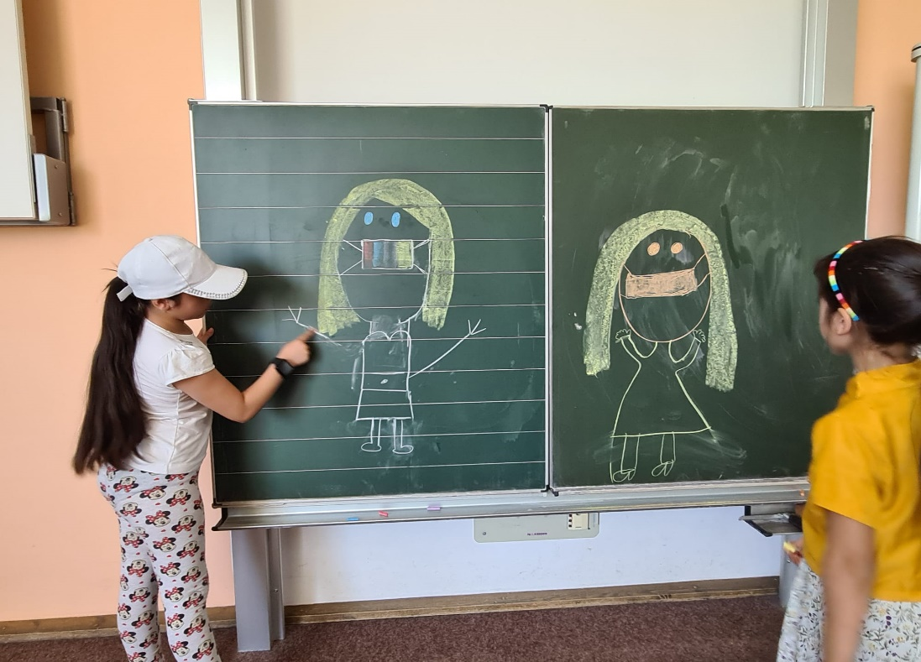
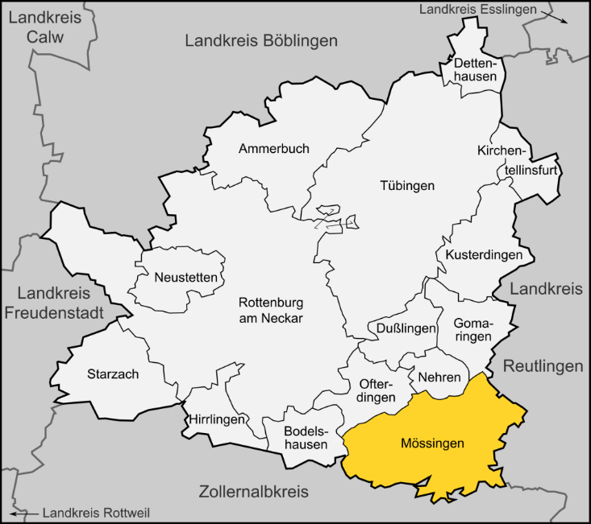
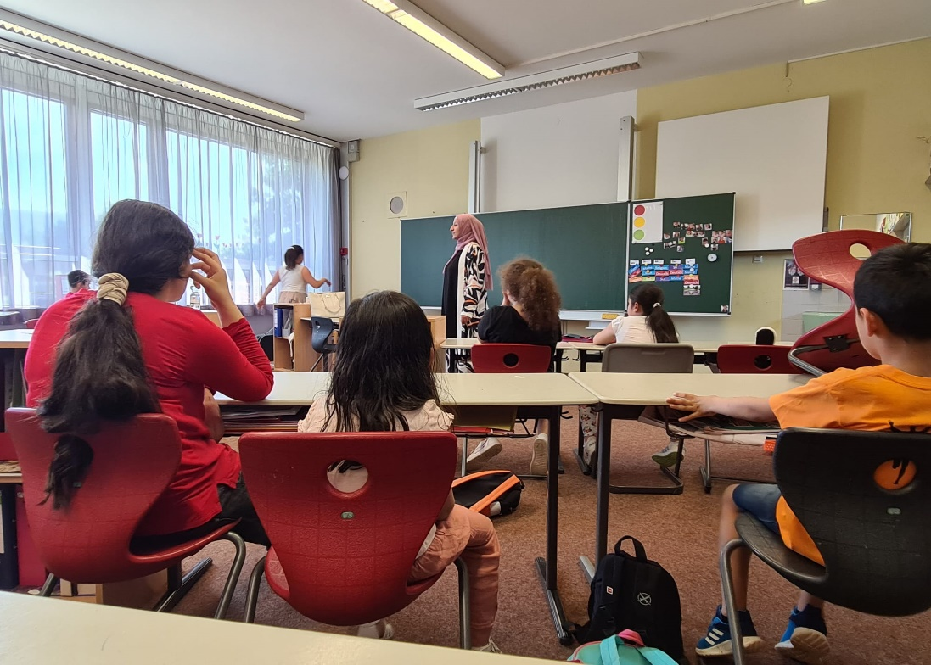
Education In The Time of Covid-19: Learning Beyond Schooling
Cultivation and Leveraging of Social and Cultural Capital During the Pandemic by Refugee Families in South Germany
Mobility Semester 2021/2022
Shobha Rana Grover
shobhagrover123@gmail.com
    The COVID-19 pandemic and related protective regulations have impacted lives globally, and school education is one area that has borne a severe brunt. The lockdowns in 2020 led to the closure of daycares and primary and secondary schools, affecting millions of students worldwide. The length of closures varied widely. Schools in Germany opened and closed as the infections ebbed or advanced, and learning became a hybrid of in-person and remote arrangements. This study explores the educational consequences of the pandemic-related safety measures for the school-aged children who are in Germany following civil strife and war in their home countries. According to UNHCR’s flagship report, Global Trends, 82.4 million people were forcibly displaced globally at the end of 2020, and the number of refugees in the same year reached 26.4 million, and at least half were minors. I have tried to record the experiences of families identifying as refugees about the education and learning of their minor children living in the city of Mössingen in the southern state of Baden-Württemberg. The six-month-long fieldwork addresses the two-fold issue of parental aspirations for their children’s educational achievements and the structural problems plaguing the German school education system. This study also focuses on the ways these families leverage their social and cultural capital to navigate the challenges posed by the pandemic and related regulations.
    This research focuses on Muttersprachliche Schule Mössingen – a project aimed at strengthening multilingualism among migrants. The brainchild of city administration and supported by the Baden-Württemberg Stiftung, this native language training school began in September 2021 and currently offers oral, reading, and writing lessons in Albanian, Arabic and Persian.The teachers are native speakers of these languages, and classes are held weekly at a primary school in the heart of the city. The school offers children a space to interact with each other in their native language and gives their parents a chance to network with families sharing similar linguistic and cultural backgrounds. I explore this school as a site for the generation of social and cultural capital for its students and their families.
OVERVIEW
MUTTERSPRACHLICHE SCHULE
Two eight-year-old girls drawing on the blackboard depicting their first day of regular school. Both of them started their school life wearing face masks (Source: Self-clicked)
    Duration of fieldwork: October 2021 – April 2022
    Case study - Muttersprachliche Schule Mössingen
    Group discussion and interviews - Children at the Muttersprachliche Schule
    Participant observation - Syrian and Afghani Families, narrative life-history interviews
    Formal, semi-structured interviews - Integration official and volunteers
    Number of participants- 24 children (age range 6 to 15 years) and 13 adults
RESEARCH METHOD
This study prioritizes children’s perspectives on education, learning, and overall life in the pandemic, records their stories and ideas and addresses the oft-evoked binary of victimhood and agency associated with children in anthropological research. It explores the impact of their social and cultural capital in the generation and assertion of their agency during the pandemic-related restrictions. By situating these young people at the epicenter of research, I have attempted to address the issue of what scholars term the “invisibility of children” in anthropology.
AIM
Location of the town of Mössingen in the district of Tübingen (Source: Wikipedia)
    Donnelly, R., Patrinos, H. A., & Greshan, J. (2021, April 02). The Impact of COVID-19 on Education – Recommendations and Opportunities for Ukraine. The World Bank. https://www.worldbank.org/en/news/opinion/2021/04/02/the-impact-of-covid-19-on-education-recommendations-and-opportunities-for-ukraine
    Hirschfeld, L. (2002). Why Don’t Anthropologists Like Children? American Anthropologist, 104(2), 611-627.
    La Fontaine, J. S. (1998). Are Children People? In: La Fontaine, JS, Rydstrom, H. (Eds). The Invisibility of Children: An International Conference on Anthropology and Children. University of Linköping, Sweden.
    Lancy, D. F. (2012). Why Anthropology of Childhood? A short history of an emerging discipline. AnthropoChildren. (French Studies in the Anthropology of Childhood) Vol. 1
    United Nations High Commissioner for Refugees. (2020). Global Trends: Forced Displacement in 2020. https://www.unhcr.org/flagship-reports/globaltrends/
Learning acquired a non-linear and multidimensional form during the pandemic.
Family values constituted powerful cultural capital.
Religion and native language constituted both social and cultural capital helping families form support networks and navigate circumstances related to the pandemic.
Families recounted experience of fleeing from strife-torn homelands and challenges faced during initial years in Germany and compared it with the uncertainty and chaos associated with the pandemic.
REFERENCES
OBSERVATIONS
Children learning Arabic at the Muttersprachliche Schule Mössingen (Source: Self-clicked)

