Slide 1
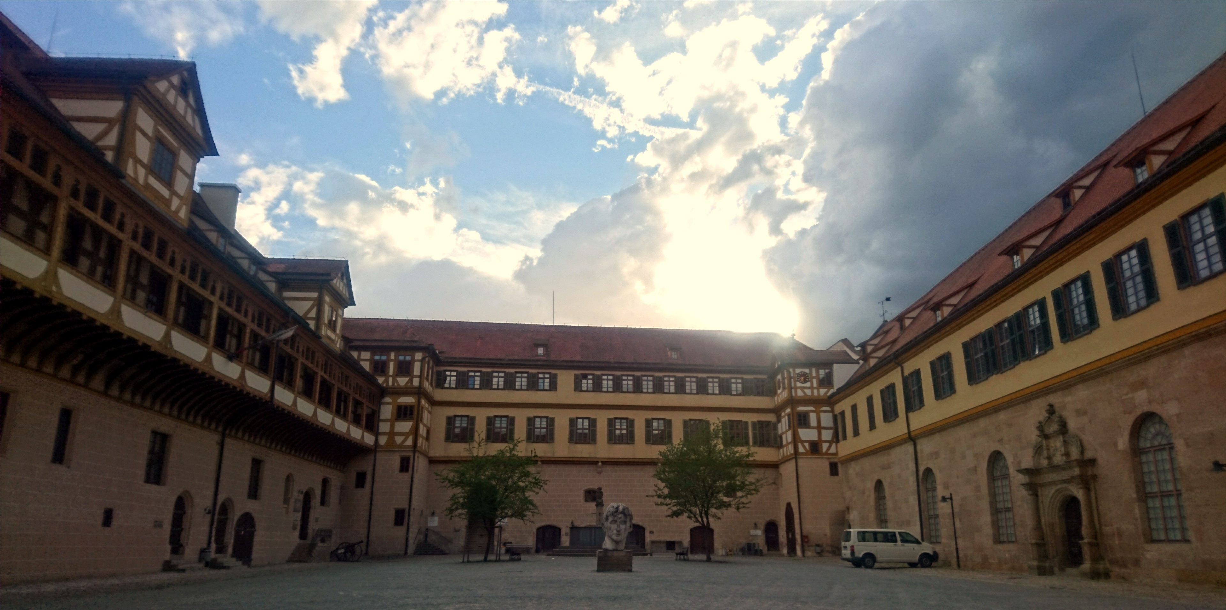

Welcome to the Library of the Department of Social and Cultural Anthropology at the Asien-Orient-Institut
Introduction

Slide 2

What is this presentation about?
Resources of the Library of the Department of Social and Cultural
How to do literary research?
Where do I find specific research area related books?
How do I borrow books?
Opening hours and current hygiene concept

Slide 3
Inventory the Library of the Department of Social and Cultural
Departmental Libraries of the AOI: Indology and Comparative Religion, Japanese Studies, Oriental and Islamic Studies, Sinology and Korean Studies
20,000 monographs and 20 current journals, as well as a larger collection of offprints
General systemic areas, reference works, bibliographies and introductory texts
Regional literature, ordered by geographical regions and countries, especially Central Asia and the Mediterranean region, but also Africa, Asia, North and South America and East Asia
Journals and series

Slide 4
How to do literary research?
The the resource of the central university library and all university libraries are completely listed in the online catalog of the University of Tübingen:
https://tue.ibs-bw.de/aDISWeb/app?service=direct/0/Home/$DirectLink&sp=SOPAC02
  https://www.ub.uni-tuebingen.de/

Slide 5
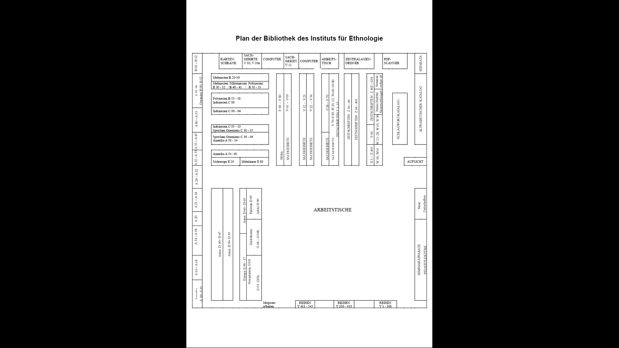
Plan of the Library

Slide 6
How to rent?
Opening Hours of the Library
Extending your rental time for books
Information: User pass and fees

Slide 7
If you have any questions, you can contact:
general queries:
manuela.uysal@ub.uni-tuebingen.de
borrowing:
bibliothek@ethno.uni-tuebingen.de

