Slide 1
Privacy in Public Places and Counter-Terrorism Investigations
John Guelke
guelkej@adf.bham.ac.uk

Slide 2
A Puzzle
When we say that someone is entitled to privacy in S1, this usually indicates:
  Any observation of the person in S1 will be intrusive.
  Any sharing of information about the person acquired while they are in S1 will be intrusive.
Example somebody in their home, or sleeping in a hotel room.

Slide 3
The puzzle: neither of these principles seem to hold when a person is in public, yet a number of techniques for surveilling people in public are objected to as deeply intrusive.

Slide 4
[ICO Report on the Surveillance Society] Dr David Murakami-Wood told BBC News that, compared to other industrialised Western states, the UK was "the most surveilled country...We have more CCTV cameras and we have looser laws on privacy and data protection," he said.” http://news.bbc.co.uk/2/hi/uk_news/6108496.stm
[House of Lords constitution committee report]: growth in surveillance by both the state and the private sector risked threatening people's right to privacy, which it said was "an essential pre-requisite to the exercise of individual freedom"... Among areas of most concern were the growth of CCTV cameras, of which there are now an estimated four million in the UK. http://news.bbc.co.uk/2/hi/7872425.stm

Slide 5
Three examples:
  CCTV
  Automatic Number Plate Recognition
  Surveillance in places of worship

Slide 6
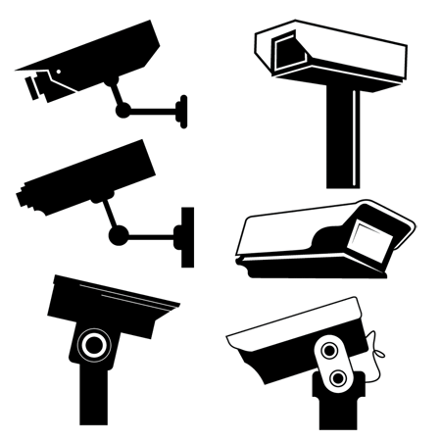
CCTV

Slide 7
Developments in technology and media have been argued threaten privacy before:
“Recent inventions and business methods call attention to the next step which must be taken for the protection of the person, and for securing to the individual what Judge Cooley calls the right "to be let alone“. Instantaneous photographs and newspaper enterprise have invaded the sacred precincts of private and domestic life; and numerous mechanical devices threaten to make good the prediction that "what is whispered in the closet shall be proclaimed from the house-tops." For years there has been a feeling that the law must afford some remedy for the unauthorized circulation of portraits of private persons; and the evil of invasion of privacy by the newspapers, long keenly felt, has been but recently discussed by an able writer.”
(Warren and Brandeis, 1890)

Slide 8
“The life of Mrs Aremac. Mrs Aremac is an old lady living in her third-floor apartment in the centre of town. Due to her age, her legs no longer allow her to take part in public life. Luckily, her sight is still intact. Every morning Mrs Aremac is assisted to an armchair placed in the bay window looking out onto the street. From there she has a good view of street life, compensating a little for a life she is no longer able to participate in. In the evening she is assisted to bed, after a day made more bearable than if she had remained in bed... The question the example gives rise to is: does Mrs Aremac in any way act wrongly in her daily life?”
(Ryberg, 2007)

Slide 9
“Recent inventions and business methods call attention to the next step which must be taken for the protection of the person, and for securing to the individual what Judge Cooley calls the right "to be let alone“. Instantaneous photographs and newspaper enterprise have invaded the sacred precincts of private and domestic life; and numerous mechanical devices threaten to make good the prediction that "what is whispered in the closet shall be proclaimed from the house-tops." For years there has been a feeling that the law must afford some remedy for the unauthorized circulation of portraits of private persons; and the evil of invasion of privacy by the newspapers, long keenly felt, has been but recently discussed by an able writer.”
(Warren and Brandeis, 1890)

Slide 10
The Right to be Left Alone
“Consider, for example, the familiar proposal that the right to privacy is the right "to be let alone." On the one hand, this doesn't seem to take in enough. The police might say, "We grant we used a special X-ray device on Smith, so as to be able to watch him through the walls of his house; we grant we trained an amplifying device on him so as to be able to hear everything he said; but we let him strictly alone: we didn‘t touch him, we didn't even go near him-our devices operate at a distance.” Anyone who believes there is a right to privacy would presumably believe that it has been violated in Smith's case; yet he would be hard put to explain precisely how, if the right to privacy is the right to be let alone. And on the other hand, this account of the right to privacy lets in far too much. If I hit Jones on the head with a brick I have not let him alone. Yet, while hitting Jones on the head with a brick is surely violating some right of Jones', doing it should surely not turn out to violate his right to privacy.”
(Judith Jarvis Thomson, 1975)

Slide 11
Thomson is right that the right to be left alone cannot be the same as the right to privacy.
Is Thomson right that watching someone from afar leaves them alone?

Slide 12
Not all watching does leave a person alone. Mrs. Aremac leaves the people she watches alone, but the stalker, even if they do nothing but watch, does disrupt a person’s life.

Slide 13
These days we accept as routine, photographs taken of people in public without their permission – often feature on the cover of newspapers to illustrate a story.
But we wouldn’t accept publishing photographs that humiliate a person.

Slide 14
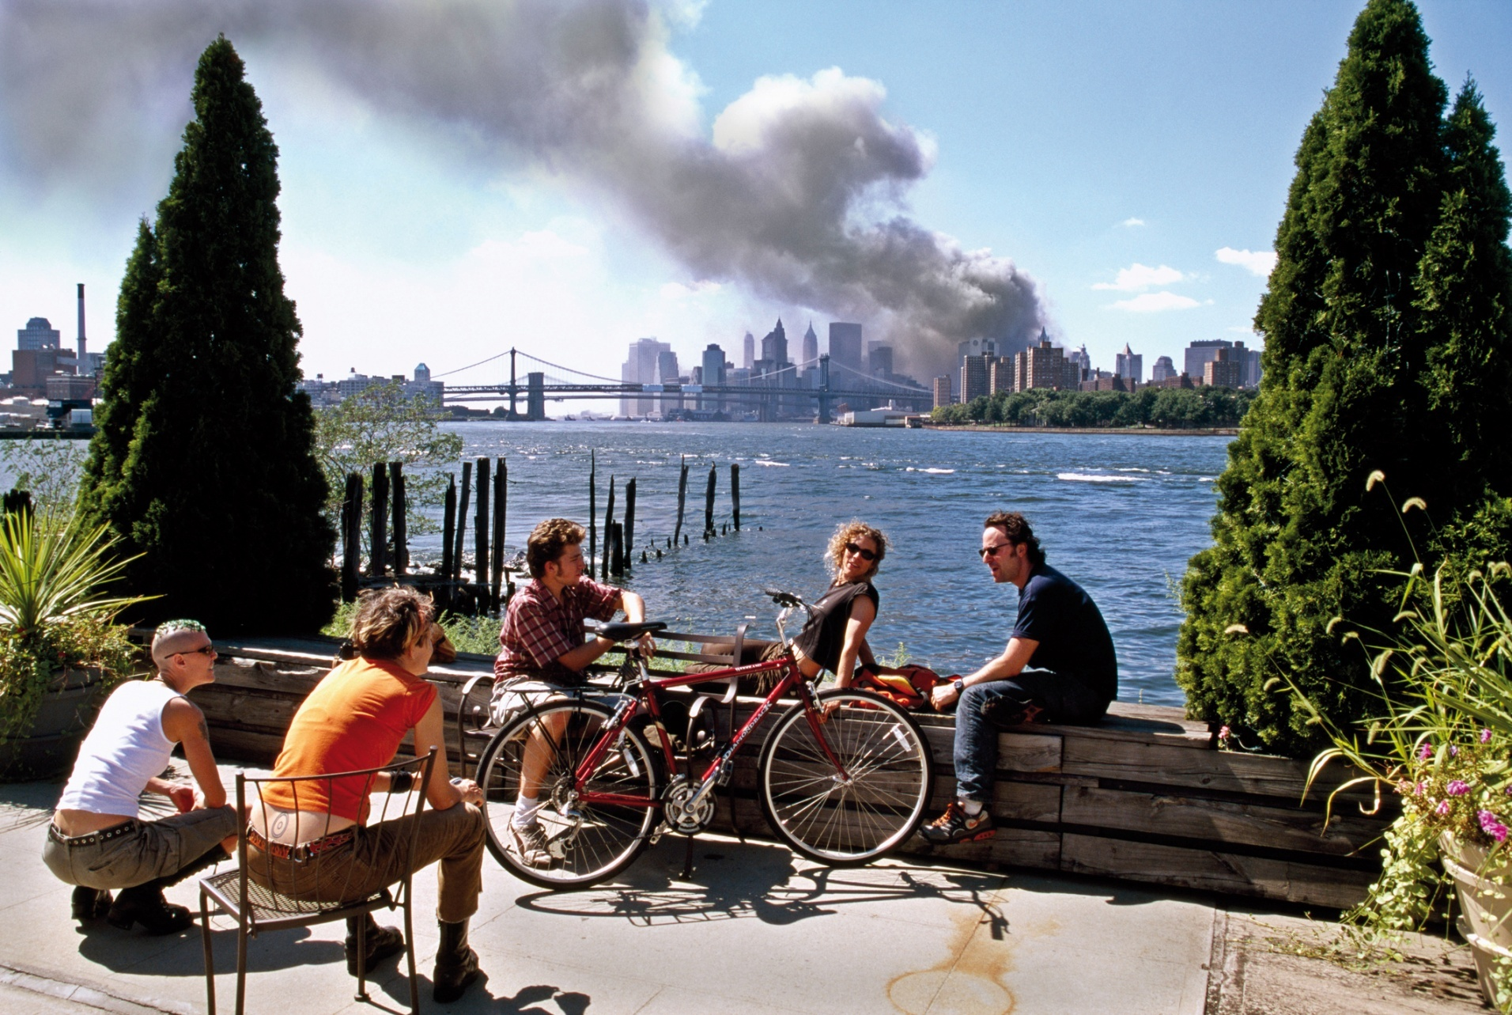

Slide 15
Hoepker did not publish it at the time, but rather waited a number of years.
The people photographed are unhappy about its publication, complaining that it misrepresents them.

Slide 16
There are many, many instances of people being ‘punished’ for bad behaviour in public space completely getting out of hand.
What is wrong with these cases is you are not letting people alone.

Slide 17
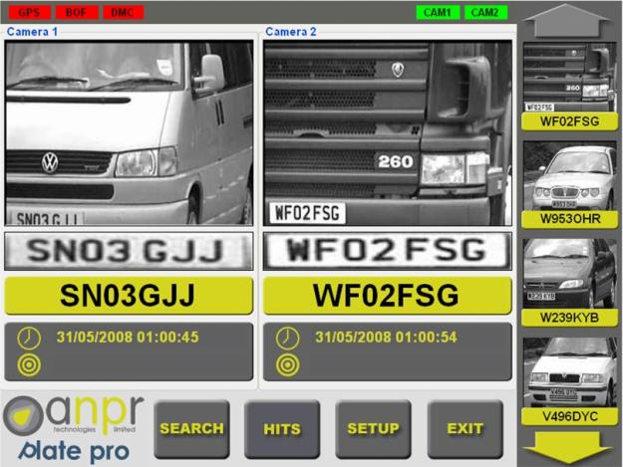
ANPR

Slide 18
If this is a threat to privacy, why aren’t number plates?
There is an analogy to be made with identity cards, though number plates are arguably worse.
We accept that we have little right to anonymity on the road.

Slide 19
A privacy issue or a data protection issue? Case of DVLA selling user data to Castrol.
Police databases of suspicion. Is this a privacy issue, or one of potential error and miscarriage of justice?

Slide 20
Locational privacy: might be an issue if successfully used to track somebody’s movements.
Again, the issue is not watching, but stalking.
How fine grained?

Slide 21
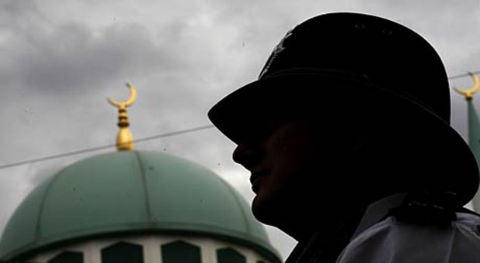
Places of Worship

Slide 22
In the context of current terrorism concerns, attention is likely to be focussed on Mosques, but the issue has come up in relation to certain communities in Northern Ireland.

Slide 23
Surveillance could involve deception, if moles are sent into these communities. If bugs, or bugging of mobile receivers is used.
What I’m concerned with: cases not involving the use of technology, where there is no deceptive statement about who one is or why one is there. Is this intrusive?

Slide 24
My view: not intrusive.
Nevertheless still has a moral cost, and may be highly inadvisable for counter-terrorism strategy.

Slide 25
Privacy in Public Space?
There are a series of restrictions on observations of people in public space. Collectively these share some features of privacy rights, but we do not have to concede the existence of a general ‘right to privacy’ in public to account for this.

Slide 26
Why Does it Matter?
There is suspicion about much of the talk of the importance of privacy.
The attitude arises in relation to counter-terrorism debates where privacy concerns are often considered frivolous next to public safety.
Also arises more generally in relation to warnings against exhibitionism. Overblown rhetoric about privacy risks both cynicism and defeatism.

Slide 27
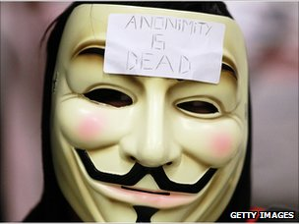

Who’s the bigger threat to privacy? Old Mrs. Aremac or the cynicism and defeatism of young Mr. Koobecaf?

