Slide 1
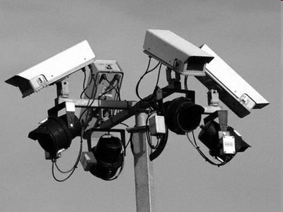
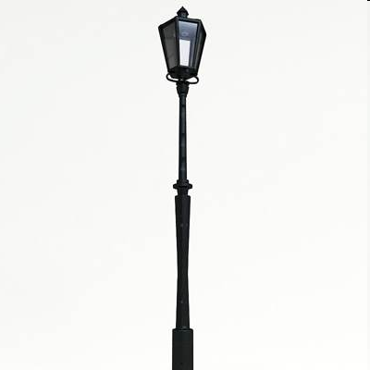
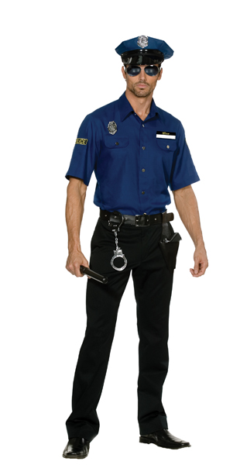
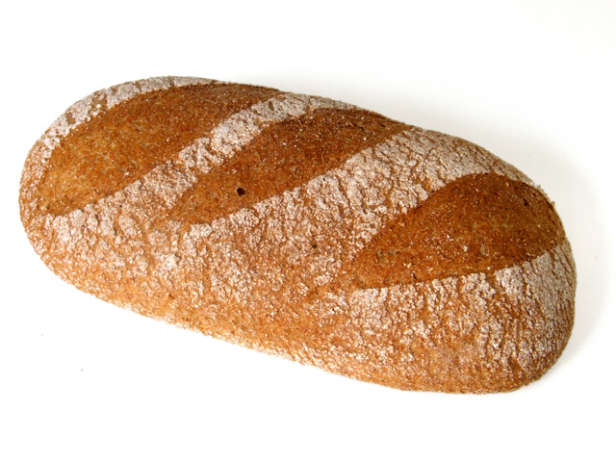
Revisiting Spheres of Justice
“Security” as a social good

Slide 2
WHY REVISTING
SPHERES OF JUSTICE?
Part One
2 | Security, Ethics, and Justice – M. Nagenborg: Revisiting Spheres of Justice © 2012 Universität Tübingen

Slide 3
Privacy as contextual integrity
Nissenbaum (2009)
  Nissenbaum (2004)
  Van den Hoven (1999)
3 | Security, Ethics, and Justice – M. Nagenborg: Revisiting Spheres of Justice © 2012 Universität Tübingen

Slide 4
Office
Hard Work
Kinship and Love
Free Time
Divine Grace
Security and Welfare
Political Power

Slide 5
Office
Hard Work
Kinship and Love
Free Time
Divine Grace
Security and Welfare
Political Power

Slide 6
Kinship and Love
Office
Hard Work
Free Time
Security and Welfare
Divine Grace
Political Power

Slide 7
Office
Hard Work
Kinship and Love
Free Time
Divine Grace
Security and Welfare
Political Power

Slide 8
Office
Healthcare
Education
Free Time
Hard Work
Security
Market

Slide 9
Office
Healthcare
Education
Free Time
Hard Work
Security
Market

Slide 10
Office
Healthcare
Education
Free Time
Hard Work
Security
Market

Slide 11
Office
Healthcare
Education
Free Time
Hard Work
Security
Market

Slide 12
Office
Healthcare
Education
Free Time
Hard Work
Security
Market

Slide 13
Office
Healthcare
Education
Free Time
Hard Work
Security
Market

Slide 14
Office
Healthcare
Education
Free Time
Hard Work
Security
Market

Slide 15
Office
Healthcare
Education
Free Time
Hard Work
Security
Market

Slide 16
Revisiting spheres of justice
Part Two

Slide 17
Basic ideas (I): social goods
„All the goods with which distributive justice is
concerned are social goods.“
(Walzer 1983, p. 7)

Slide 18
Basic ideas (I): social goods
„Goods don‘t just appear in the hands of distributive agents who do with them as they like or give them out in accordance with some general principle. Rather, goods … come into people‘s minds before they come into their hands; distributions are patterned in accordance with shared conceptions of what the goods are and what they are for.“ (Walzer 1983, p. 6-7)
18 | Security, Ethics, and Justice – M. Nagenborg: Revisiting Spheres of Justice © 2012 Universität Tübingen

Slide 19
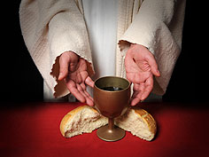
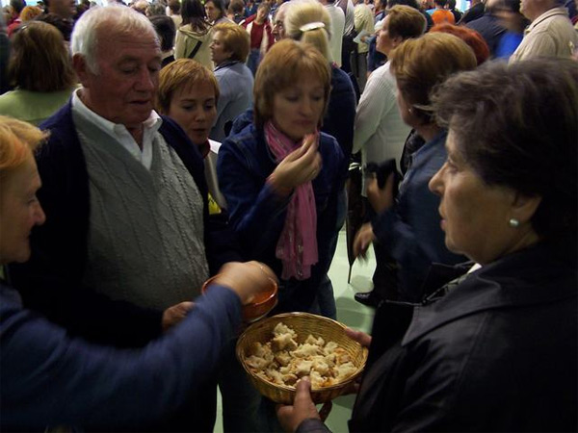
The meaning of „bread“
„Bread“ as commodity
  market / free exchange
„Bread“ as basic food
  welfare / need
„Bread“ as „God‘s flesh“
  religion

Slide 20
Basic ideas (I): social goods
„Goods“ don‘t have an universal meaning.
The meaning of a specific good is based on the „shared conceptions“ (Walzer), the way the good is being used and distributed within a given community.
20 | Security, Ethics, and Justice – M. Nagenborg: Revisiting Spheres of Justice © 2012 Universität Tübingen
Notes:
20

Slide 21
Basic ideas (I): social goods
„Goods“ don‘t have an universal meaning.
The meaning of a specific good is based on the „shared conceptions“ (Walzer), the way the good is being used and distributed within a given community.
21 | Security, Ethics, and Justice – M. Nagenborg: Revisiting Spheres of Justice © 2012 Universität Tübingen
Notes:
21

Slide 22
Basic ideas (II): complex equality
Walzer (1994, p. 26) „Distributive justice is relative to social meanings.“
Walzer (1983, p. 10): „When meanings are distinct, distribution must be autonomous. Every social good or set of goods constitute … a distributive sphere within which only certain criteria and arrangements are approbiate.“

Slide 23
Basic ideas (II): complex equality
Walzer (1983, p. 20): „No social good x should be distributed to men and women who possess some other good y merely because they posses y and without regard to the meaning of x.“
Also: No social good x should not be distributed to men and women who don‘t possess some other good y merely because they don‘t possess y and without regard to the meaning of x.
  „Cumulative disadvantages“
Walzer (1983, p. 146): „We don‘t rule out men and women with red hair or bad taste in movies or a passion for ice-skating.“
Notes:
When discussion the just distribution of „offices“ Walzer points out that „abilities that won‘t be used on the job, personal characteristics that won‘t affect the performance, and political affiliations and group identifications beyond citzenship itself“ should not be taken into account in the decission of who should have access to an office.

Slide 24
Scope and limitations
Miller (2007, xii): „Walzer‘s liberalism has little to say about rights, an idea that features so prominently in many rival versions.“
„Spheres of Justice“ as a theory of injustice (Shklar 1992)
While the idea of autonomous spheres of distribution does provide us with a criteria to recognize injustice, the analysis of the interplay between different spheres is not part of Walzer‘s theory of (in)justice.

Slide 25
SECURITY
AS A SOCIAL GOOD
Part Three

Slide 26
Distribution according to need
„Security“ and „welfare“ are to be distributed according to the principle of need: „From each according to his ability (or resources); to each according to his social recognized needs.“ (Walzer 1983, p. 91)
Distribution based on „social recognized needs“ should not affect the distribution of other social goods.

Slide 27
„Security“, „need“, and politics
„We could provide absolute security, eliminate every source of violence except domestic violence, if we put a street light and stationed a policeman every ten yards throughout the city. But that would be very expensive, and so we settle for something less. How much less can only be decided politically.“ (Walzer 1983, p. 67)
27 | Security, Ethics, and Justice – M. Nagenborg: Revisiting Spheres of Justice © 2012 Universität Tübingen
Notes:
Cf. Walzer (1981) where he also favours democratic decission making over political philosophers arguing in favour of universal rights.
27

Slide 28
„Security“, „need“, and politics
„We could provide absolute security, eliminate every source of violence except domestic violence, if we put a street light and stationed a policeman every ten yards throughout the city. But that would be very expensive, and so we settle for something less. How much less can only be decided politically.“ (Walzer 1983, p. 67)
28 | Security, Ethics, and Justice – M. Nagenborg: Revisiting Spheres of Justice © 2012 Universität Tübingen
Notes:
Cf. Walzer (1981) where he also favours democratic decission making over political philosophers arguing in favour of universal rights.
28

Slide 29
„Security“, „need“, and politics
„We could provide absolute security, eliminate every source of violence except domestic violence, if we put a street light and stationed a policeman every ten yards throughout the city. But that would be very expensive, and so we settle for something less. How much less can only be decided politically.“ (Walzer 1983, p. 67)
29 | Security, Ethics, and Justice – M. Nagenborg: Revisiting Spheres of Justice © 2012 Universität Tübingen
Notes:
Cf. Walzer (1981) where he also favours democratic decission making over political philosophers arguing in favour of universal rights.
29

Slide 30
„Security“, „need“, and politics
Walzer (1983): „Any philosophical effort to stipulate in detail the rights or the entitlement of individuals would radically constrain the scope of democratic decision making.“ (Cf. Walzer 1981)
Conflict between (inter-)national security regulations and local understanding of the need for security.
  Walzer (1983): „… security is provided because the citizens need it. And because, at some level, they all need it, the criterion of need remains a critical standard … .“
30 | Security, Ethics, and Justice – M. Nagenborg: Revisiting Spheres of Justice © 2012 Universität Tübingen
Notes:
Cf. Walzer (1981) where he also favours democratic decission making over political philosophers arguing in favour of universal rights.
30

Slide 31
The changing meaning of „security“
Reminder: The way a social good is being distributed shapes it‘s meaning.
How does the use of body scanners change the meaning of „security“?
  What does „security provided by body scanners“ mean to people, that might become visible and potentially marked as, e.g., persons with hidden disabilities?
  Will they have a word in the political decision making process about the way „security“ is being provided?

Slide 32
Summary and outlook
Final Part

Slide 33
Summary and Outlook
Security as social good is a least a useful metaphor.
  What is the underlying principle for the distribution of security?
  What is the meaning of security today?
But we should be aware of the scope and the limitations of such an approach.
  Theory of injustice, that says little about the interplay between different spheres.
Outlook
  Dirty work: Security personell
  Punishment: Preventive Detention

Slide 34
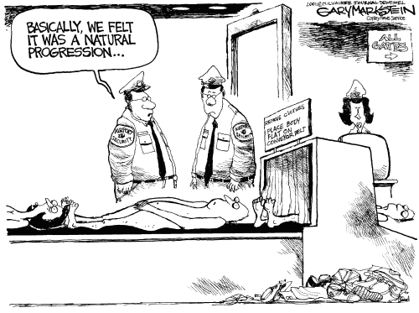
Thank you for your attention!
Correspondence address:
Dr. Michael Nagenborg
Wilhelmstr. 19, 72074 Tübingen, Germany
Fon: +49 7071 29-77516
Fax: +49 7071 29-5255
michael.nagenborg
@izew.uni-tuebingen.de

Slide 35
References
Miller, D. (2007): Introduction. In: M. Walzer: Thinking Politically. New Haven, pp. xii-xxi.
Minton, A. (2009): Ground control. London - New York.
Nissenbaum, H. (2009): Privacy in Context. Palo Alto.
Nissenbaum, H. (2004). Privacy as contextual integrity. Washington Law Review, 79, 119-158.
Rosa, H. (2006): Kommunitarismus. In: M. Düwell / C. Hübenthal / M. Werner (Eds.): Handbuch Ethik. 2nd Edition. Stuttgart, pp. 218–230.
Shklar, J. (1992): The Faces of Injustice. New Haven.

Slide 36
References
J. van den Hoven (1999): Privacy or Informational
Injustice? In: L. J. Pourciau (ed.): Ethics and Information in the Twenty-First Century. West Lafayette: Purdue University Press, pp. 140-150.
Walzer, M. (1990): The Communitarian Critique of Liberalism. In: Political Theory,18 (1), pp. 6–23.
Walzer, M. (1994): Thick and Thin. Notre Dame: University of Notre Dame Press.
Walzer, M. (1995): Response. In: D. Miller / M. Walzer (eds.): Pluralism, Justice, and Equality. Oxford, pp. 281-297.
Walzer, M. (1999): Vernunft, Politik und Leidenschaft. Frankfurt am Main: Fischer Taschenbuch.

