Slide 1

GIF-Project 2015-2017
Isaac Breuer
Selected Works
Prof. Dr. Matthias Morgenstern (Eberhard Karls-Universität Tübingen)
Prof. Dr. Meir Hildesheimer (Bar Ilan-University, Israel)
Notes:
1

Slide 2
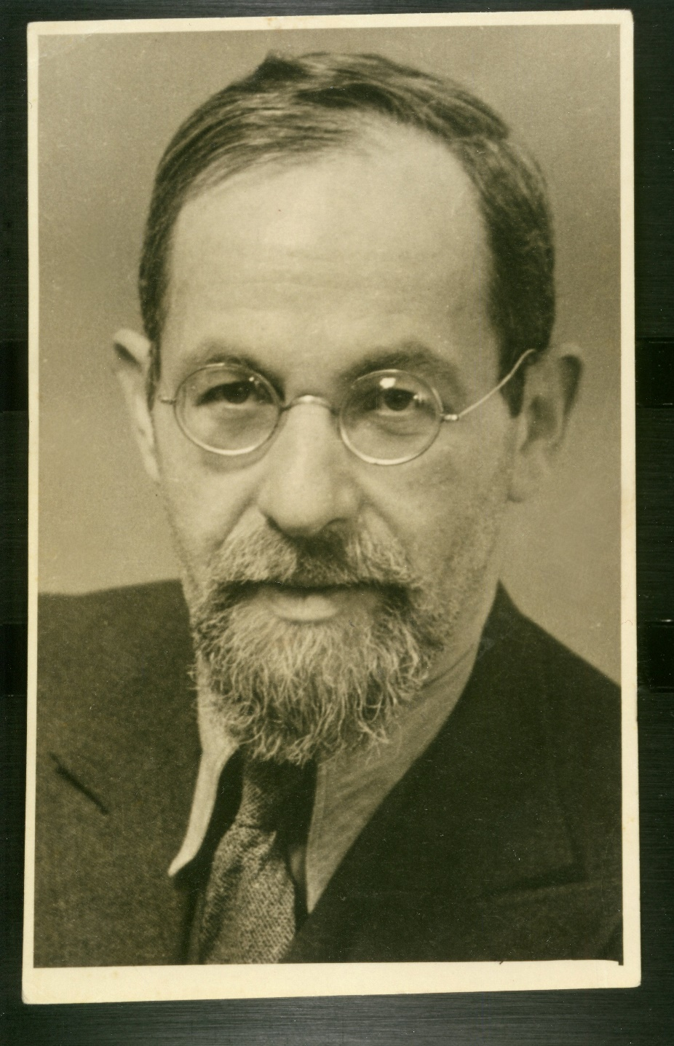
Isaak Breuer
(1883-1946)
Born in Pápa (Hungary), lived in Frankfurt a.M. and Jerusalem
Philosopher, legal scholar and attorney, novelist, political activist
Spokesman of German-Jewish Orthodoxy and Agudat Israel
Ideologist of an alternative Zionism
Notes:
2

Slide 3



Oeuvre
Early Writings
Belles-lettres and novels
Philosophy, law and legal theory
History of German Orthodoxy
Philosophy of religion
Zionism and Agudism
Hebrew texts
Miscellanea
Notes:
3

Slide 4
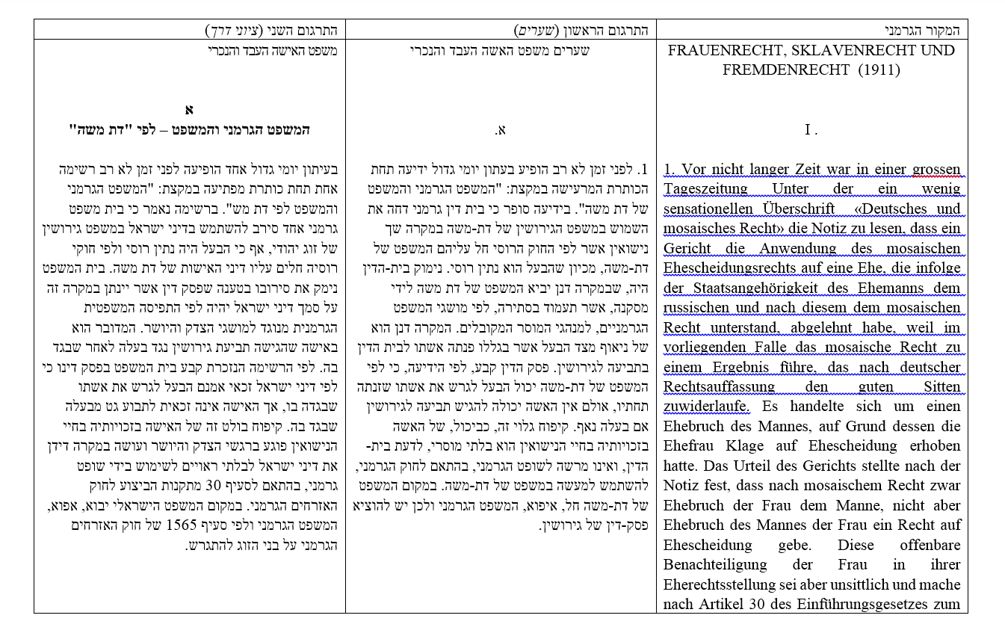
Research
New annotated edition of Breuer's major works in the original language (German, English, Hebrew)
Completion of bibliography
New manuscripts, texts, documents
Notes:
4

Slide 5
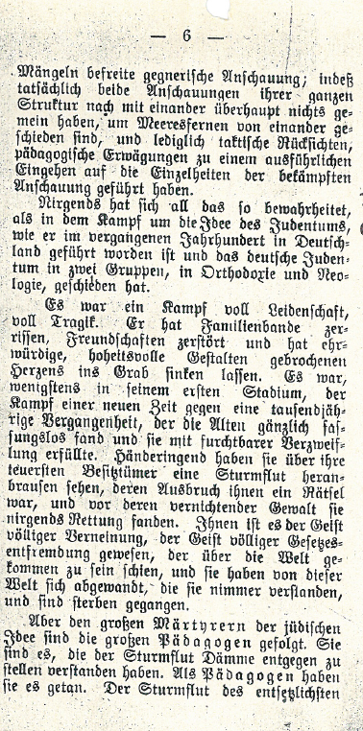
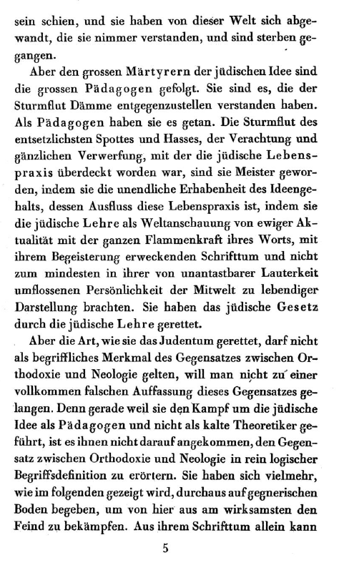
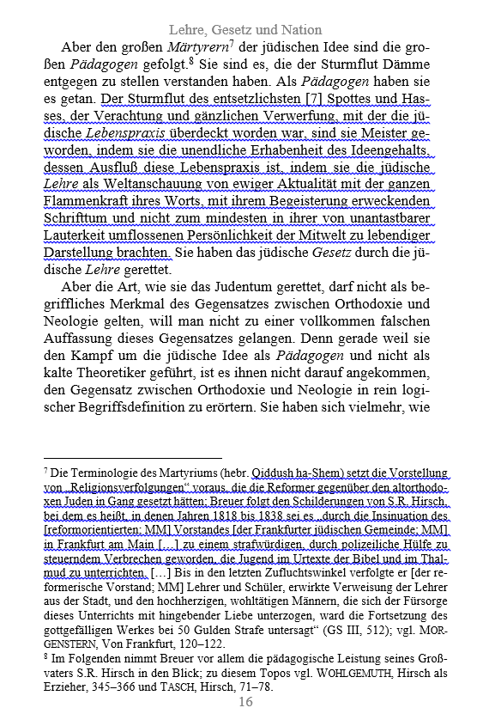
Comparing and Commenting different Versions of Breuer‘s texts
Notes:
5

Slide 6
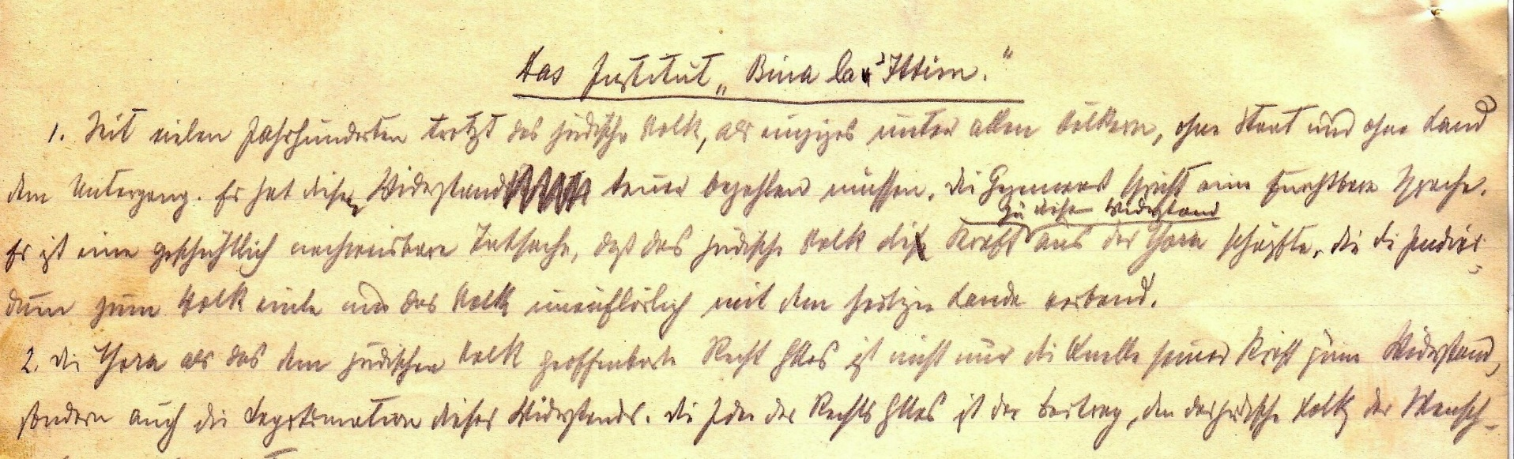
Project Publications and Activities
Volume I: Early Philosophical Writings
Volume II: Texts on Zionism and Agudism
Volume III: Early Literary Writings
Academic Conference in Israel (August 3, 2017)
Notes:
6

Slide 7
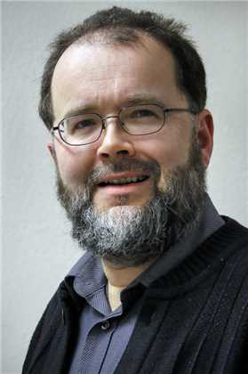
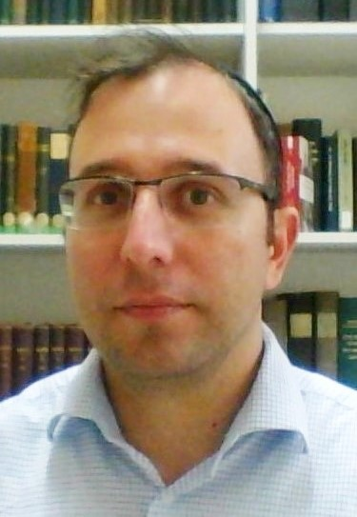
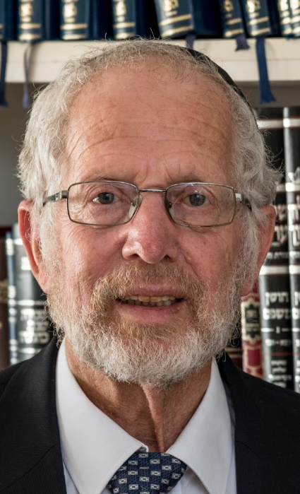
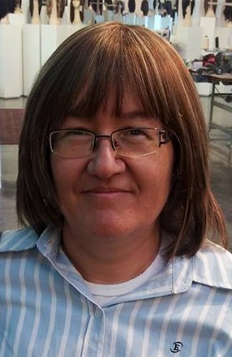
Our Team
Samson Raphael Hirsch Chair for Research on the Tora with Derekh Erez Movement, Bar Ilan University
Institutum Judaicum,
Eberhard Karls-Universität Tübingen
Prof. Dr. Matthias Morgenstern
Rabbi Yeshaya P. Balog
Prof. Dr. Meir Hildesheimer
Chaya-Bathya Markovits
Notes:
7

