Slide 1

TUCKU – Exchange Year Info Event 2023
‹#› |TUCKU - Exchange Year Info Event 2023

Slide 2
Who can apply for exchange year in Korea?
All majors MUST apply
All majors must submit the transcript for their 1st semester language and content courses by the time of the application
Minors- your choice
To be prioritized in the selection process as a minor, we recommend that students complete their required 1st semester language courses before applying
★ Ideally, we recommend applying after finishing 3rd semester language course, for minors. This way, you can be placed into a higher level Korean course (level 3) when you are in Korea and get most out of your exchange semester ★
For those not Majoring or Minoring in Korean Studies
Applicants who are able to provide certificates proving their Korean language proficiency—e.g., certificate of completing Sejong Institute language courses—will be prioritized in the selection process
‹#› | TUCKU - Exchange Year Info Event 2023

Slide 3
How to apply for exchange year in Korea
Submit everything by August 15th
If you are taking the re-exam of language course
by September 5th
Minor students planning to go to Korea for the Fall Semester 🡪 by February 15th
You will NOT be receiving a confirmation email after your submission.
Submission of physical copy of the application is NOT necessary.
‹#› | TUCKU - Exchange Year Info Event 2023

Slide 4
Application Documents
Every applicant has to send in TWO documents
File name should be “ApplicationExchangeYr”
All items should be created into ONE file and uploaded at once.
Don‘t forget to use your first and last name that matches your formal documents
‹#› | TUCKU - Exchange Year Info Event 2023

Slide 5
Document 1 - Contents
Abitur certificate (simple copy)
CV (German or English) 🡪 include student number, birthdate, nationality, and TWO email address (provide BOTH your university email and one that is NOT the university email)
Letter of motivation (English)
Course plan for the semester abroad 🡪 information about type, number of hours and content. See for example http://www.korea.edu/
Internship project detailing possible institutions and dates (only for majors)
‹#› | TUCKU - Exchange Year Info Event 2023
Notes:
Highlighted in yellow as further explanation will follow later

Slide 6
Document 1 - Contents
Informal overview table with grades of the certificates obtained so far and conversion of the average grade into GPA
Signed Declaration of Consent 🡪 sign a consent form regarding the requirements and conditions for participation in the TUCKU exchange program with partner universities in Korea; Download from our webpage. https://uni-tuebingen.de/en/faculties/faculty-of-humanities/departments/asian-and-oriental-studies/koreanistik/tucku/application/
Your THREE preferred universities
Non-majors (including Korean Studies minors) must submit a recommendation letter from a professor of your major department that can vouch for your academic ability (sample form is uploaded on the webpage) 🡪 should be sent by the professor through this link; file name „recommendationletter_studentname“
link:https://unitc-my.sharepoint.com/:f:/g/personal/ankla01_cloud_uni-tuebingen_de/EtRvs11MZoBLju477JMLOEwBKiyYhghsXplhw7ClJjFp9Q
Notes:
Highlighted in yellow as further explanation will follow later

Slide 7
What to write in the Letter of Motivation?
Write what type of interest in Korea that you would like to develop further during your time in Korea—why you are interested in it, and how will you further pursue this interest during your stay
Write what university’s language program will fit you best—based on your current language proficiency and what the university offers (or based on your future career plan)
For non-majors (including minors) -- On the first sentence of your Letter of Motivation, clearly state whether you are applying for one or two semesters.

Slide 8
How to Create Informal Overview Table/GPA?
For majors—the table ONLY includes courses in Korean Studies Department
For minors—the table includes ALL courses you took, both from Korean Studies Department but also from your major
For those not majoring or minoring in Korean Studies— the table includes ALL courses you took

Slide 9
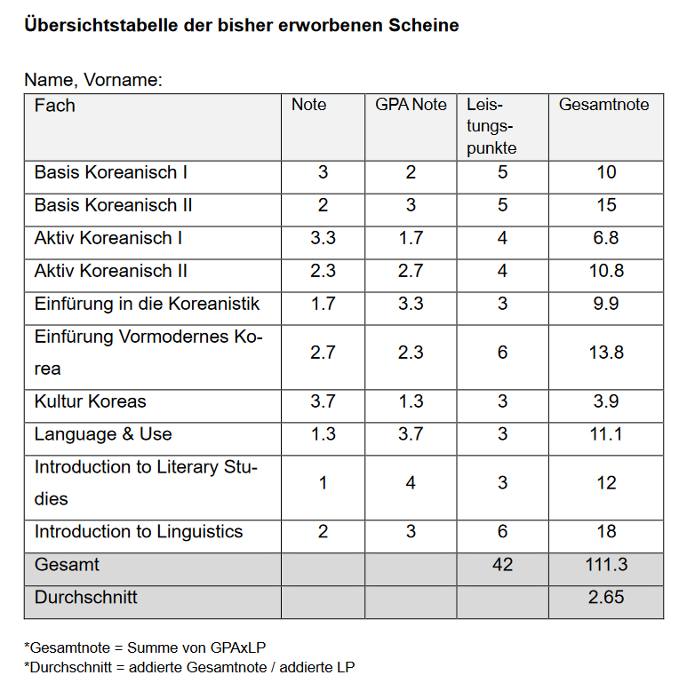
*from TUCKU Info brochure on website

Slide 10
Document 2
ID photo 🡪 File name „ExchangeYrPhoto“
Applications are to be sent to this link (also provided in word document on website):
https://unitc-my.sharepoint.com/:f:/g/personal/ankla01_cloud_uni-tuebingen_de/EnEKJp62a4BMofX_uobQMQABHbXorFLtCE9QVf_i3jG4Ow
During the uploading step, it will ask for your name. Don’t forget to put your first and last name that matches your formal documents
* For further information on the application process refer to the guideline provided online 🡪 Website Korean Studies Tübingen > TUCKU > Bewerbung
‹#› | TUCKU - Exchange Year Info Event 2023

Slide 11
How to fulfill “MODUL BQ: INTERKULTURELLE KOMPETENZ” credit?
You can take courses in other departments and count that towards your “Modul BQ: Interkultruelle Kompetnz (21-BQ-LA)” credit.
The Department of Korean Studies offers two courses “Vorbereitungskurs Interkulturalität” and “Nachbereitungskurs Interkulturalität.” You can take both courses and each receive 3ECTS (unbenoted).
Your work experience in Germany
- Does not have to be Korea related work experience!
- ★ Check ahead with Prüfungsamt (Ms. Sonja Bauer/ sonja.bauer@uni-tuebingen.de) to see if your particular work experience can be counted towards BQ credit. ★
* For further information on BQ Module refer to the guideline provided online🡪 Korean Studies website > Studium > Studiengänge > B.A. Koreanistik/Korean Studies

Slide 12
How to fulfill “MODUL BQ: Getting Work Experience Recognized
The head of the organization (or your superior) must write you a “letter of proof” stating your work experience. The letter MUST include: (Submit Letter of Proof to the Prüfungsamt)
- Full Name of students (with student ID#)
- Duration and frequency of your work (e.g. twice a week for 14 weeks).
- Approximately how many total hours you worked
- The nature of your work—the tasks you were assigned
- Your performance in the work
- Signature of the head of the organization (or your direct superior)

Slide 13
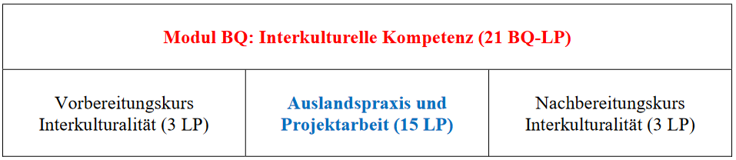
BQ Module

Slide 14
How to fulfill “MODUL BQ: INTERKULTURELLE KOMPETENZ” credit in Korea?
“AUSLANDSPRAXIS UND PROJEKTARBEIT”
(max. 15LP)
An “extra” content course (3ECTS) taken in Korea—outside the major and minor subject—could be counted towards 3 ECTS of your “Auslandspraxis und Projektarbeit” credit (unbenotet).
Participation in various workshops (or excursions) in Korea organized by Dr. Myong Hoon Shin (TUCKU Director) could also be counted (unbenotet).
★ Please contact Dr.Shin to get your BQ credits appear in your German transcript ★
Notes:
Stipendium:
Asiana Airlines
Auslands BAFöG
DAAD
MAKES DAAD
Diverse Stipendien
‹#›

Slide 15
TO RECEIVE “AUSLANDSPRAXIS UND PROJEKTARBEIT” CREDIT (15LP)
Participation in an internship (or a part-time job) could also be counted (unbenotet) (Max. 10ECTS)
  while you are in Korea, make sure to submit the “letter of proof” to Dr. Myong Hoon Shin (TUCKU Director).
* For further information on the BQ credits refer to the guideline provided online on the Website Korean Studies Tübingen > Studium > Studiengänge > BA Koreanistik / Korean Studies
https://uni-tuebingen.de/fakultaeten/philosophische-fakultaet/fachbereiche/asien-orient-wissenschaften/koreanistik/studium/studiengaenge/ba-koreanistik-korean-studies/

Slide 16
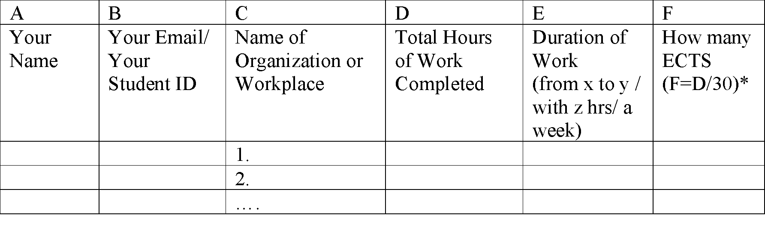
HOW TO RECEIVE “AUSLANDSPRAXIS UND PROJEKTARBEIT” CREDIT (15LP)
3.2. Your internship or work experience does not have to take place in Korea. If your work experience was in Germany, submit the “letter of proof” to Prüfungsamt (Ms. Sonja Bauer/ sonja.bauer@uni-tuebingen.de)
  The work experience does NOT have to be Korea-related in any ways.
  When you are submitting the letter to Prüfungsamt (Ms. Sonja Bauer/ sonja.bauer@uni-tuebingen.de), also include a separate sheet of document with the table. After reviewing your letter of proof and document, Ms. Sonja Bauer will process your request.

Slide 17
HOW TO RECEIVE “AUSLANDSPRAXIS UND PROJEKTARBEIT” CREDIT (15LP)
4. If you are still missing ECTS to meet your needed “Auslandspraxis und Projektarbeit” credit requirements, you can also take courses in other departments in Tübingen (not related to your major or minor) and count that towards your “Auslandspraxis und Projektarbeit” credit.
  -In this case, you will have to request your course lecturer to issue you a Schein under the Modul BQ: Interkultruelle Kompetenz. Then, you would be responsible for collecting & submitting the Schein directly to the Prüfungsamt. (Never lose the Schein that was issued to you! We do not reissue the Schein.)

Slide 18
Other Infos
BAföG
If you need your BAföG form signed, it needs to be done during the semester. (BAföG related business is not handled during the break)
You must sign up for Prof. Yewon Lee’s office hours. Come with the BAföG form and your full transcript. In case a course is missing, bring proof that you completed all your requirements.
‹#› | TUCKU - Exchange Year Info Event 2023

Slide 19

Thank you for your attention!
Universität Tübingen
AOI, Abt. Koreanistik
Wilhelmstr. 133, 72074 Tübingen
E: koreanistik@uni-tuebingen.de
W: www.korea.uni-tuebingen.de
Photo by Manuel Schönfeld_Fotolia_95673822
Notes:
Photo by Manuel Schönfeld_Fotolia_95673822_M
‹#›

