Slide 1

TUCKU – Exchange Year Info Event 2024

Slide 2
Being able to take the Korean Language Course offered by universities for free is a unique feature of our exchange program ( For major and minor Korean Studies student )
Do not waste that privilege
Language will open up windows for you to have a deeper engagement with Korea!
Notes:
Unique feature of our program…

Slide 3
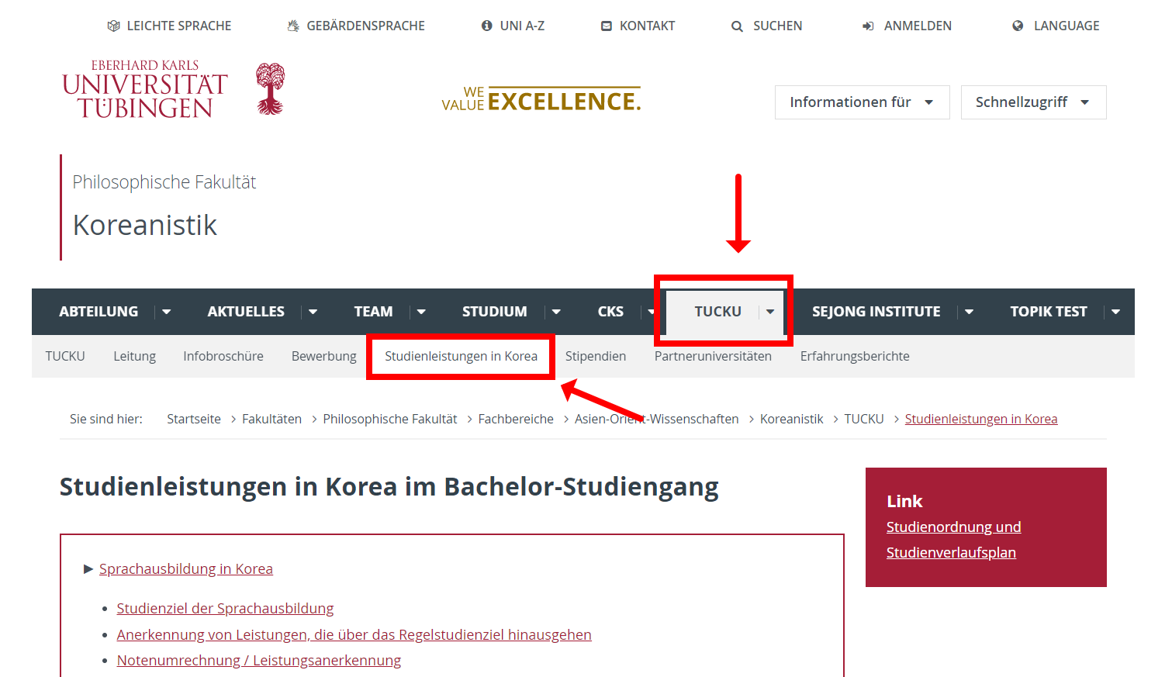

Slide 4
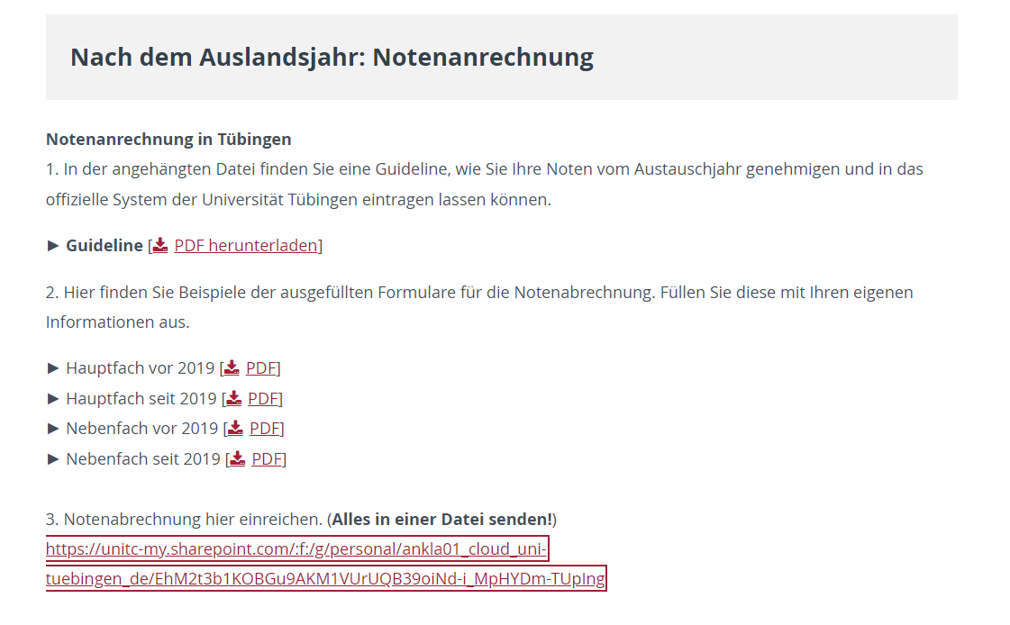
Scroll Down!!
Download the form in pdf and convert it into Word
Fill it out !

Slide 5
Exchange Grade Transfer
After filling out the form, submit ALL THREE documents listed below as a single file to this link (also on website):
https://unitc-my.sharepoint.com/:f:/g/personal/ankla01_cloud_uni-tuebingen_de/EhM2t3b1KOBGu9AKM1VUrUQB39oiNd-i_MpHYDm-TUpIng
The word document form that you filled out
Your exchange year transcript (also include content course transcripts if you want them to be recognized)
Your language certificates—Level 3 & 4. (Also, Level 5 if it applies to you)

Slide 6
How to Get Your Exchange Grade Transferred?
your grades are not automatically transferred into our university system
fill out the “exchange grades” word document that applies to you (on the website)
Do this immediately upon your return to Tübingen!!
Fill out the form with both your language courses and content course(s)
Important Reminder:
3 ECTs in Korea are a full 6 ECTs course in terms of course load
So, you must have taken final exam and/or submit a final paper (You cannot fail your Korean course and ask for 3ECTS credit in Germany because you did part of the work)
You should have brought all the language certificates and transcripts (both in English and Korean) * Except for Ewha and Yonsei University

Slide 7
Exchange Grade Transfer – Extra Content Courses
If you want to acknowledge the extra content courses you took in Korea to count as one of the content courses—one of the courses you were supposed to have taken during 2nd and 3rd semester but failed to pass—this is possible. Write down the exact module name based on Tübingen study plan in the word document. (ex. Modul Kor-BA-09:Aufbaumodul/ PS Gesellschaft Koreas)
Extra content courses took in Korea (not related to your major or minor subjects) can also be counted towards your Interkulturelle Kompetenz if you write down the module name as “Modul BQ:Interkulturelle Kompetenz” and fill out the rest
If the course was conducted by Dr. Myong Hoon Shin (TUCKU Director), please contact Dr.Shin to get the credit appear in your German transcript.
(Don’t fill it out on the transfer form and don’t email Prof.Lee for these particular courses. Dr. Shin is in charge.)
Notes:
However, the content course should be unrelated to Korea!—to be recognized as BQ

Slide 8
First Name | Last Name | Student ID Number | What year did you start your education in the Department of Korean Studies? | Are You a Major or Minor in the Department of Korean Studies? | Module Name | course name (as appears in the Korean transcript) | ECTS | Year course was taken | Grades | Write down additional information that you would like to communicate
 |  |  |  |  | Modul KOR-BA-04: Koreanisch Mittelstufe I |  | 9 | SS 2020 (for example)
 |  |  |  |  | Modul KOR-BA-05: Koreanisch Mittelstufe II |  | 9 | WS 2020-2021 (for example)
 |  |  |  |  | Modul KOR-BA-10: Auslandsmodul PS Wahlpflicht Modernes Korea |  | 3
 |  |  |  |  | Modul BQ: Interkulturelle Kompetenz Auslandpraxis und Projektarbeit |  |  |  | unbenoted
The first language course grade is
always based on the first course you took
If you did Level 5, the second language course will be graded as 1

Slide 9
First Name | Last Name | Student ID Number | What year did you start your education in the Department of Korean Studies? | Are You a Major or Minor in the Department of Korean Studies? | Module Name | course name (as appears in the Korean transcript) | ECTS | Year course was taken | Grades | Write down additional information that you would like to communicate
 |  |  |  |  | Modul KOR-BA-04: Koreanisch Mittelstufe I |  | 9 | SS 2020 (for example)
 |  |  |  |  | Modul KOR-BA-05: Koreanisch Mittelstufe II |  | 9 | WS 2020-2021 (for example)
 |  |  |  |  | Modul KOR-BA-10: Auslandsmodul PS Wahlpflicht Modernes Korea |  | 3
 |  |  |  |  | Modul BQ: Interkulturelle Kompetenz Auslandpraxis und Projektarbeit |  |  |  | unbenoted
Content course you take must be broadly in the topic of Korea (minors too)
Extra Content Course Only!

Slide 10
For Minors
First Name | Last Name | Student ID Number | What year did you start your education in the Department of Korean Studies? | Are You a Major or Minor in the Department of Korean Studies? | Module Name | course name (as appears in the Korean transcript) | ECTS | Year course was taken | Grades | Write down additional information that you would like to communicate
 |  |  |  |  | Modul KOR-BA-15: Koreanisch Grundstufe III |  | 6 | SS 2020 (for example)
 |  |  |  |  | Modul KOR-BA-16: Koreanisch Grundstufe IV |  | 6 | WS 2020-2021 (for example)
 |  |  |  |  | Modul KOR-BA-18: Basismodul/ PS Koreanische Geschichte |  | 3
Language Course Korean 2 = Koreanisch Grundstufe 3 (Modul KOR-BA-15) + Koreanisch Grundstufe 4 (Modul KOR-BA-16)
<average the grade and add the same grade for both modules>

Slide 11
Exchange Grade Transfer
After a review of your request, we will take the administrative steps to transfer your grades.
You will NOT get a confirmation email during this process.
It is your responsibility to check your transcript to see which of your request has been accepted and processed.
* For further information on the exchange grade transfer refer to the guideline provided online 🡪 Website Korean Studies > TUCKU > Studienleistungen in Korea
Notes:
Do this process right after returning….do not push it to later when you want to graduate…the process takes time

Slide 12
How to fulfill “MODUL BQ: INTERKULTURELLE KOMPETENZ” credit?
You can take courses in other departments and count that towards your “Modul BQ: Interkultruelle Kompetnz (21-BQ-LA)” credit.
The Department of Korean Studies offers two courses “Vorbereitungskurs Interkulturalität” and “Nachbereitungskurs Interkulturalität.” You can take both courses and each receive 3ECTS (unbenoted).
Your work experience in Germany
- Does not have to be Korea related work experience!
- ★ Check ahead with Prüfungsamt (Ms. Sonja Bauer/ sonja.bauer@uni-tuebingen.de) to see if your particular work experience can be counted towards BQ credit. ★
* For further information on BQ Module refer to the guideline provided online🡪 Korean Studies website > Studium > Studiengänge > B.A. Koreanistik/Korean Studies

Slide 13
How to fulfill “MODUL BQ: Getting Work Experience Recognized
The head of the organization (or your superior) must write you a “letter of proof” stating your work experience. The letter MUST include: (Submit Letter of Proof to the Prüfungsamt)
- Full Name of students (with student ID#)
- Duration and frequency of your work (e.g. twice a week for 14 weeks).
- Approximately how many total hours you worked
- The nature of your work—the tasks you were assigned
- Your performance in the work
- Signature of the head of the organization (or your direct superior)

Slide 14
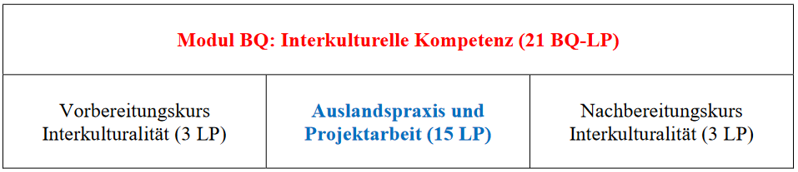
BQ Module

Slide 15
How to fulfill “MODUL BQ: INTERKULTURELLE KOMPETENZ” credit in Korea?
“AUSLANDSPRAXIS UND PROJEKTARBEIT”
(max. 15LP)
An “extra” content course (3ECTS) taken in Korea—outside the major and minor subject—could be counted towards 3 ECTS of your “Auslandspraxis und Projektarbeit” credit (unbenotet).
2. Participation in various workshops (or excursions) in Korea organized by Dr. Myong Hoon Shin (TUCKU Director) could also be counted (unbenotet).
★ Please contact Dr.Shin and discuss regarding the credits!
Notes:
Stipendium:
Asiana Airlines
Auslands BAFöG
DAAD
MAKES DAAD
Diverse Stipendien
15

Slide 16
TO RECEIVE “AUSLANDSPRAXIS UND PROJEKTARBEIT” CREDIT (15LP)
Participation in an internship (or a part-time job) could also be counted (unbenotet) (Max. 11ECTS)
  while you are in Korea, make sure to submit the “letter of proof” to Dr. Myong Hoon Shin (TUCKU Director).
* For further information on the BQ credits refer to the guideline provided online 🡪 Website Korean Studies Tübingen > Studium > Studiengänge > BA Koreanistik / Korean Studies
https://uni-tuebingen.de/fakultaeten/philosophische-fakultaet/fachbereiche/asien-orient-wissenschaften/koreanistik/studium/studiengaenge/ba-koreanistik-korean-studies/

Slide 17
Other Infos
BAföG
If you need your BAföG form signed, it needs to be done during the semester.
You must sign up for Prof. Yewon Lee’s office hours.
https://uni-tuebingen.de/fakultaeten/philosophische-fakultaet/fachbereiche/asien-orient-wissenschaften/koreanistik/team/lee-yewon/
Come with the printed BAföG form and your full transcript. In case a course is missing, bring proof that you completed all your requirements.
Notes:
If you are in Korea and cannot come to the meeting yourself, send a representative---explain all the situation to a friend

Slide 18
For Korean Studies Majors: BA Thesis Writing
At least one semester before you are planning to file your thesis, approach your prospective thesis advisor.
You must get their approval to go ahead and write the thesis
Three people are in charge of overseeing the BA thesis:
Prof. Dr. You Jae Lee (History – German or English)
Jun-Prof. Dr. Yewon Lee (Society – English)
Dr. Birgit Geipel (Culture – German or English)
Notes:
18

Slide 19
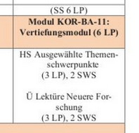
For Korean Studies Majors:
How to plan your study after getting back from Korea
RULE: for the 6th semester courses, you cannot get it recognized with other courses - must take the 6th semester ones.
You need to take at least TWO courses during the summer semester in Korean Studies Department 🡪 one is HS and the other is Ü (either in your 6th or 8th semester)
If you are considering writing your thesis with either Prof. You Jae Lee or Prof. Yewon Lee, it is highly recommended to take their 6 semester course

Slide 20
Fast Track / On Time:
already finished most of your minor’s requirements.
Even before starting your 6th semester course, think about what your thesis topic will be.
If you have figured out the topic in the beginning of the 6th semester, you could finish that semester.
If not, at the latest by the end of the 6th semester, go to the faculty you want to work with and discuss your possible topic - then, potentially, you can finish in your 7th semester

Slide 21
Normal Track:
you still have minor requirements to fulfill
Fulfill all your requirements (major/ minor) during the 6th – 8th semester.
Write your thesis throughout 7th~ 8th semester.
Behind Track:
you still need to make up for your 2nd & 3rd semester content courses or your exchange year content course
You can take any courses under the modul KOR-BA-08 or KOR-BA-09 and count it towards your 2nd & 3rd semester required content courses. But remember that all the 6 semester content course requirements can only be met by taking the 6 semester courses!
* Recommendation for both Normal Track & Behind Track—start thinking of your thesis topic early on & approach the possible thesis advisor so that throughout the remaining years of your study you can develop your thesis idea while fulfilling the course requirements
Notes:
For those in the normal or “behind track” the recommendation is to still take the 6semester courses early on and start thinking of your thesis topic seriously….have a meeting by the end of 6th semester…so throughout the rest of the semester you can write your thesis while fulfilling your course requirements.

Slide 22

Thank you for your attention!
Universität Tübingen
AOI, Abt. Koreanistik
Wilhelmstr. 133, 72074 Tübingen
E: koreanistik@uni-tuebingen.de
W: www.korea.uni-tuebingen.de
Photo by Manuel Schönfeld_Fotolia_95673822
Notes:
Photo by Manuel Schönfeld_Fotolia_95673822_M
22

