Slide 1



Welcome to our library!
Short Presentation on Literature Research
Kooperationspartner?
Logo hier

Slide 2
Overview over the most important scientific publishing formats
  Books
  Journals / periodicals
  Independent / non‑independent publications
Overview over the most important information resources
  Visit to the library
  Library catalogues
  Internet / databases / bibliographies
Search strategies
  Identifying information needs
  Selecting information resources
  Search procedure in practice (contentwise / formal)

Slide 3
Scientific Publishing Formats
Books
Publishing academic work in the form of a book typically involves a vast subject and represents the outcome of long-term research. When such a publication is issued as a standalone work, it is referred to as a monograph.
In contrast, an edited collection comprises multiple shorter contributions by various authors, all addressing a common overarching theme.
E‑book packages organised by academic subject are available here through the University Library, offering an alternative access point alongside the OPAC Catalog plus.

Slide 4
Scientific Publishing Formats
Journals / periodicals (printed):
Scientific journals contain concise and very recent research results.
These journals usually appear several times a year and contain articles (ranging from just a few pages to 30 pages or more) on a clearly defined subject area. They are written by scholars and undergo peer review before publication. Such journal articles are an essential resource when searching for information on specialised topics.

Slide 5
Scientific Publishing Formats
Journals / periodicals (electronic):
Scientific journals exist both as printed editions and as electronic versions. These electronic journals – often referred to as e‑journals or full‑text journals – make their content available online, though access is typically restricted.
You can reach these e‑journals through the platforms listed on the university’s homepage:
EZB – Electronic Journals Library
Subject‑based e‑book collections
You can also subscribe by email to the tables of contents of certain journals and read or download the articles via Paperboy.

Slide 6
Scientific Publishing Formats
Independent vs. non‑independent publications:
In academic publishing, a distinction is made between independent and dependent types of literature.
Books, journals, edited volumes, and dissertations (extensive written works submitted for the doctoral degree) are considered independent literature.
Dependent literature includes works that form part of a larger publication, such as journal articles or chapters in an edited volume.

Slide 7
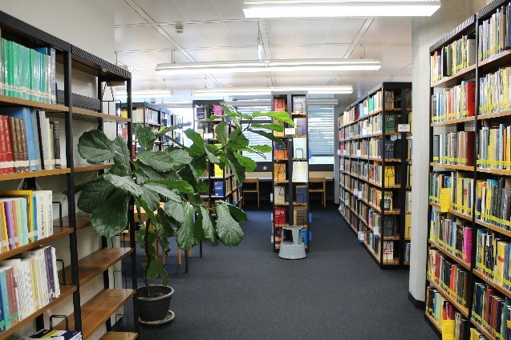
Building C, 4th floor
Auf der Morgenstelle 10
72076 Tübingen
Germany
Opening hours:
Monday – Thursday/Friday
9:00 – 19:00/18:30 Uhr (term)
9:00 – 17:00/16:30 Uhr (term break)
Mathematics and Physics Library
Visit to the library / 1:

Slide 8
Overview over the most important information resources
Visit to the library / 2:
Mathematics and Physics Library / Mathematics Section
Approx. 36.000 books
Approx. 23.200 journal volumes (housed in 6 magazine rooms)
currently 77 active journal titles

Slide 9
Overview over the most important information resources
Mathematics and Physics Library / Mathematics Section
Formal arrangement, meaning authors/titles in alphabetical order
Special locations
  Course reserves (on-site use only), temporary, accompanying lectures
  Collected works
  Historical collection (reference-only holdings)
  Plates, seminar papers, dissertations, encyclopedias
  Conference proceedings [arranged in chronological order]
  Didactics section
  Archive / closed stacks (Please feel free to contact us about this!)

Slide 10
Overview over the most important information resources
Visit to the library / 3:
Mathematics and Physics Library / Physics Section
Approx. 28.000 books
Approx. 4.000 journal volumes
currently 47 active journal titles

Slide 11
Overview over the most important information resources
Mathematics and Physics Library / Physics Section
Formal arrangement, meaning authors/titles in alphabetical order
Special locations
  Course reserves (on-site use only), temporary, accompanying lectures
  Historical collection (reference-only holdings)
  Plates
  Doctoral dissertations, academic theses, habilitation theses, offprints
  Reference works and tables
  Conference proceedings [arranged in chronological order]
  Didactics section
  Archive / Closed stacks or restricted cabinet (Please feel free to contact us about this!)

Slide 12
Overview over the Information resources
Library catalogues
A library catalogue always refers to the holdings of a specific library or library network. It does more than confirm the existence of a work: it shows its location, its call number, and whether it is available for loan. Catalogues generally list only independent publications; dependent works are recorded (if at all) only in exceptional cases or through supplementary article databases.
Tübingen University Library’s OPAC also includes metadata for items such as journal articles; this becomes clear when you explore the advanced search features.

Slide 13
Overview over the information resources
Internet / databases / bibliographies / 1:
The internet is a global network used for communication and the exchange of information.
Tools for searching the internet include search engines, which essentially function like databases and look for word matches within the data sets of web pages. They provide the corresponding web addresses as results, although not in any content‑based order. Common entry points for academic searches include arXiv.org, Science Gate, and Google Scholar, but numerous other platforms are also available.
One possibility for suitable didactic materials is offered by the ZOERR.

Slide 14
Overview over the information resources
Internet / databases / bibliographies / 2:
In physics and mathematics, databases are essential for storing, structuring and accessing research data.
A database is a technical system that enables information to be systematically recorded, managed, searched, and retrieved in a structured manner, making it an essential tool for conducting reliable and efficient scholarly research.

Slide 15
Overview over the most important information resources
Internet / databases / bibliographies / 3:
academic databases from various disciplines:
DBIS Database information system
The most important databases in mathematics are:
MathSciNet („Mathematical reviews“ on the web)
Zentralblatt MATH (Online database of the former Zentralblatt MATH)
The most important databases in physics are listed under
arXiv (an open-access online repository
for non–peer‑reviewed scientific preprints)

Slide 16
Overview over the information resources
Internet / databases / bibliographies / 4:
A bibliography is a compilation of literature references. It lists sources published on a particular subject, individual, or time period, but it does not reveal where the material is physically held — it merely documents their existence.
A bibliographic database is therefore a specific type of database that contains bibliographic information — essentially a bibliography in digital form. It provides enhanced search capabilities but, like any bibliography, remains independent of physical holdings. It identifies literature without specifying in which library it is available.

Slide 17
Search strategies
Given the abundance of scientific information and the typically limited time available for research, it is advisable to proceed systematically.
Once the questions
How much? the scope and depth of the required literature
and
What? defining the topic and identifying suitable search terms
have been clarified, the next steps concern
Where? choosing the right information sources and supporting tools, and
How? applying the search options of the chosen information source.

Slide 18
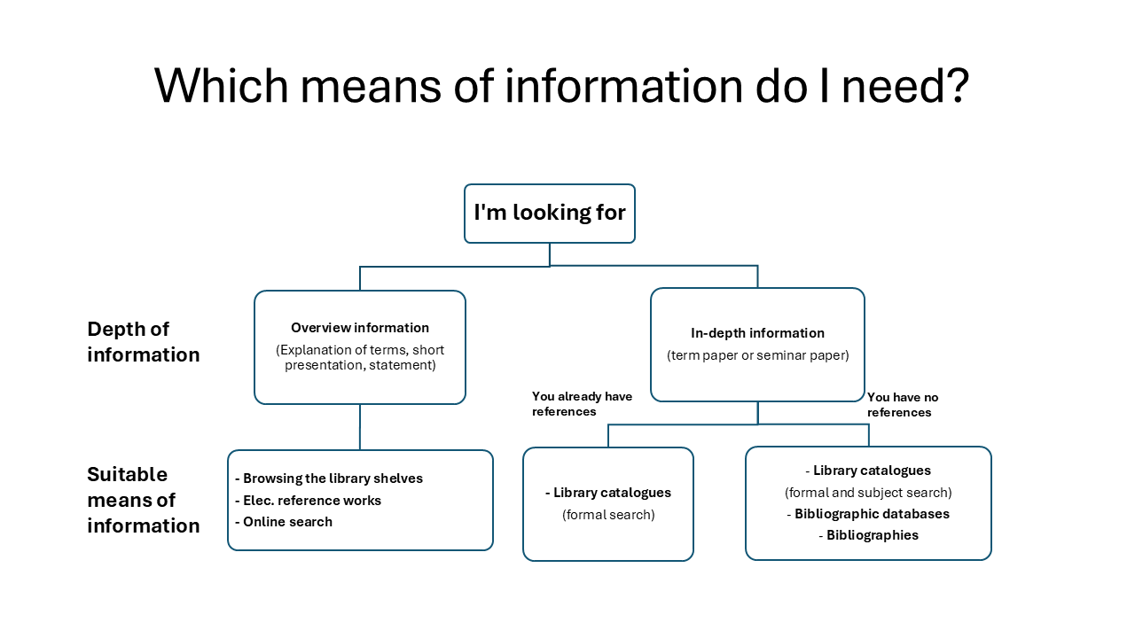

Slide 19
Search strategies
Search process: Contentwise search/1:
In libraries, literature is catalogued not only on a formal level (such as author or title) but also by content. When exploring the local book collection through the web catalogue (OPAC), users can choose between several search methods:
Basic search (using a single search field, alone or in combination)
Advanced search (allowing users to define the exact criteria for their search)
This also includes, for example,
searching by notations (a numerical classification scheme based on the American Mathematical Society system) – limited to the holdings of the Department of Mathematics.

Slide 20
Search procedure in practice
Search process: Contentwise search/2:
The content‑oriented (and also formal) search for dependent literature (journal articles, articles from edited volumes such as conference proceedings) is carried out in the following bibliographic databases:
MathSciNet (“Mathematical Reviews” online)
zbMATH Open (the central mathematics reviewing service originating from the former Zentralblatt Mathematik)
arXiv (open-access online repository)
Regularly performing content‑focused searches in these databases makes it possible to stay consistently informed about the latest developments and research trends in one’s area of specialisation.

Slide 21
Search strategies
Search procedure: Formal search/1:
When you already know concrete details about the literature you are looking for – such as the author or the title of a work – you can search directly for these details by entering them into the appropriate search fields in the catalogue.

Slide 22
Search strategies
Search procedure: Formal search/2:
The most important search fields include:
“Author” (also “Creator” or “Person”):
This field is used to look up the author or editor of a book.
“Title” (also “Keyword” or “Title words”):
This field lets you search for any word that appears exactly as part of the title.
“Quick search” (also “Free text” or “One-line search”):
This field allows you to search simultaneously – using an AND combination – for author names, title words, and subject headings.

Slide 23
Search strategies
Search procedure: Formal search/3:
Examples for common entries in a reference list
* Nagel, Rainer; Schaefer, Helmut H.: Aspects of positivity in functional analysis. – Amsterdam : North-Holland, 1986
* Mengenlehre / hrsg. von Ulrich Felgner. – Darmstadt : Wissenschaftl. Buchgesell., 1979
* Nagel, Rainer; Poland, Jan: The critical spectrum of a strongly continuous semigroup, in: Adv. Math. 152 (2000), S. 120-133
* Cherlin, Gregory; Felgner, Ulrich: Homogeneous finite groups, in: J. London Math. Soc. (2) 62 (2000) no. 3, 784-794

Slide 24

Search strategies
Search procedure: Formal search/4:
Important information for using the online catalogue (OPAC) concerning our library:
When searching for books, check the location and loan status under Availability.
  The call number corresponds to the label on the spine of the book (location indicator).
  -> It typically consists of the first four letters of the author’s surname.
  -> Books by the same author are usually arranged alphabetically.
  For edited collections or similar works, the call number is often derived from the title instead. -> the title-based call numbers of those may appear at the beginning or end of the call-number sequence.
  If the item is located in a departmental or chair library, please contact the relevant lecturer, the corresponding departmental secretary’s office or the group’s contact person to arrange access.

Slide 25


Search strategies
Search procedure: Formal search/5:
Important information for formal searches in the online catalogue (OPAC):
Using the advanced search function, you can also search directly for journal articles, which will lead you to the publication medium via the availability information.
Beyond the OPAC, the following resources can support
journal searches:
  EZB – Electronic Journals Library
  ZDB – Zeitschriftendatenbank Deutschland
For non‑commercial use, researchers and employees of the university may use the TAD (Tübingen Article Delivery Service) to request scanned copies of articles that are not electronically accessible.

Slide 26

Search strategies
Search procedure: Formal search/6:
  Is there an online version of the title you are search for?
  You can consult the issues in our computer room or via any internet connection (often restricted to the university network).
  Depending on availability, you may also download and/or print them.
  To print, either choose the print option on a university computer to send the job directly to a campus copy room using your university card,
  or save the file locally on the computer and/or your USB drive first, before optionally printing it on one of the printers in the room.

Slide 27
Search strategies
Search procedure: Formal search/7:
If the book or journal you need is not held by any library in Tübingen, you can extend your search to national and international catalogues:
Beyond the university, in addition to journal databases, you may use the KVK – the Karlsruhe Virtual Catalog (a meta‑catalog that searches library and book trade catalogues worldwide through a single interface).
Via interlibrary loan (with a fee of 1.50 euros per item), you can also locate volumes via the OPAC and request them to be delivered to the University Library Tübingen.
Document delivery services may also be commissioned.

